Slide 1
PUBLIC CAMPUS MINISTRY Why Bother?
Lake Union Conference Youth Congress
Josephine Elia Loi | February 13, 2016

Slide 2
The Problem
7 out of 10 Adventist Youths leave before 35

Slide 3
Where Are They?
Majority of Adventist youths attend secular colleges and universities
At the same, the rest of the campus…
University of Chicago
University of Illinois at Chicago
Northwestern University
Faculty: 2,205
Admin: 14,772
Students: 15,312
Faculty: 2,637
Students: 29,048
Faculty: 3,401
Students: 20,363

Slide 4
The world comes to university campuses

Slide 5
The Campus Ministry Universe
High school students
Young professionals
Undergraduate & graduate students ministry
Adventists in academia
Church members

Slide 6
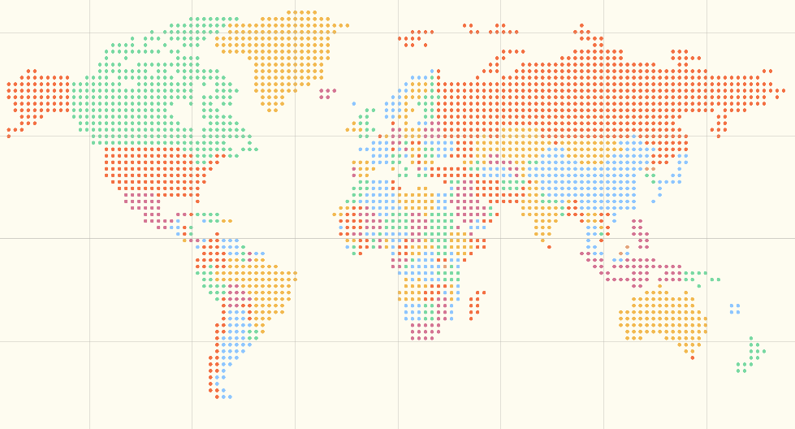
Come to the Campus Ministry Seminar
But this work must be done, and it will be done by those who are led and taught of God.
3 Selected Messages p. 234

