Slide 1
Journey to Bethlehem
Fun Outreach – Telling the Story of Jesus

Slide 2
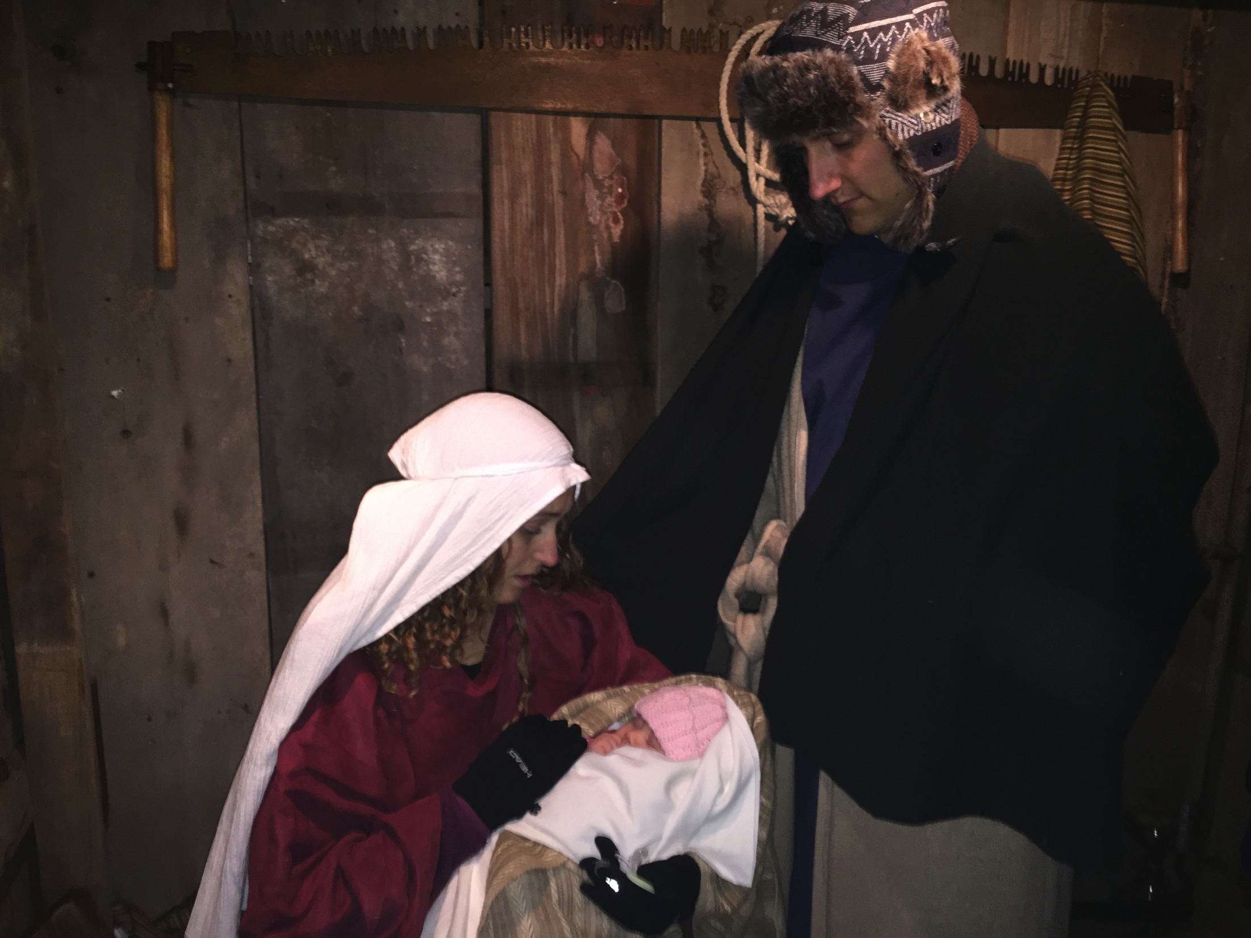
Community impact
How well do you know your neighbors?
Friendly holiday program
JTB goes beyond the manger

Slide 3
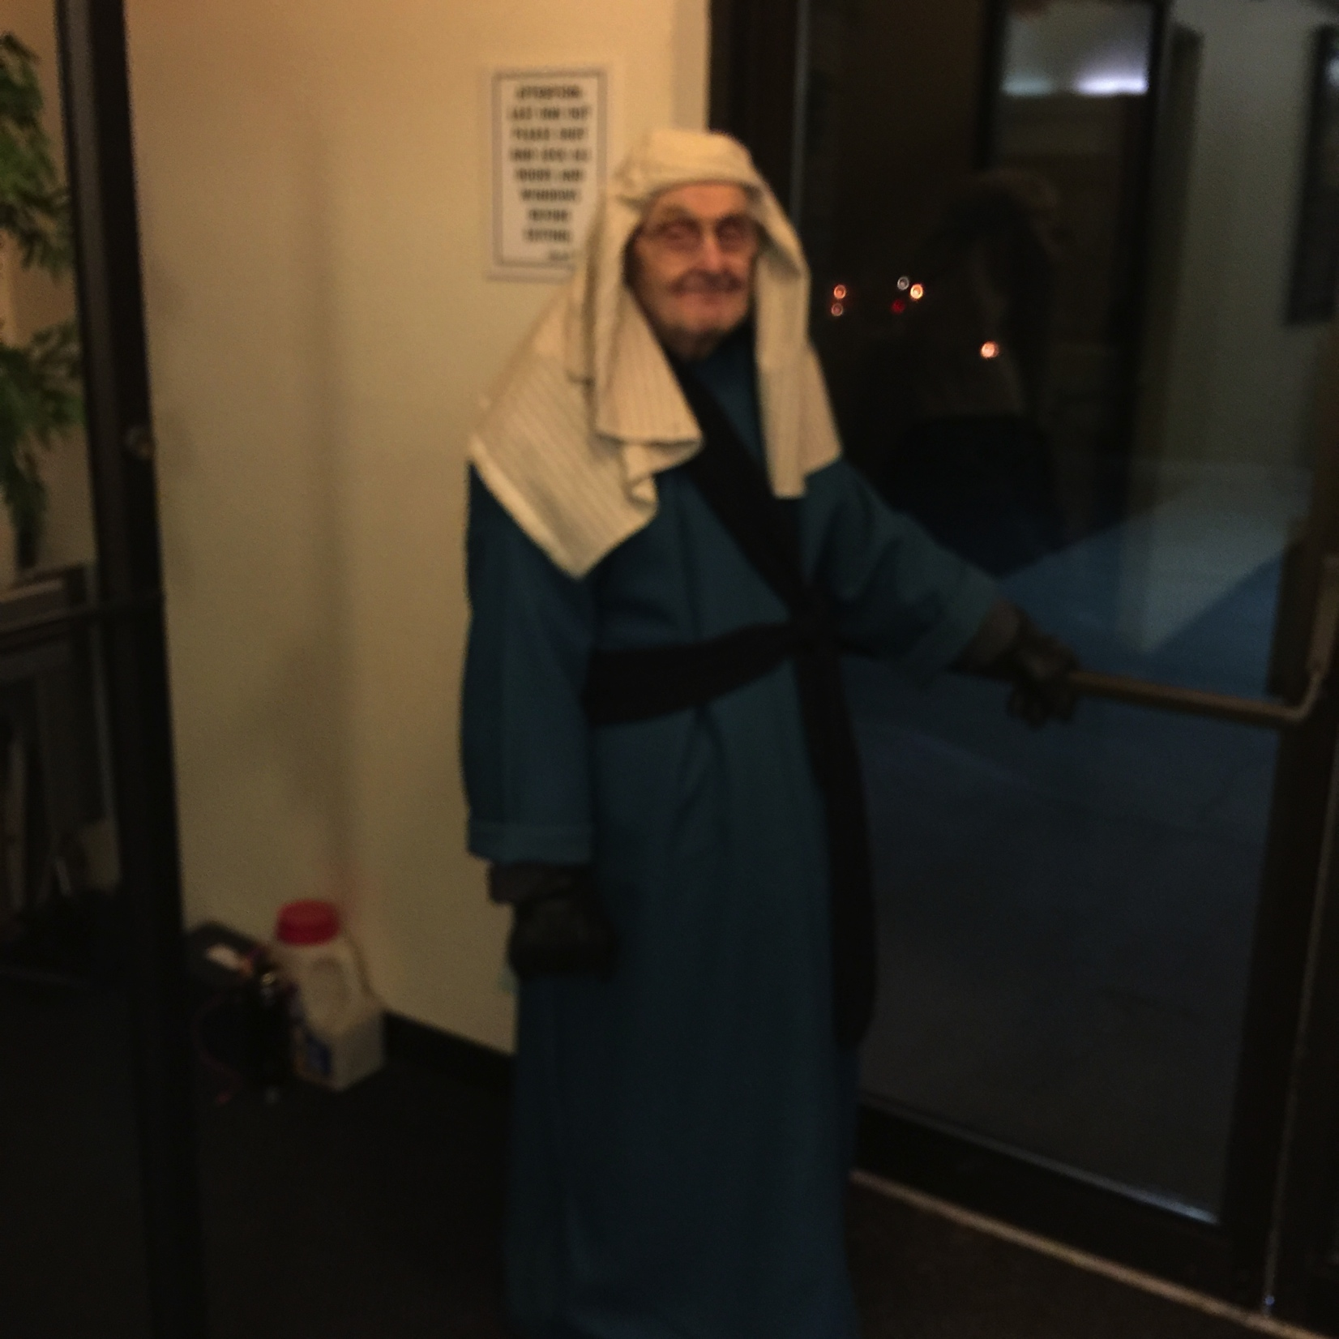
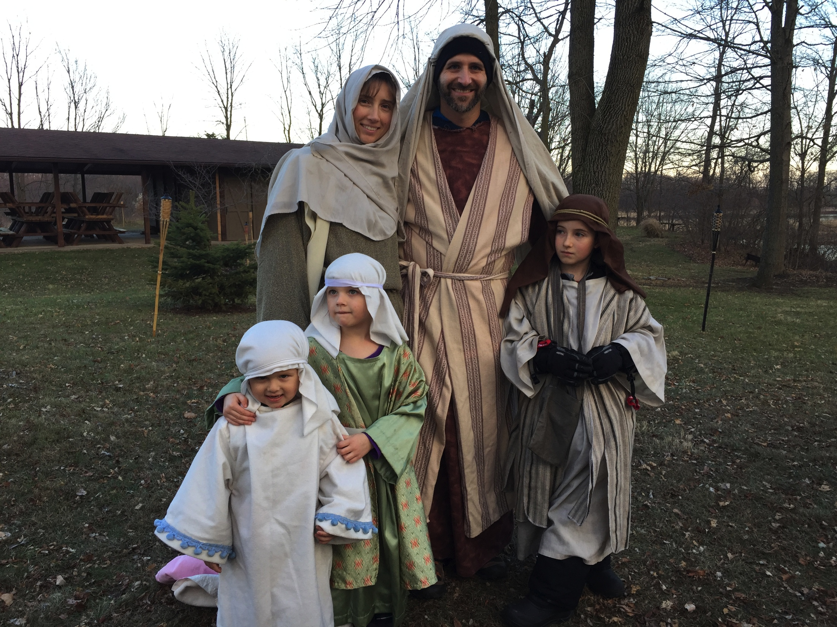
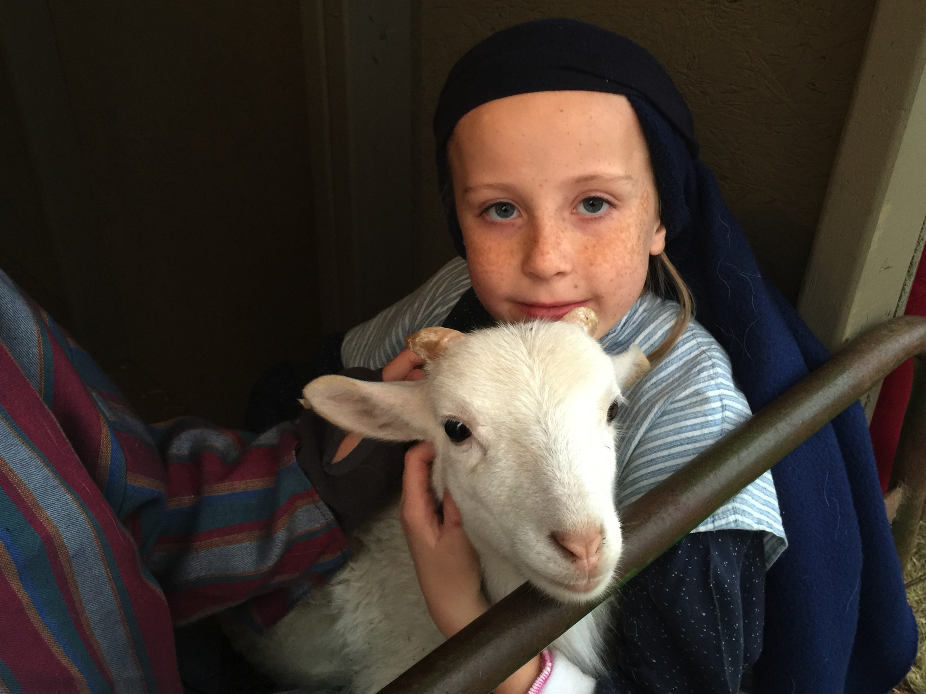
Member involvement
JTB involves everyone
You discover hidden talents
JTB bonds people together

Slide 4
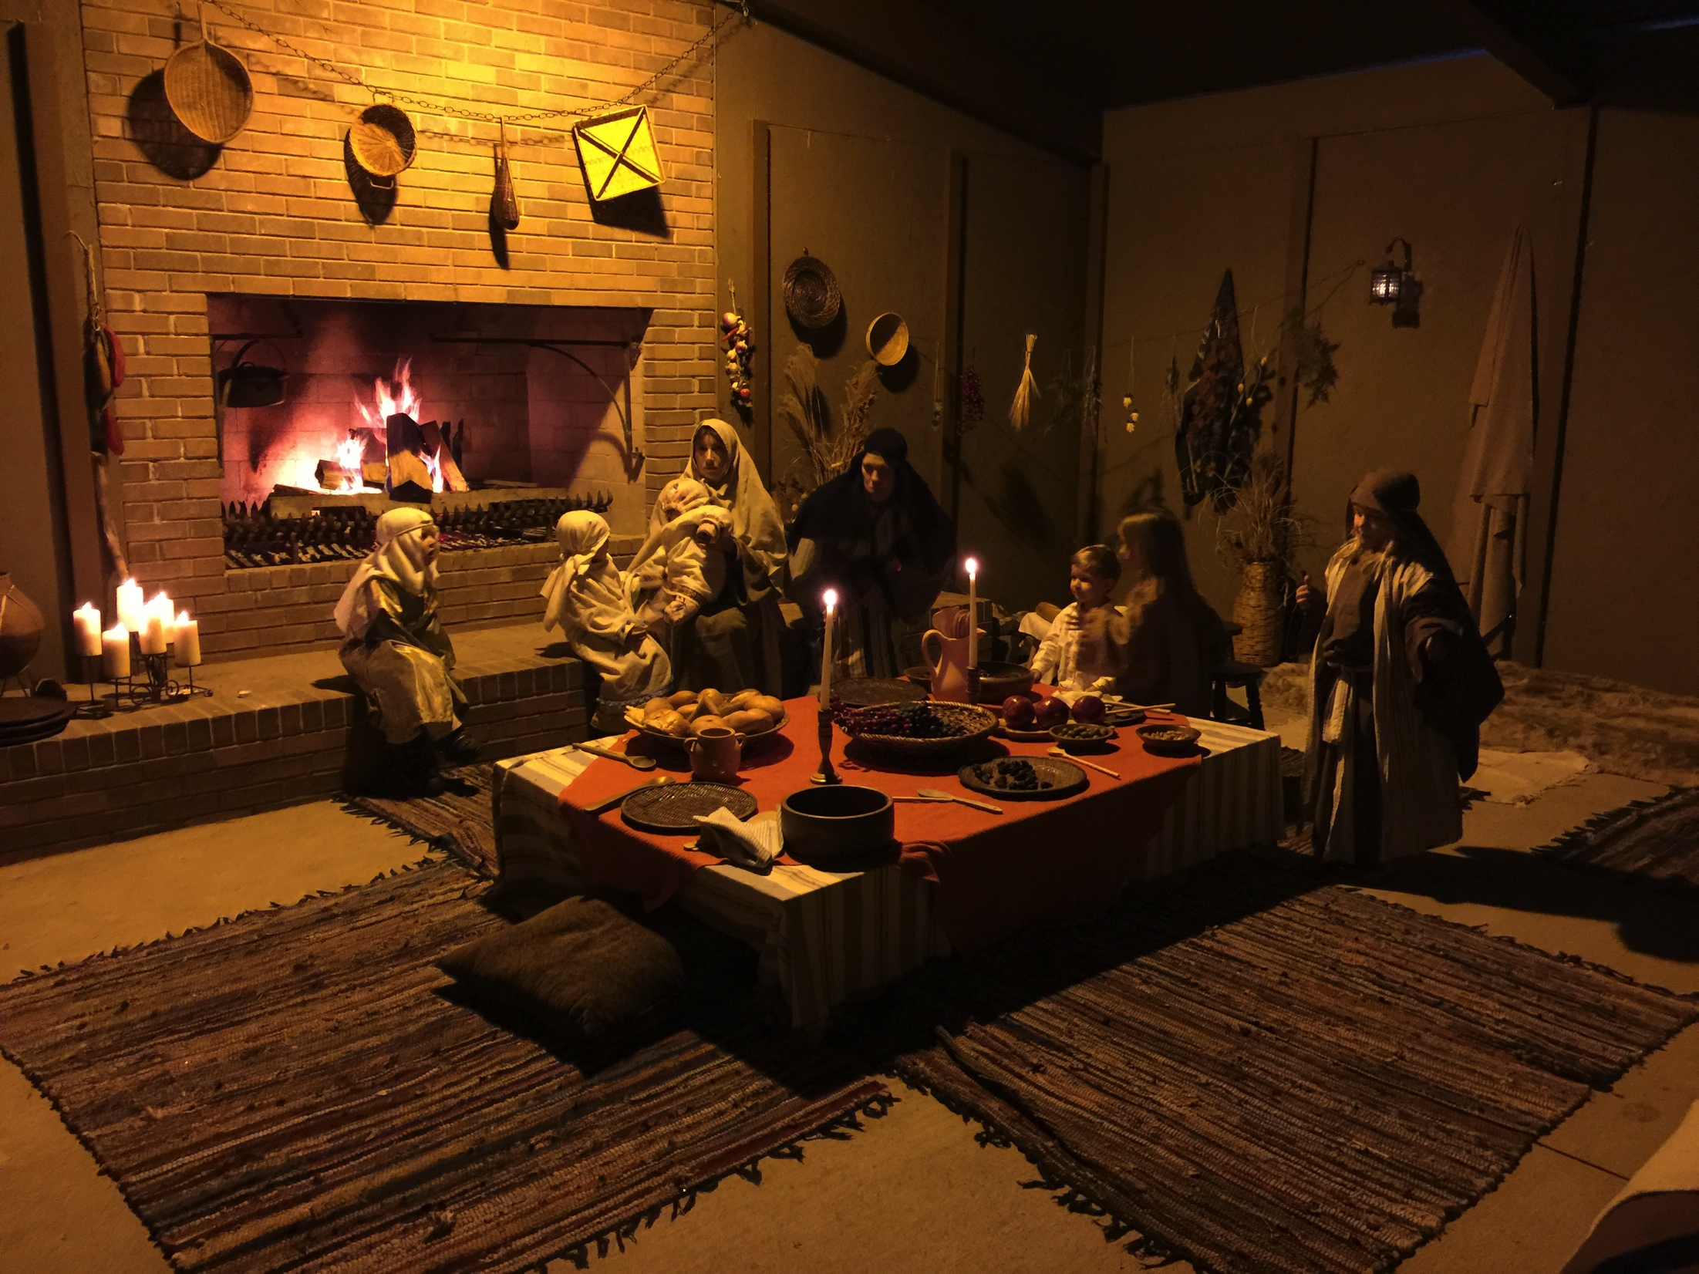
JTB Management
JTB Director/Cast Coordinator
Construction Coordinator
Props/Decorator Coordinator
Church Coordinator
Budget Manager
Public Relations Coordinator

Slide 5
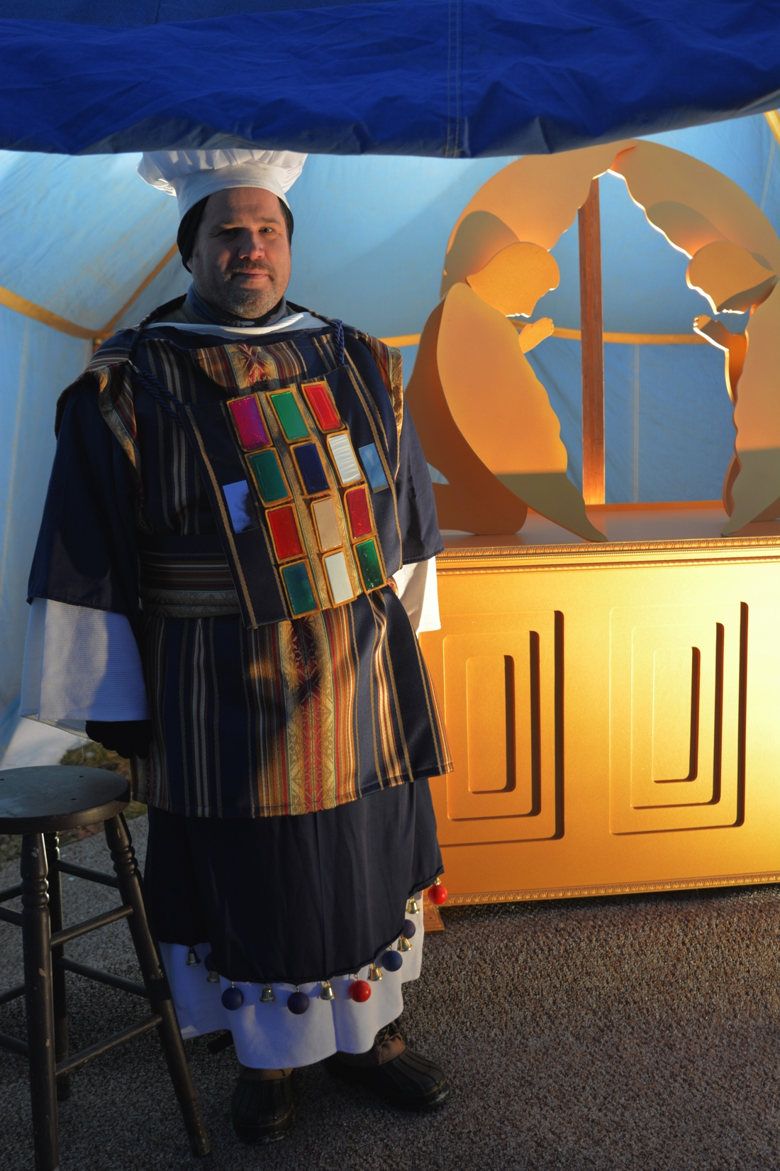
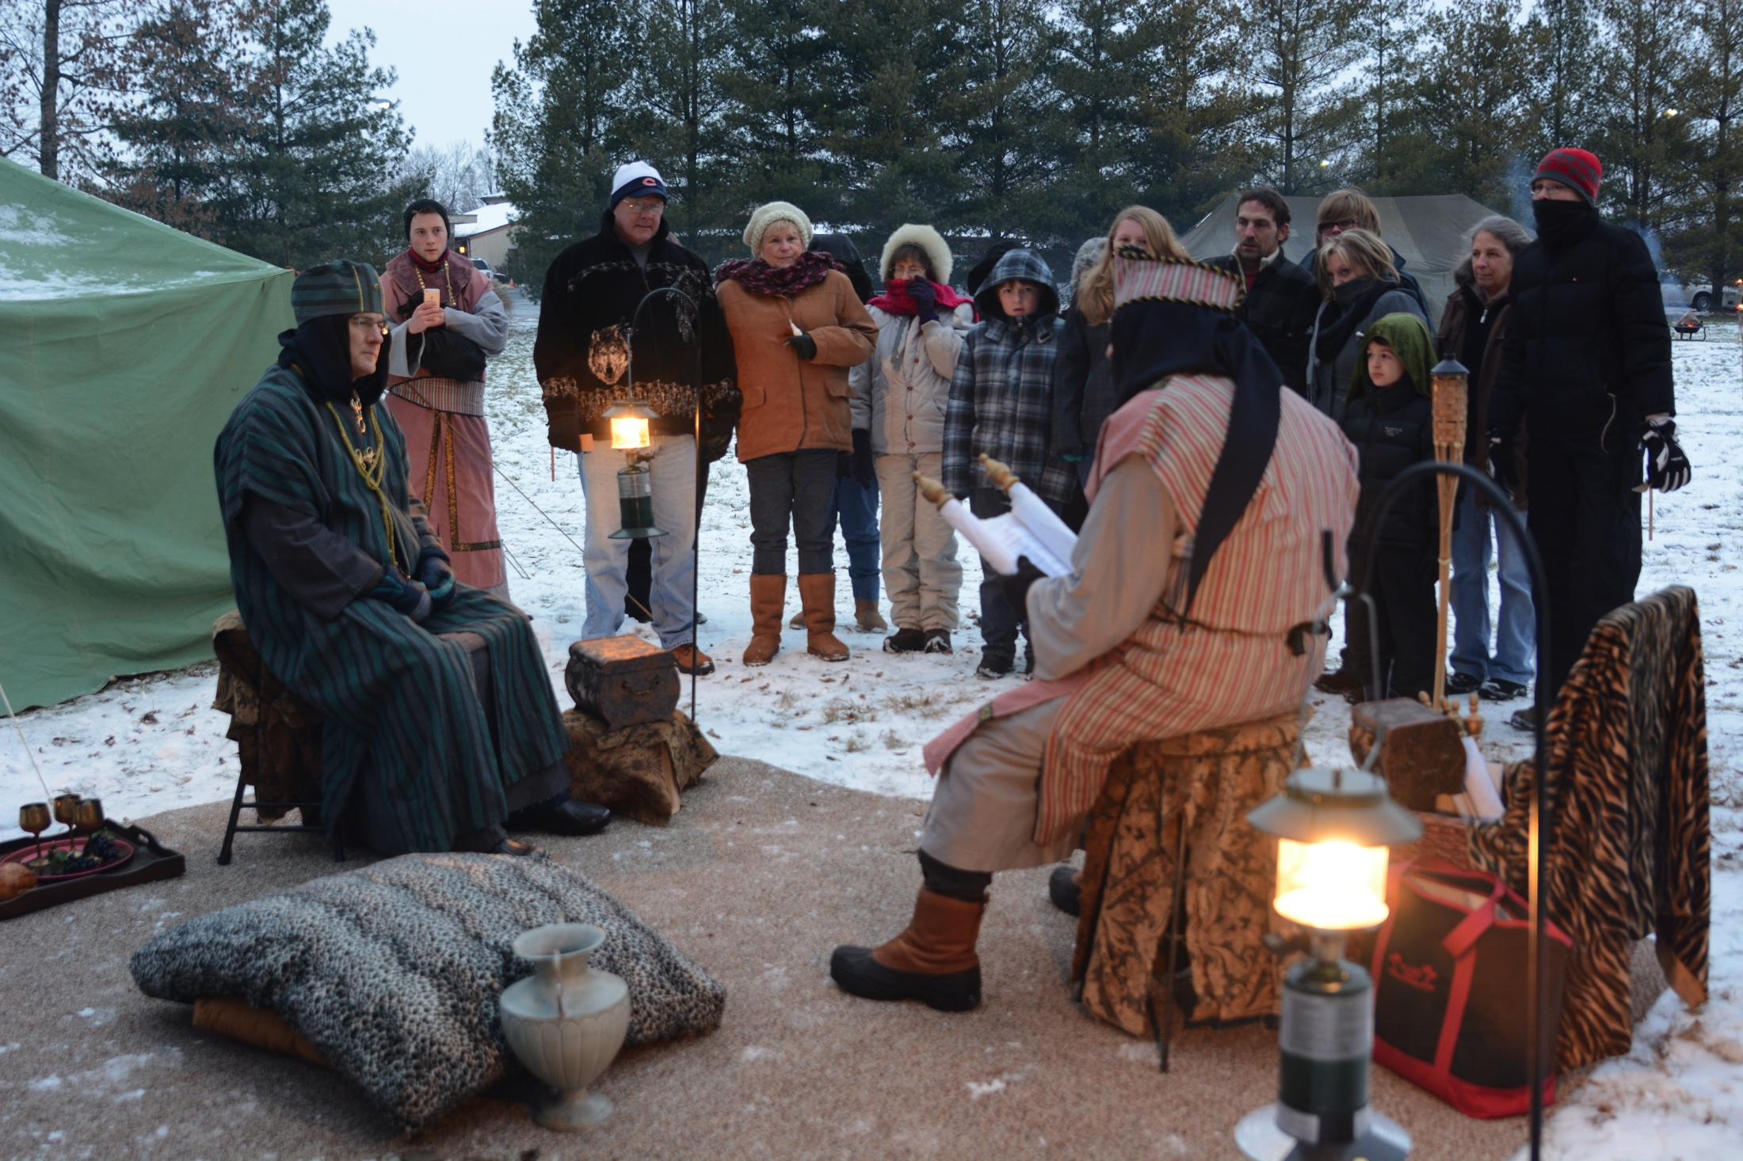
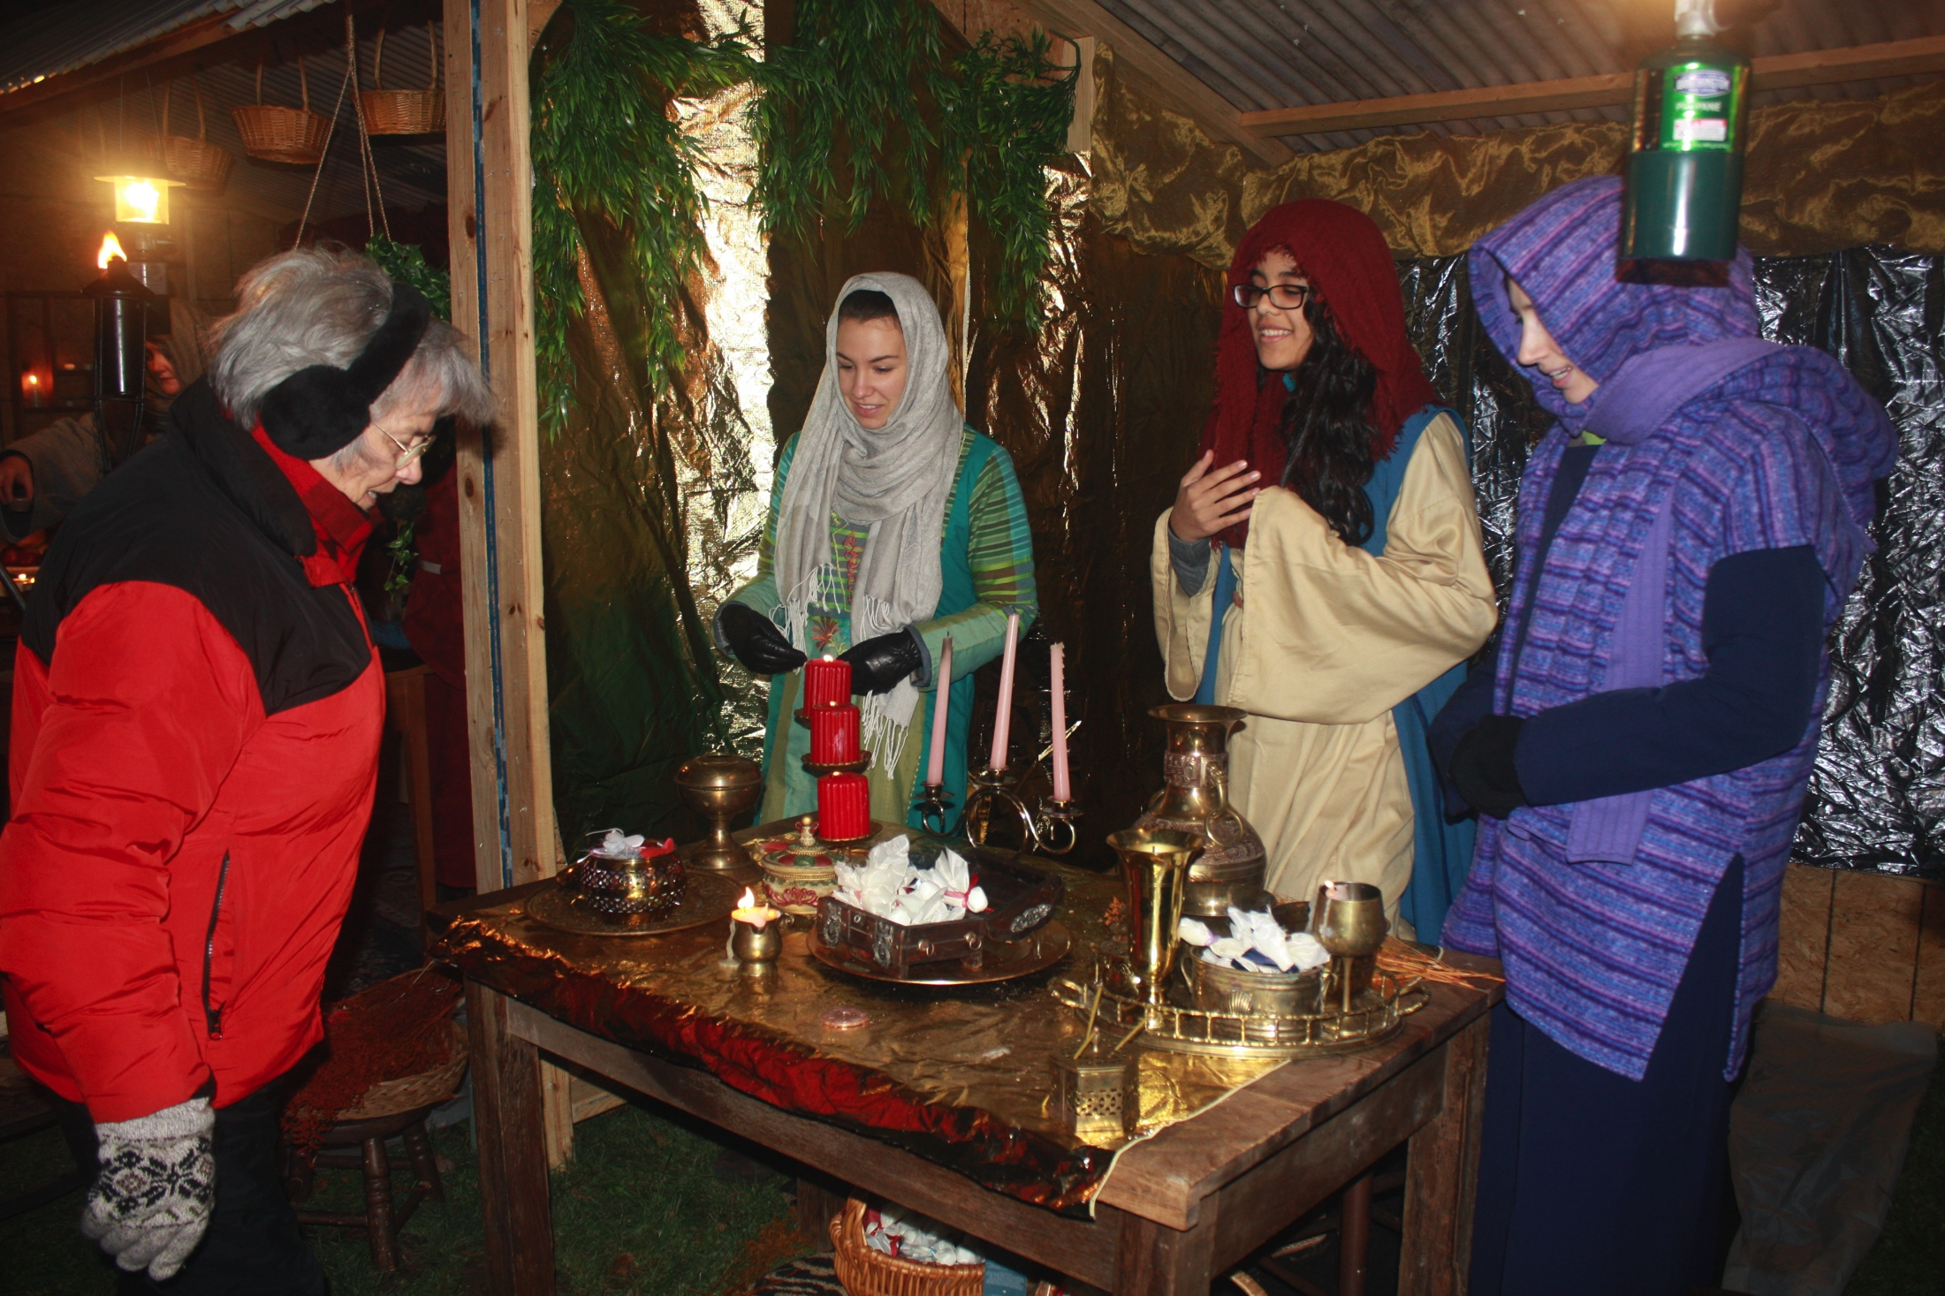
Lasting impressions
Positive, first impressions are important
Strive for improvements each year
You are representing the King of the universe

