Slide 1
Journey to Bethlehem
Management System

Slide 2
JTB Manager
Call for Initial Meeting
Establish & Manage Timeline
Manage Area Coordinators
Cast Coordinator
Coordinate Lighting & Electrical
Give Weekly Reports to Church Family

Slide 3
Construction Coordinator
Rally a Construction Team
Generate a budget for any new additions
Responsible for Village, Herod tent, Wiseman tent, Shepherd camp, Angel platform, Inn, lepers/beggar areas.
Staking the tiki lights

Slide 4
Props & Décor Coordinator
Develop a team of decorators
Visualize & Collect biblical- style decorations & fabric.
Work within the timeline
Oversee/pack away props

Slide 5
Church Coordinator
Choose a team that manages all activity in the church
Church activity: census takers, church slides & music, hospitality room, guides to village, cast snack room & church decorating
Manage the flow to the village

Slide 6
Costume Coordinator
Attract a team of seamstresses that can create new costumes.
Organize and match up costumes with all cast members.
Wash and pack away costumes.

Slide 7
Public Relations
Design/update posters & bulletin inserts for the new season
Submit 4x4 copy to area papers
Update JTB website
Distribute bulletin inserts to community churches

Slide 8
Budget Coordinator
Meet with management team to set a budget
Receive all receipts from area coordinators
Give financial updates to JTB Manager

Slide 9
Experience the Journey…

Slide 11
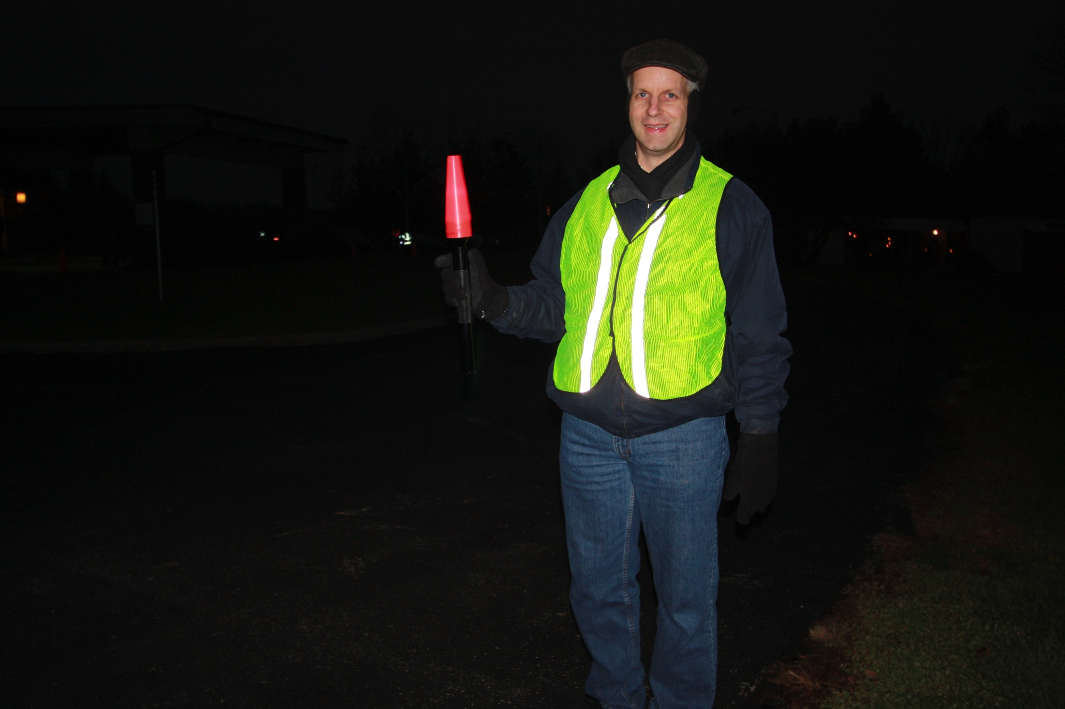

Slide 12
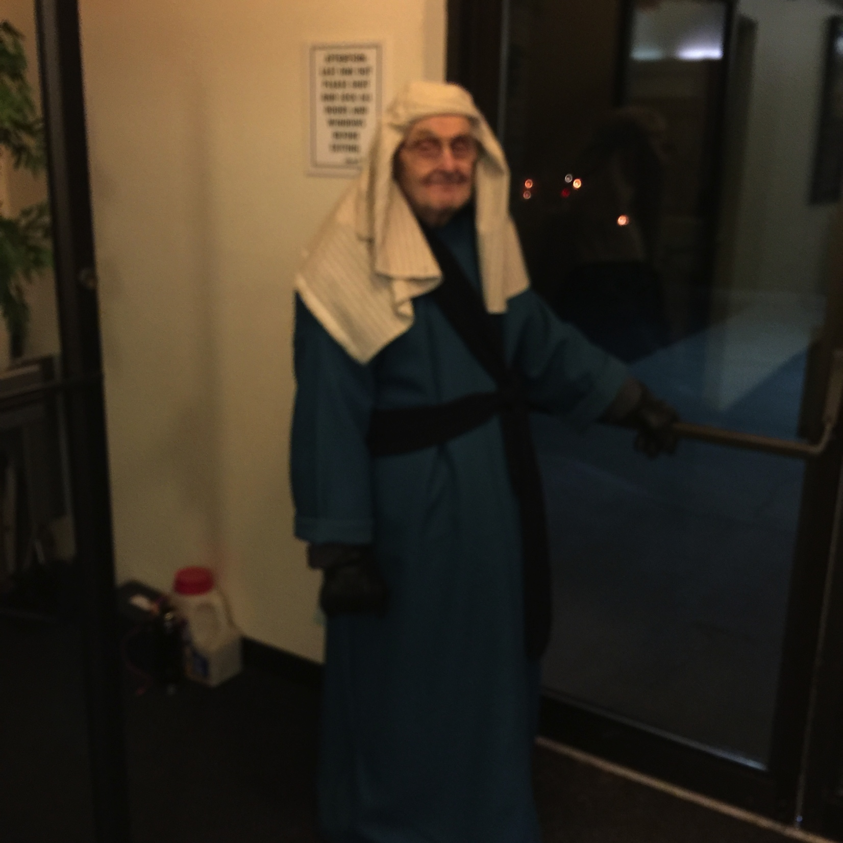

Slide 13
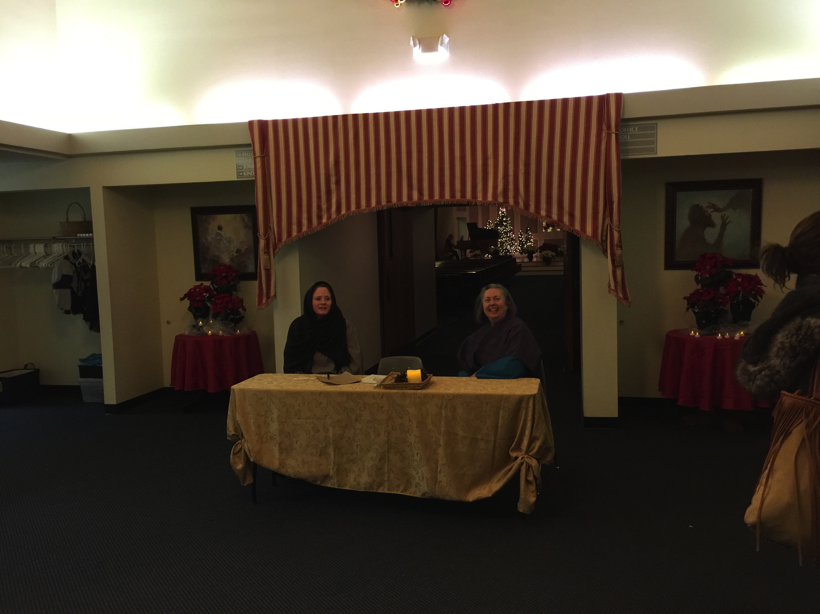

Slide 14
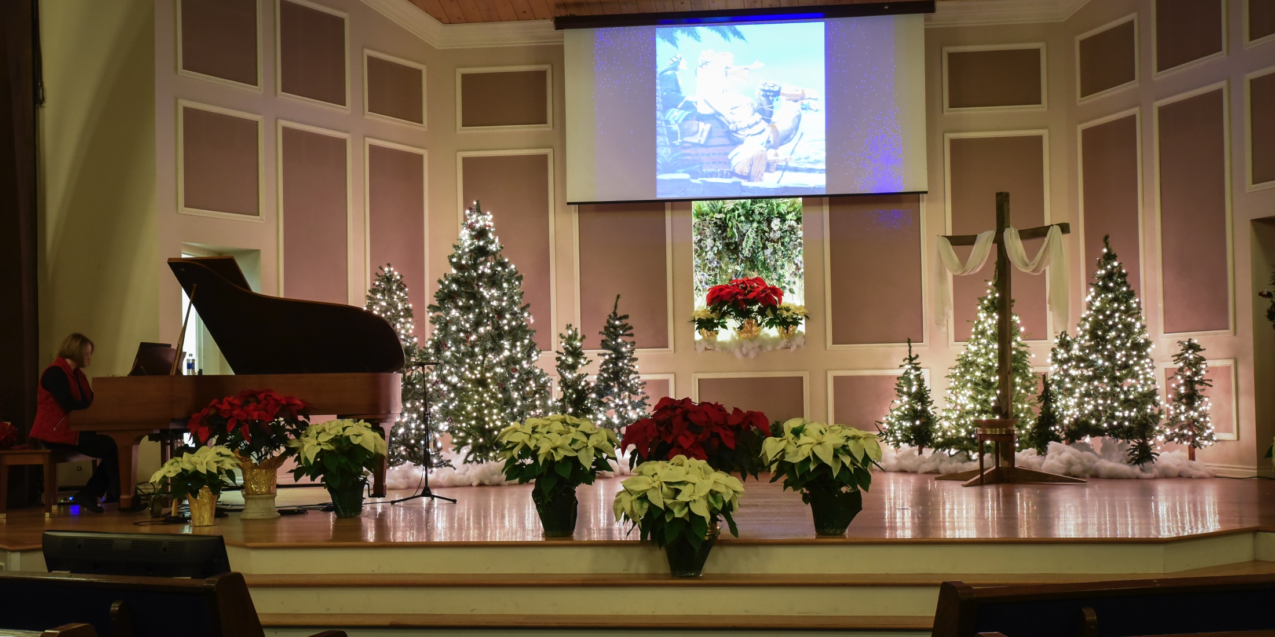

Slide 15
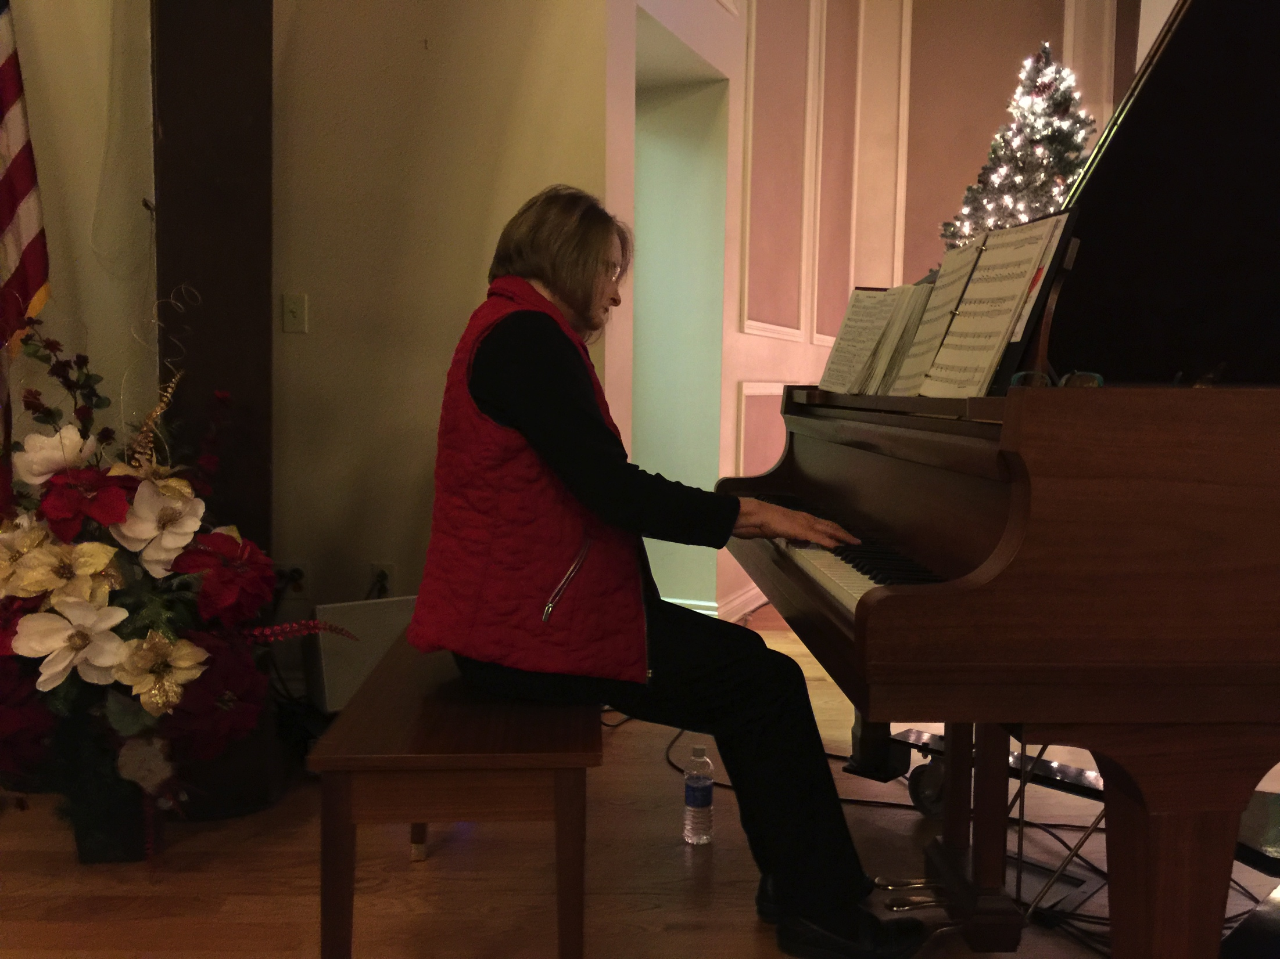
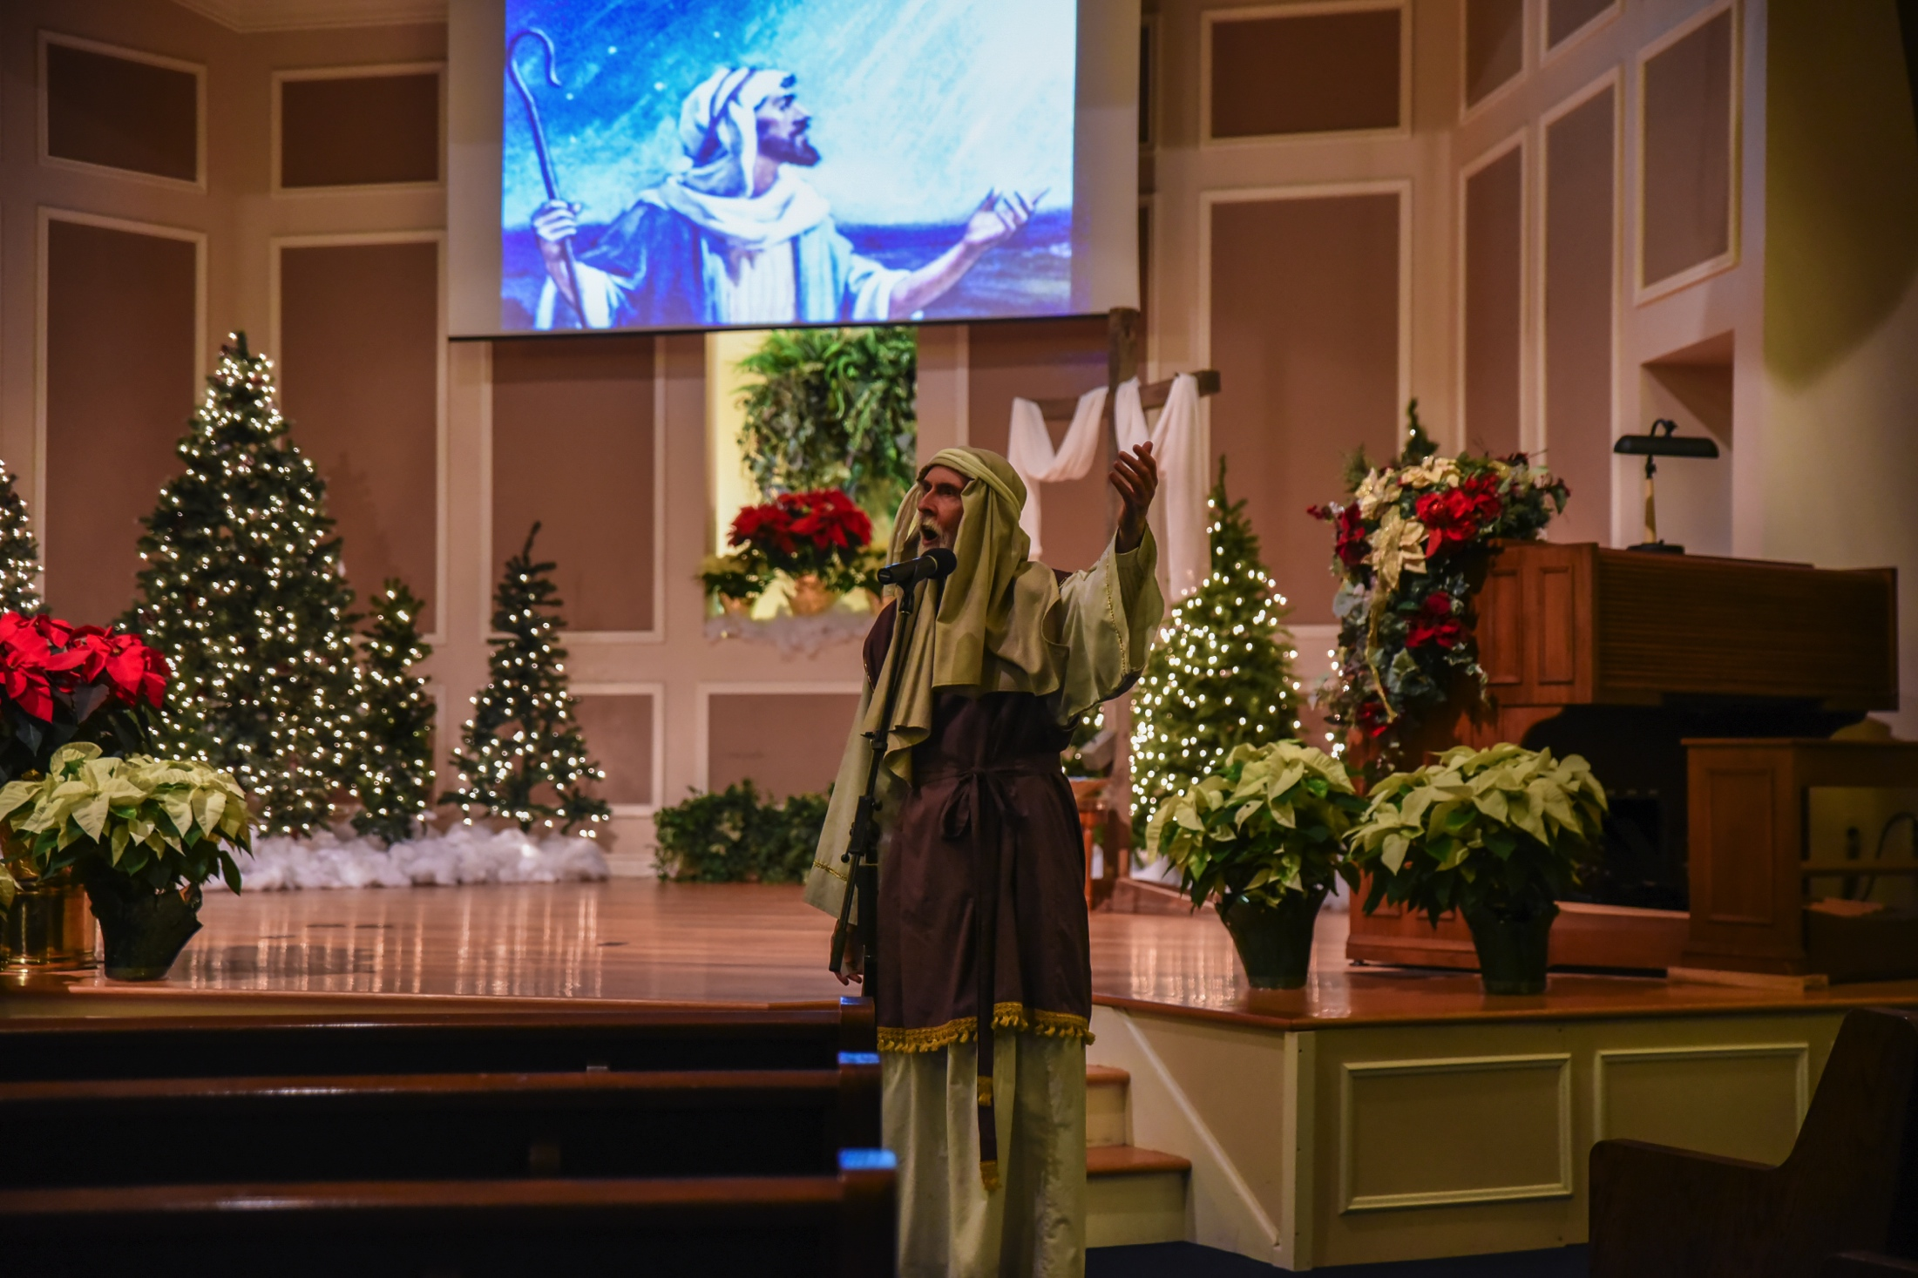

Slide 16
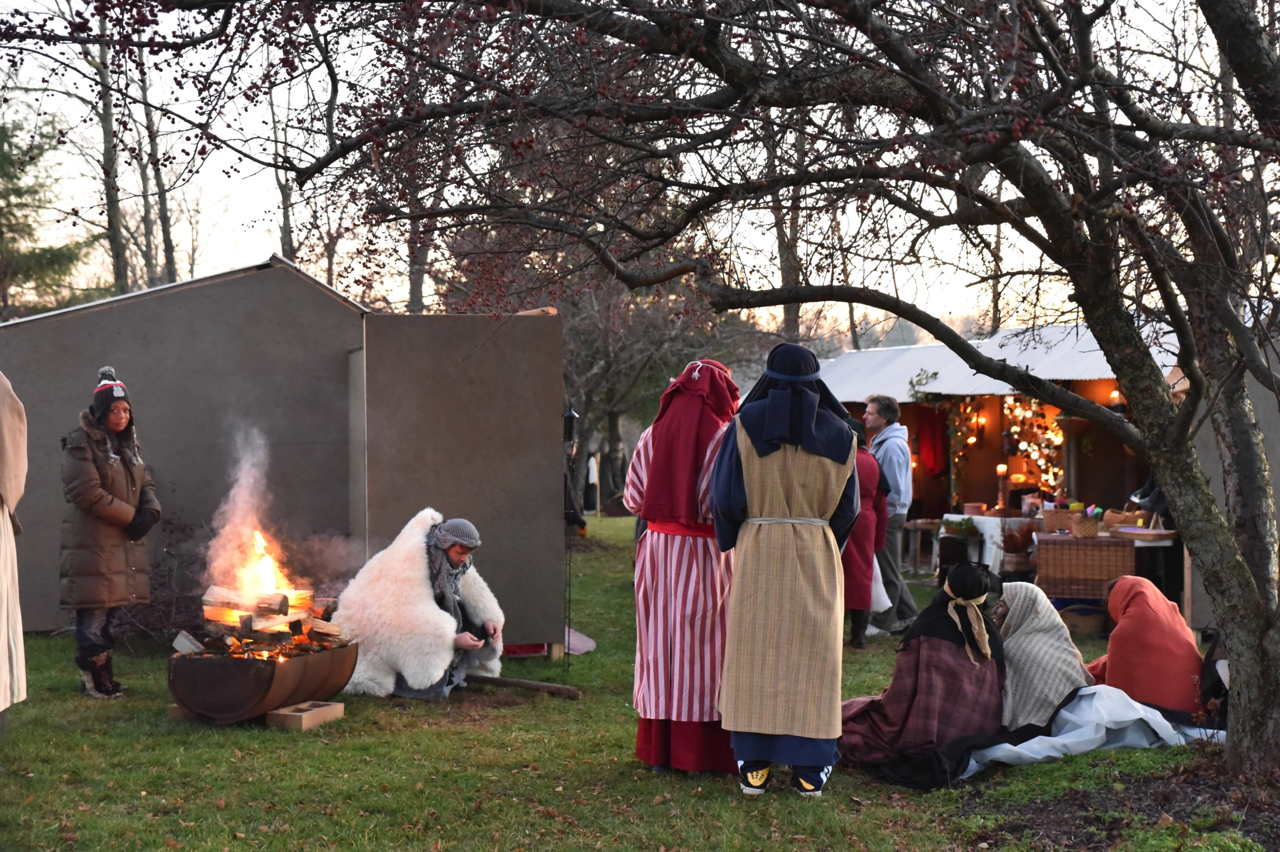

Slide 17
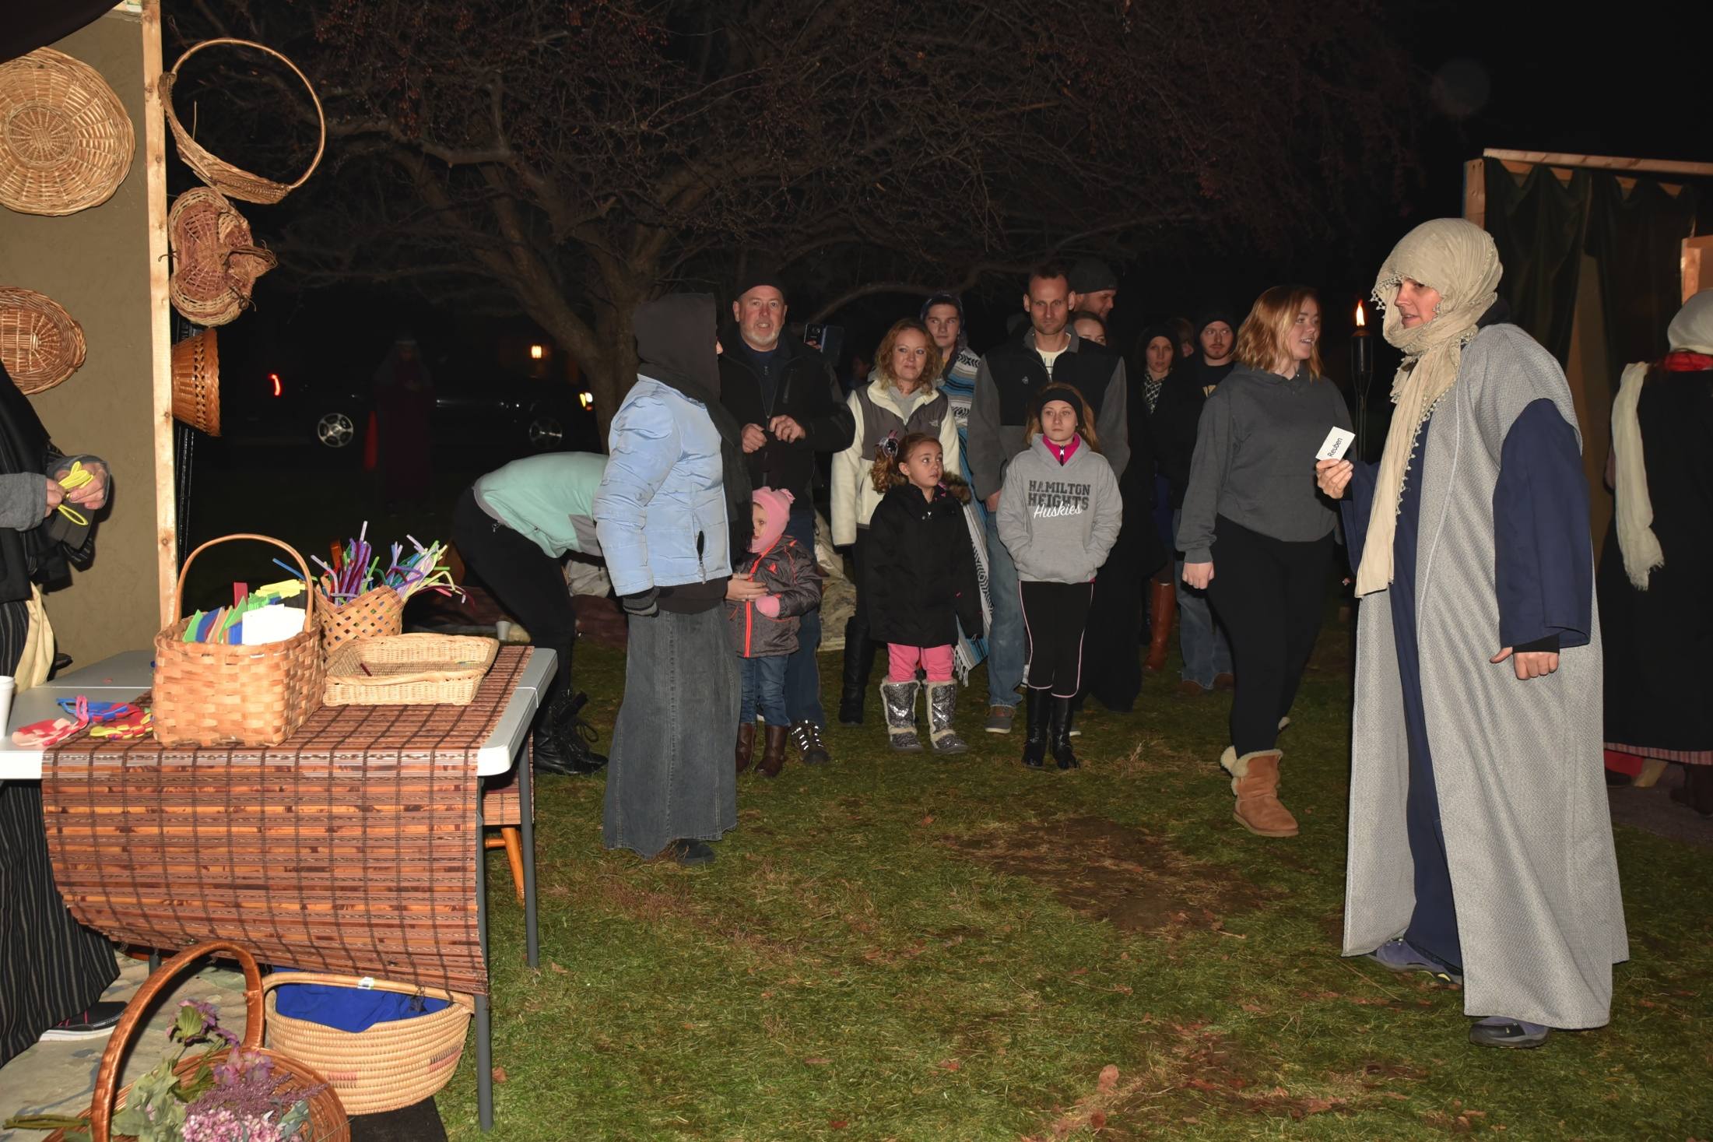

Slide 18
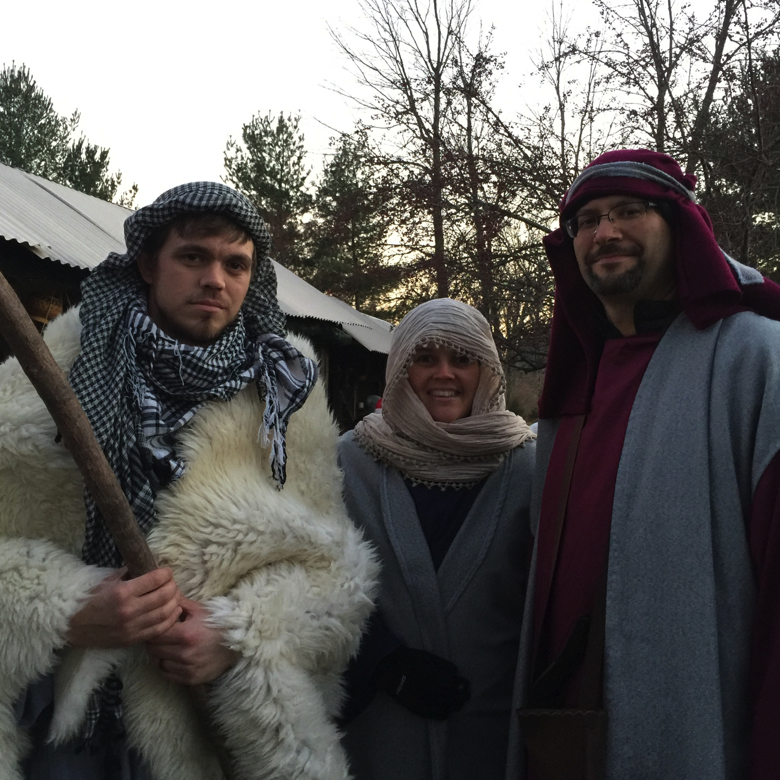

Slide 19
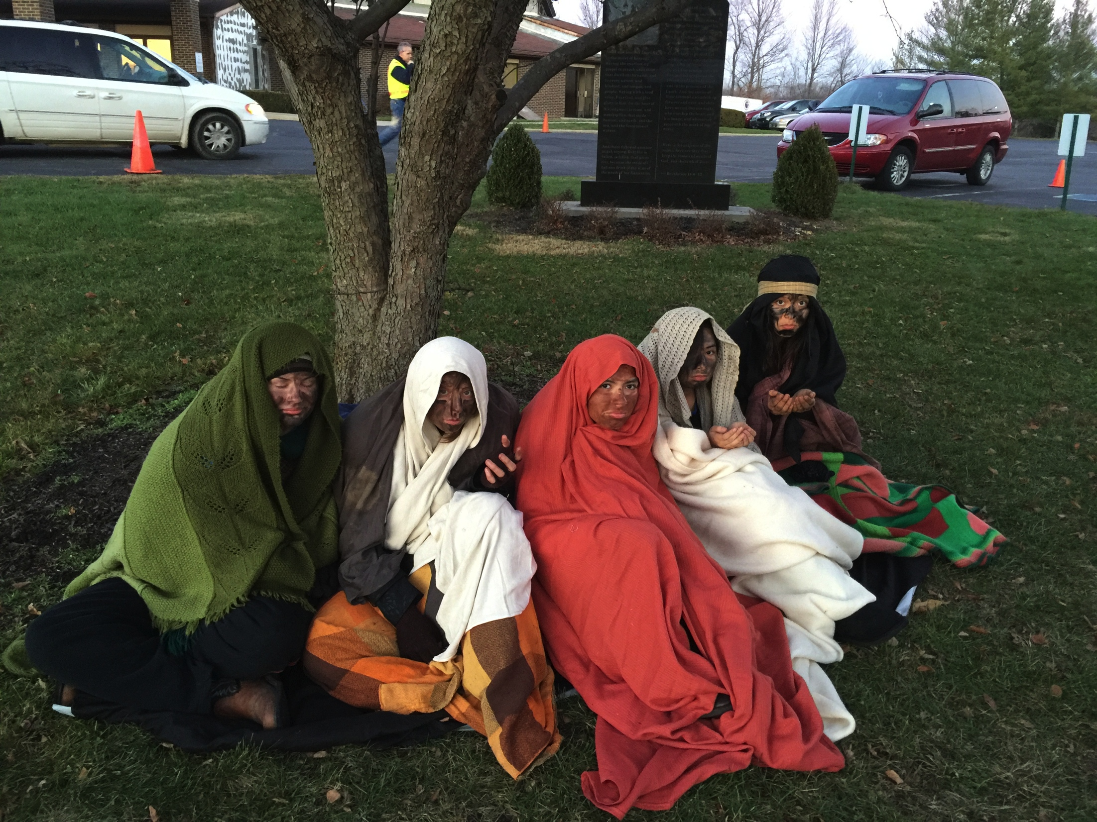

Slide 20
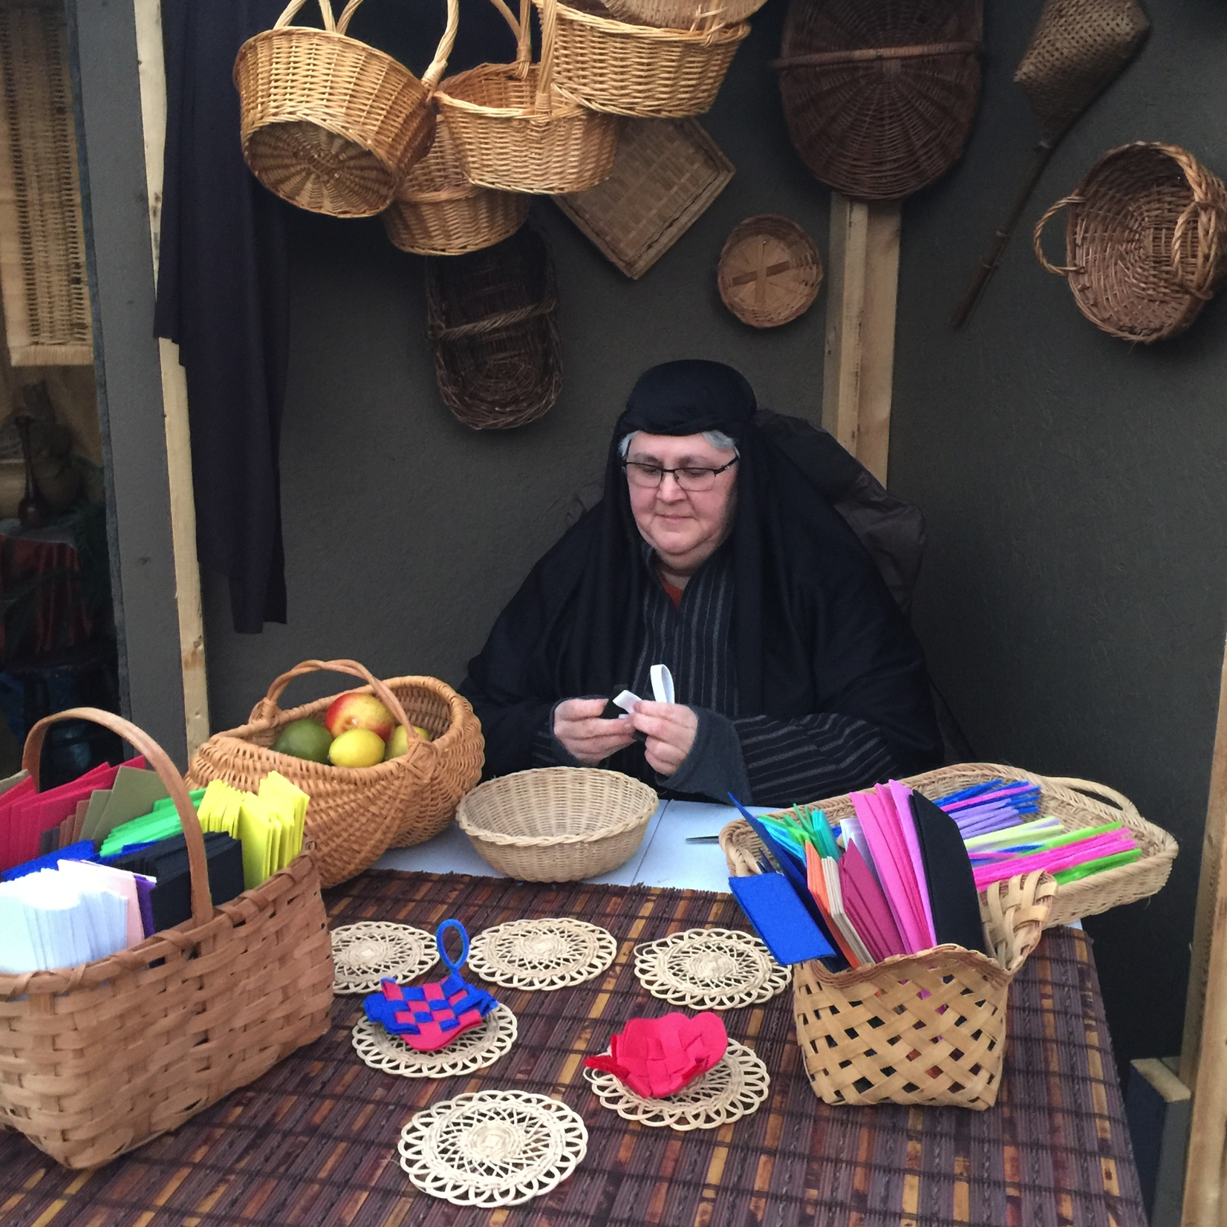

Slide 21
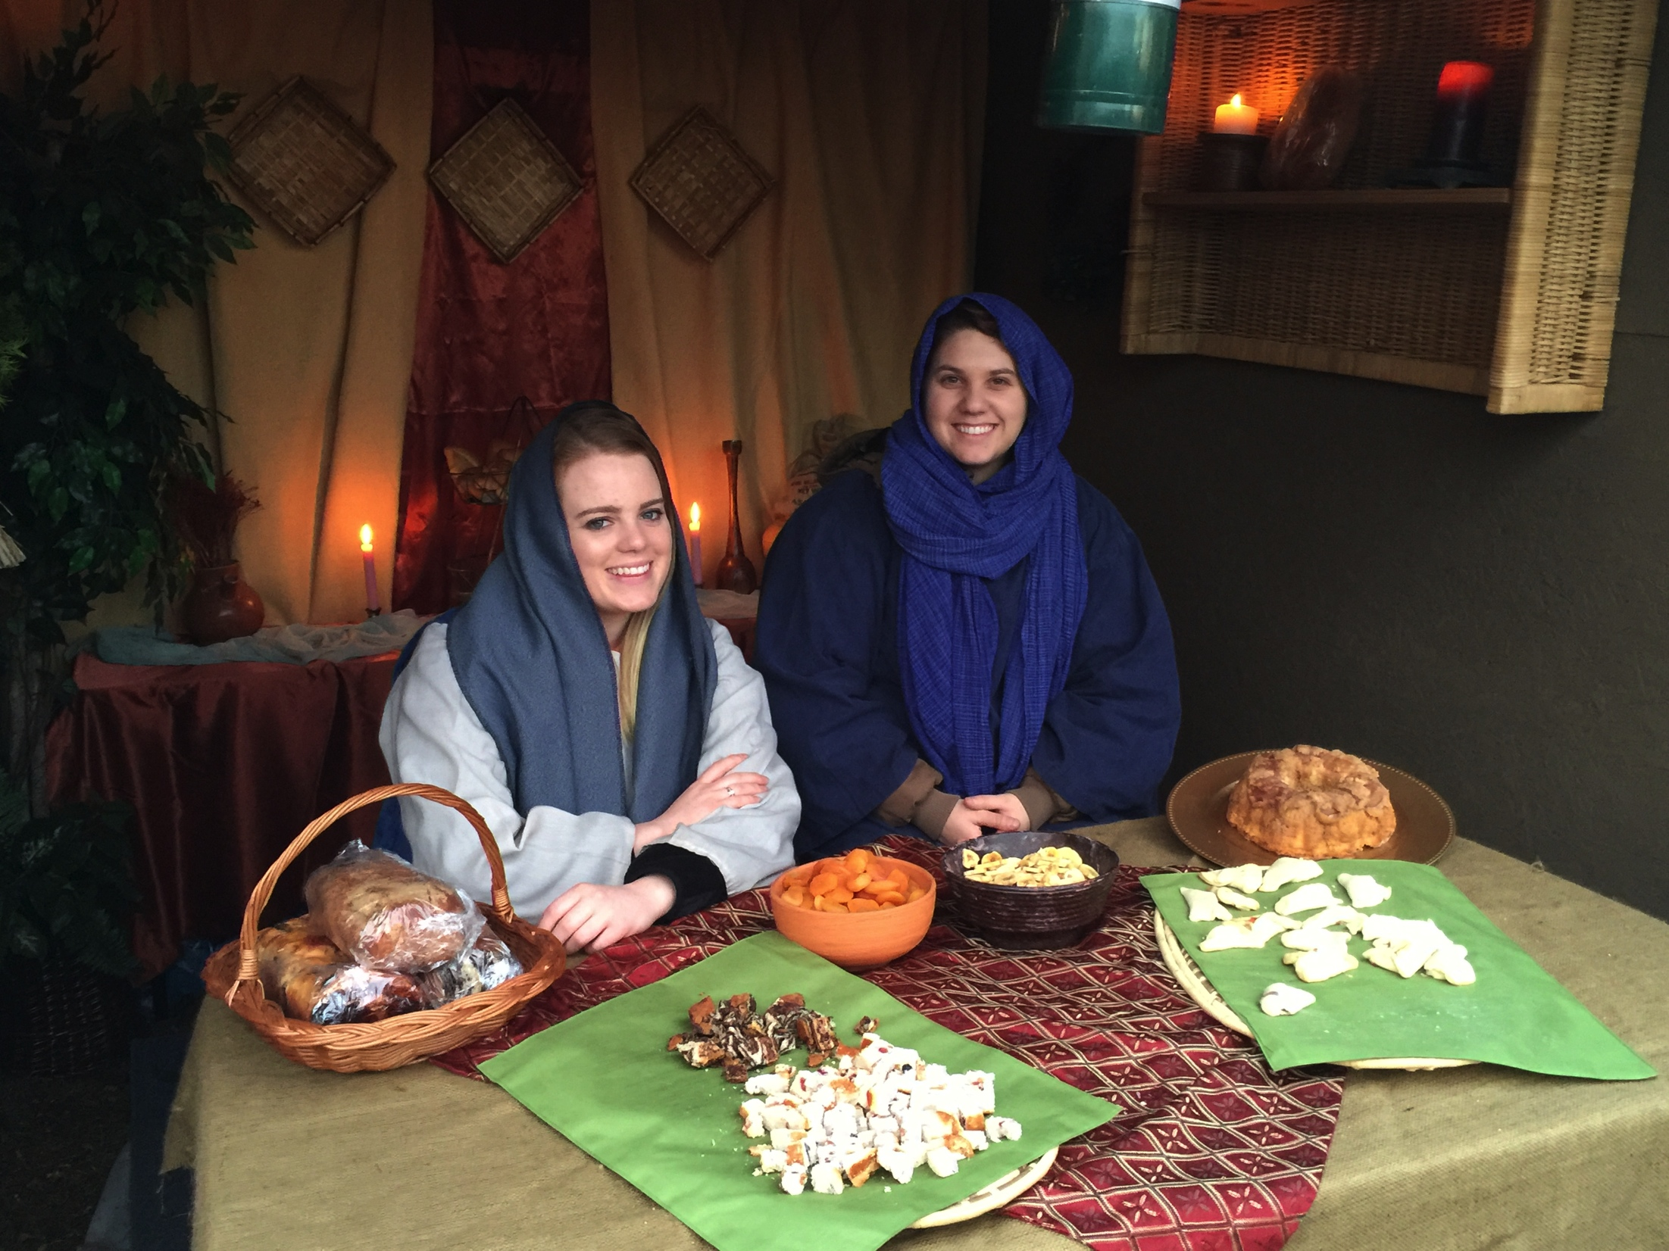

Slide 22
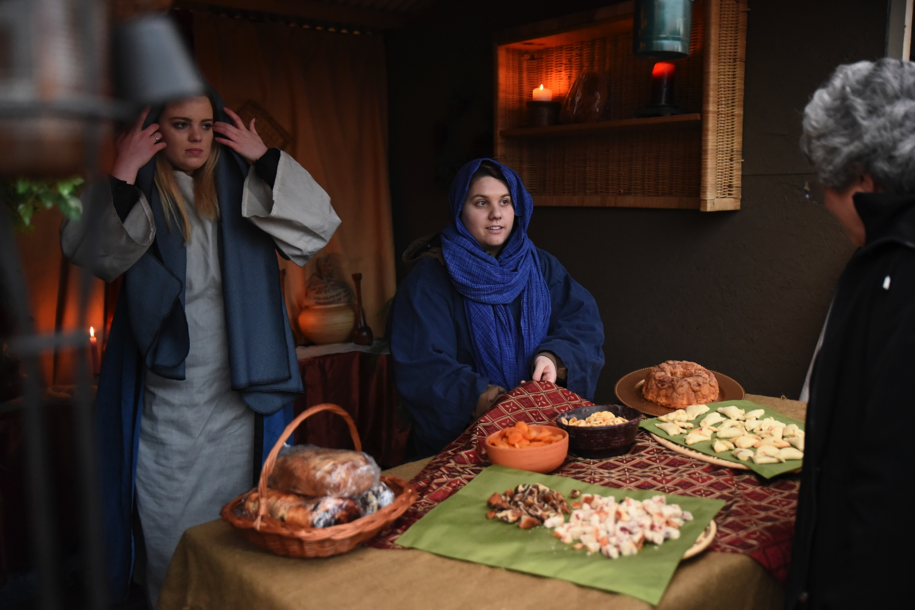

Slide 23
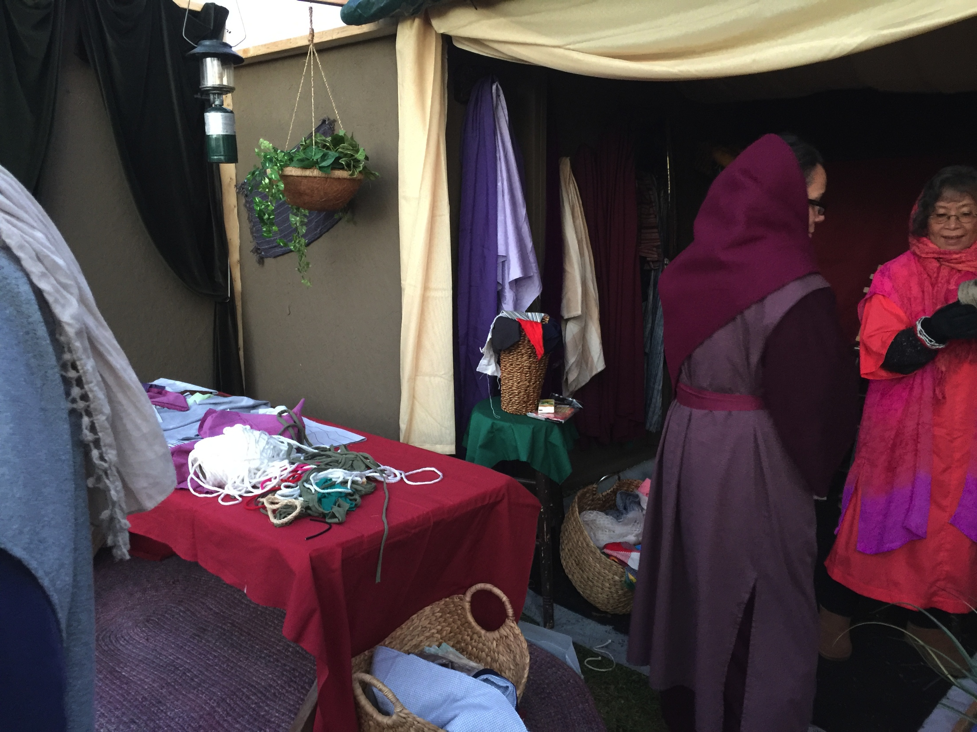

Slide 24
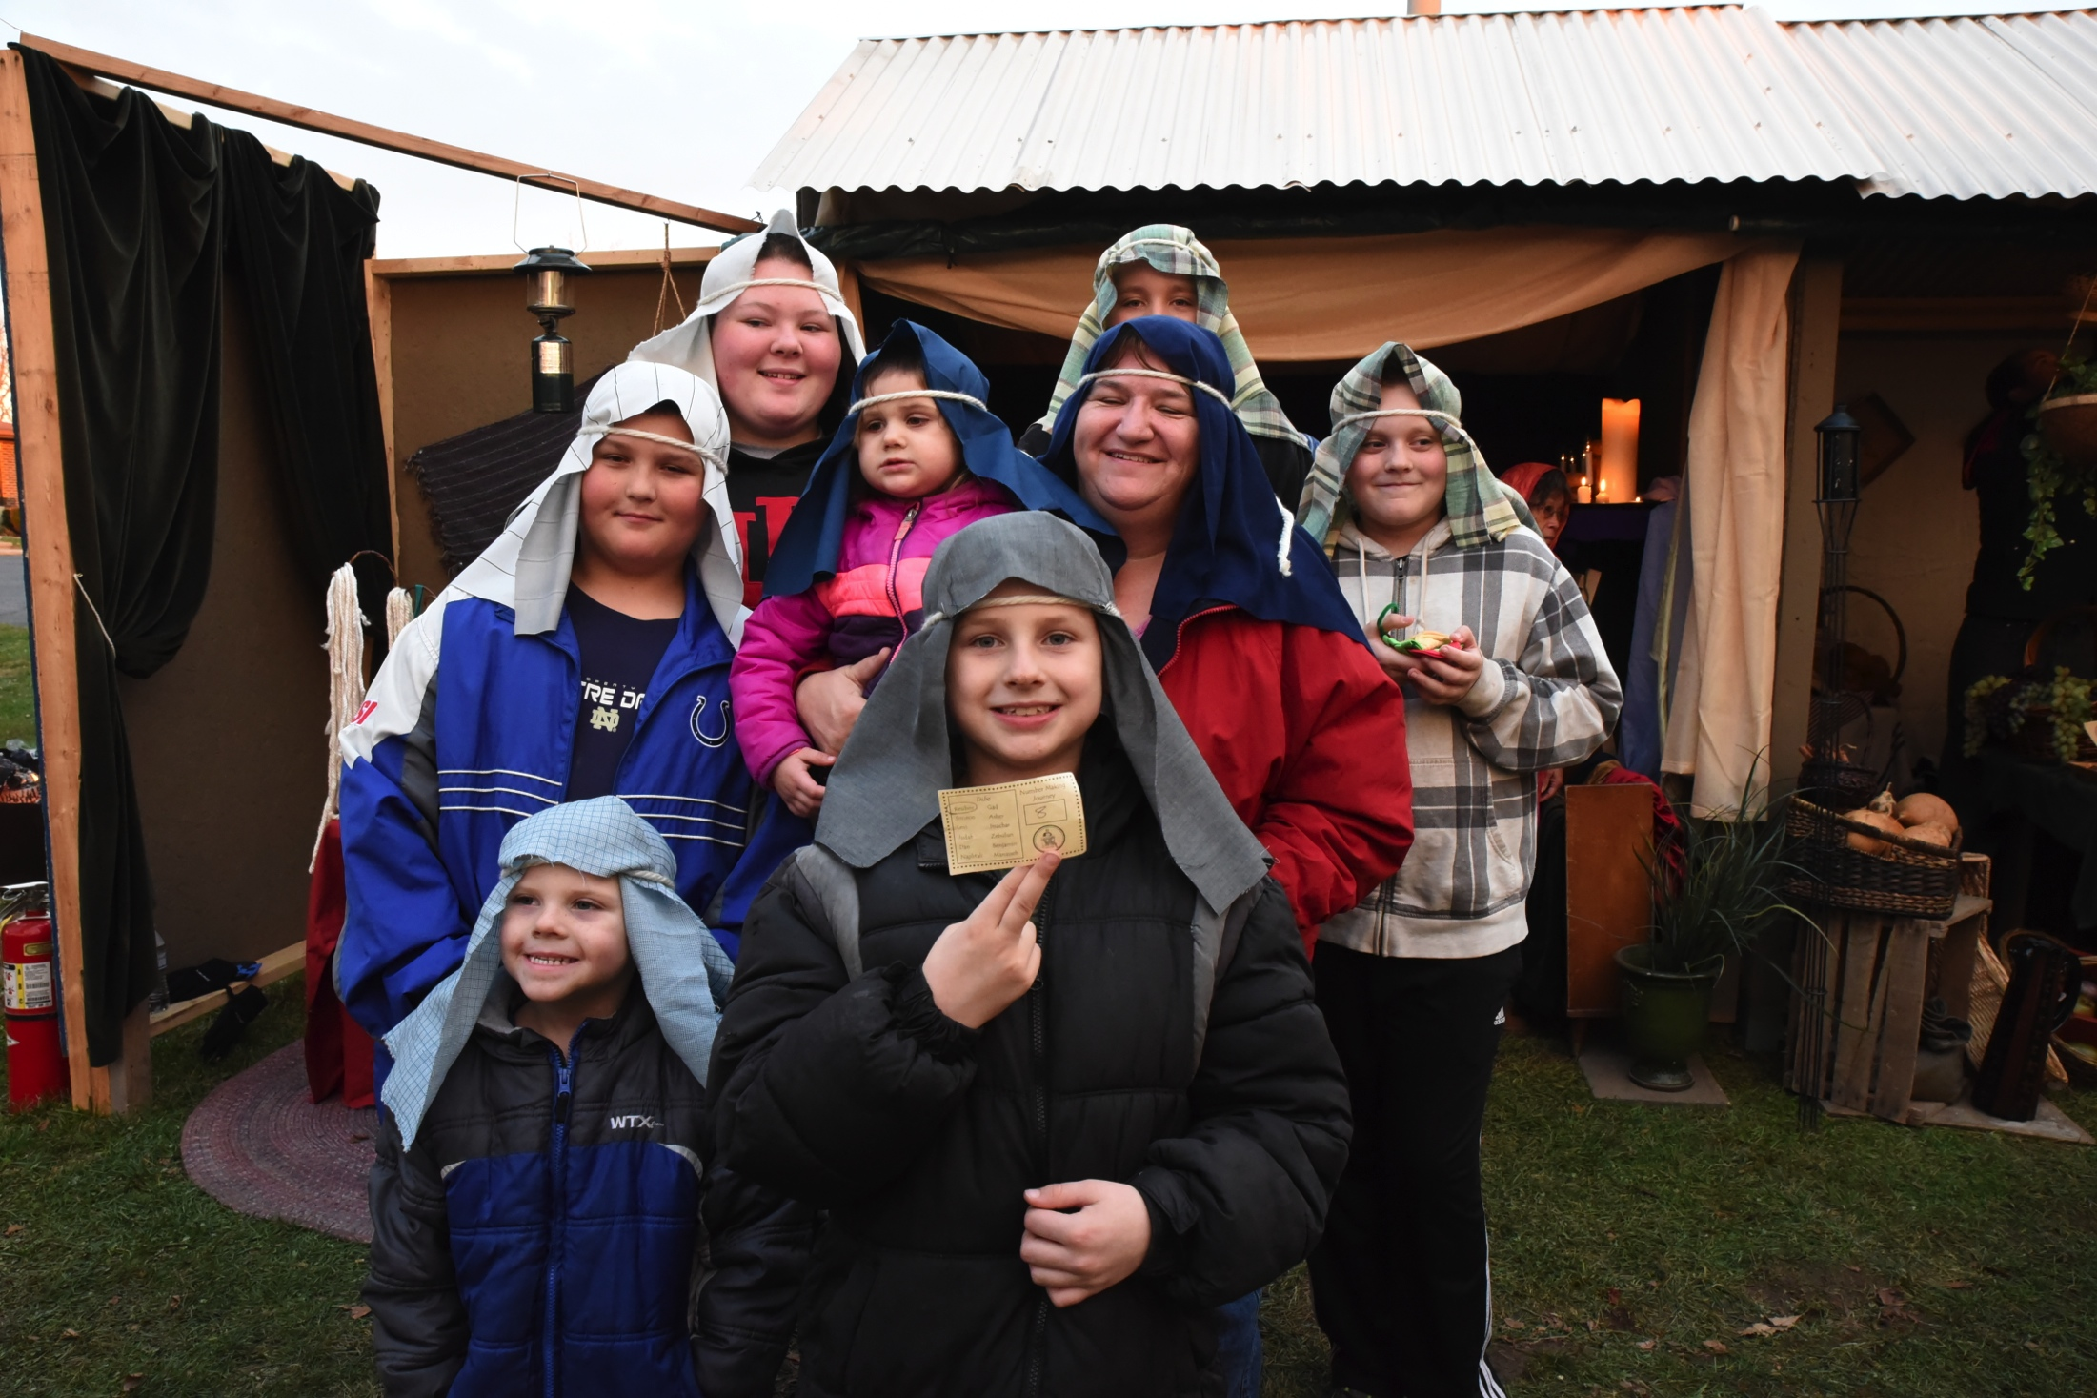

Slide 25
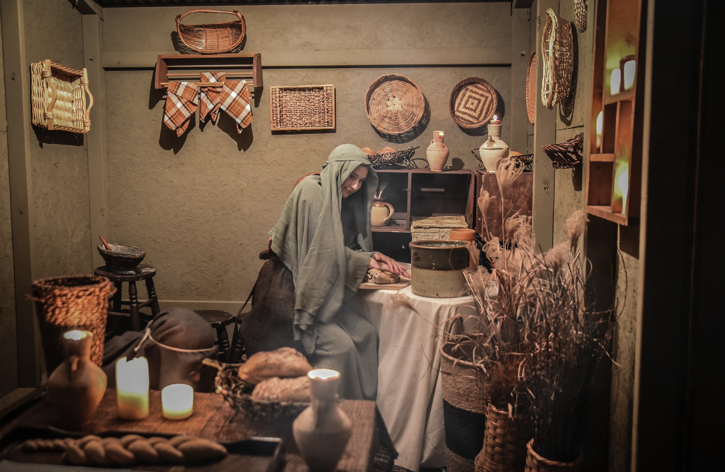

Slide 26
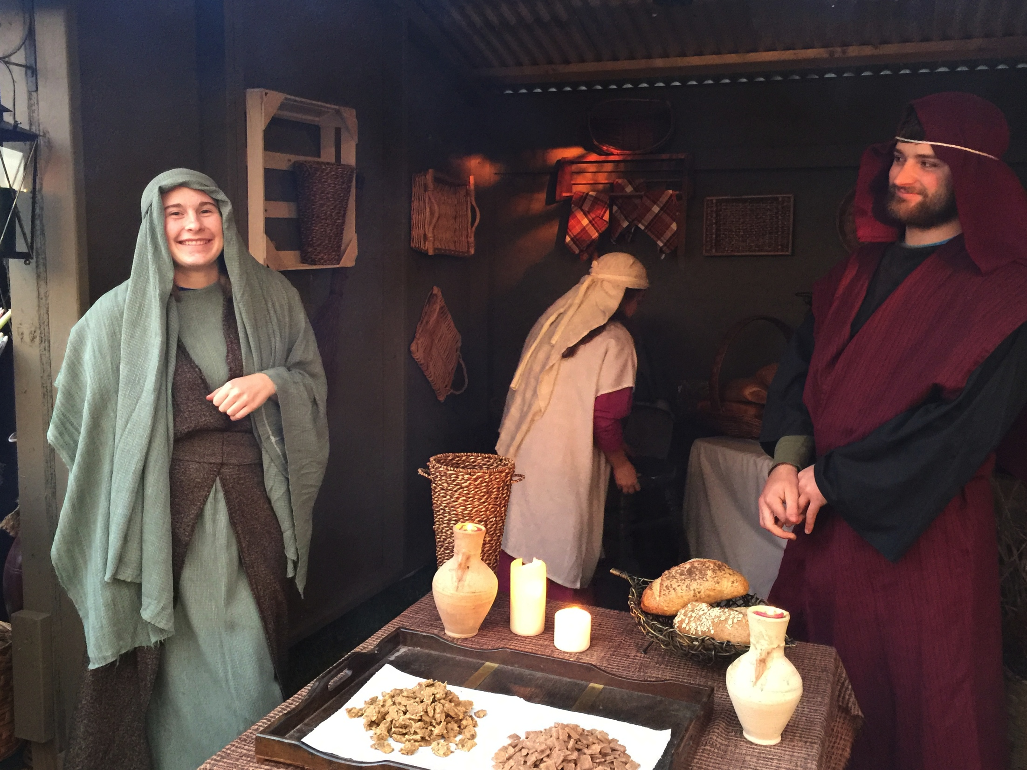

Slide 27
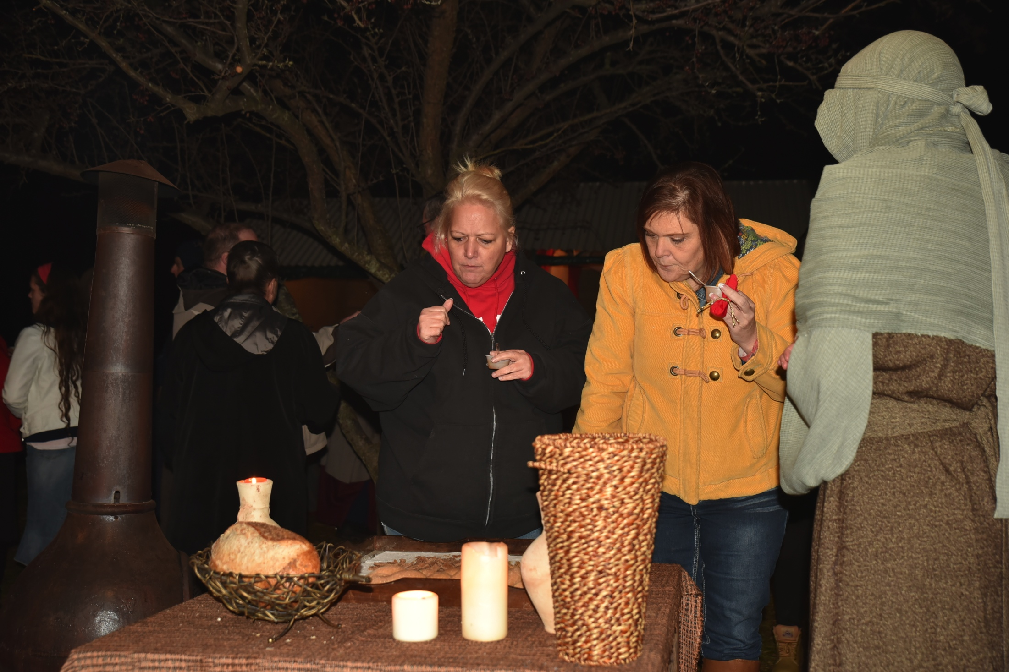

Slide 28
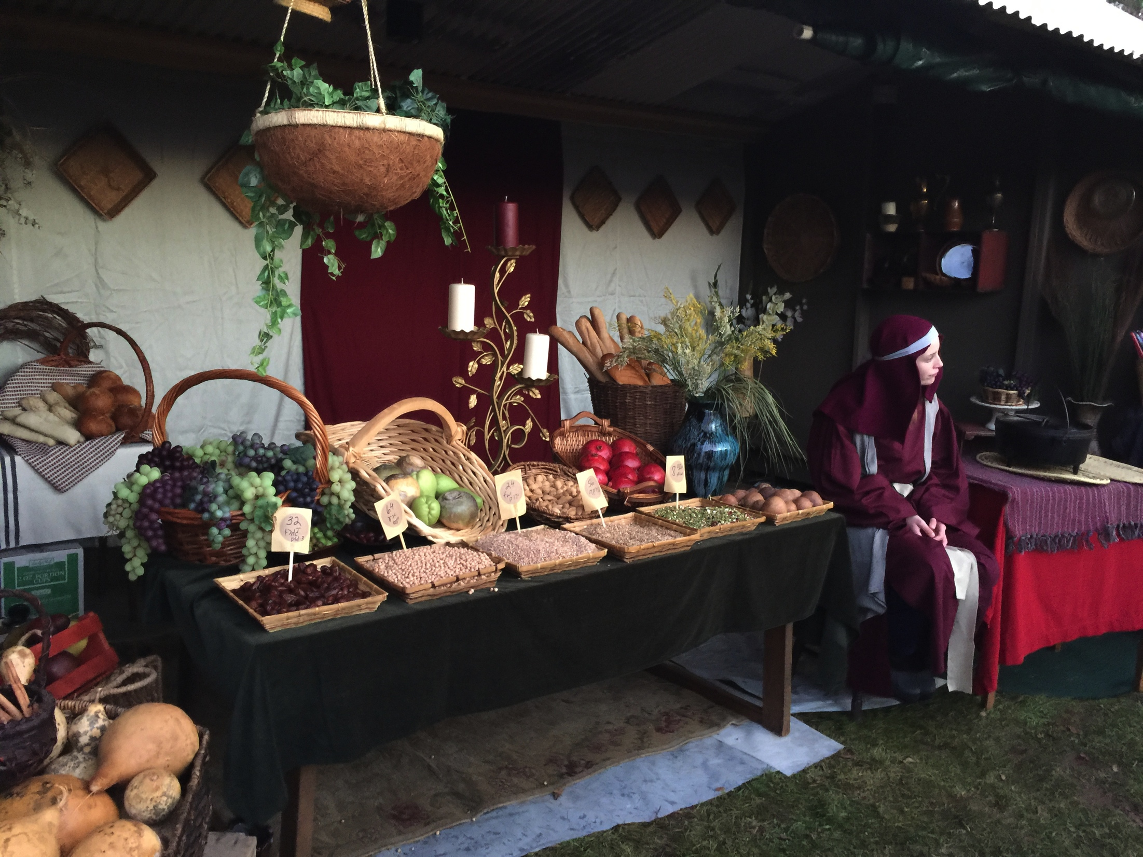

Slide 30
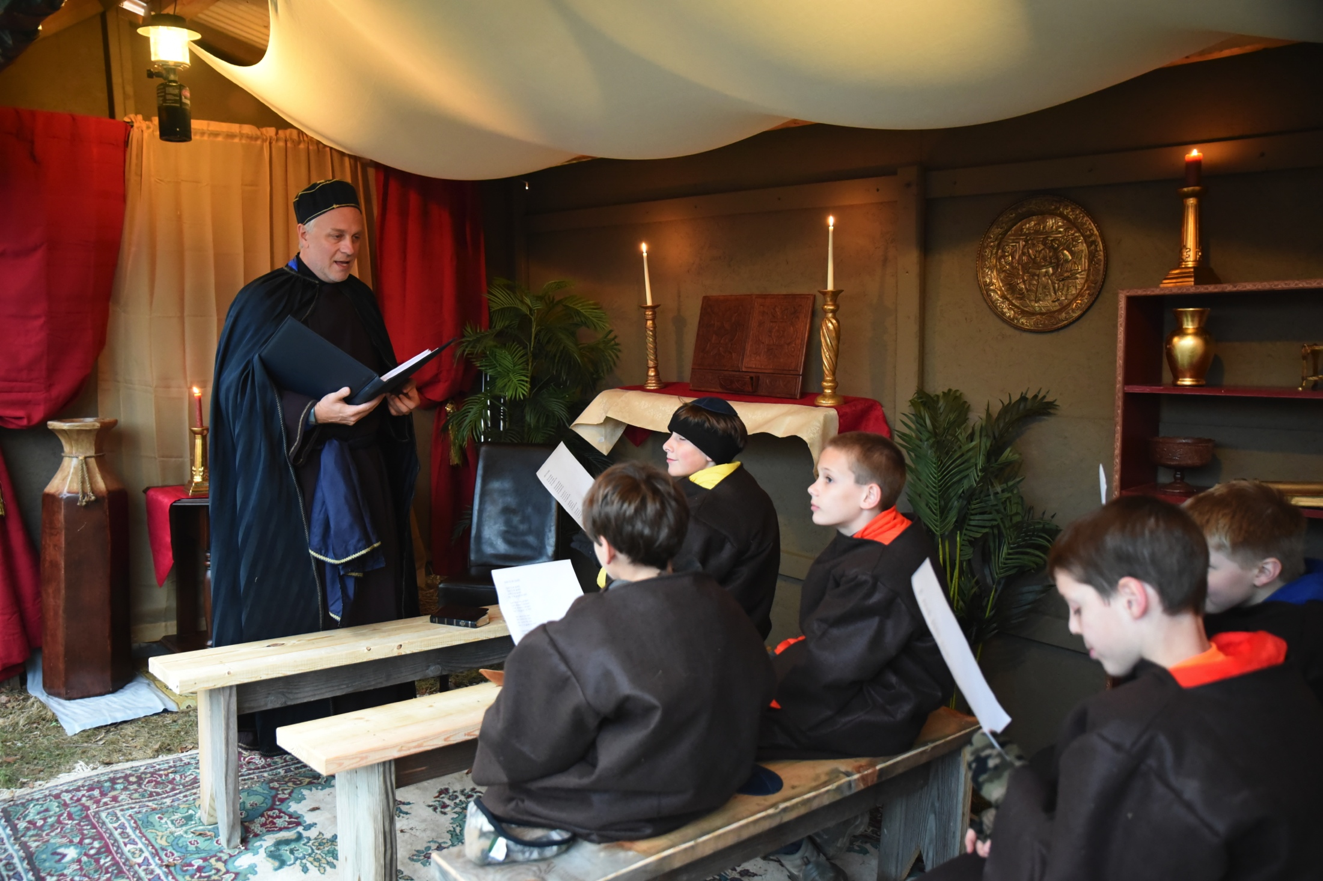

Slide 31
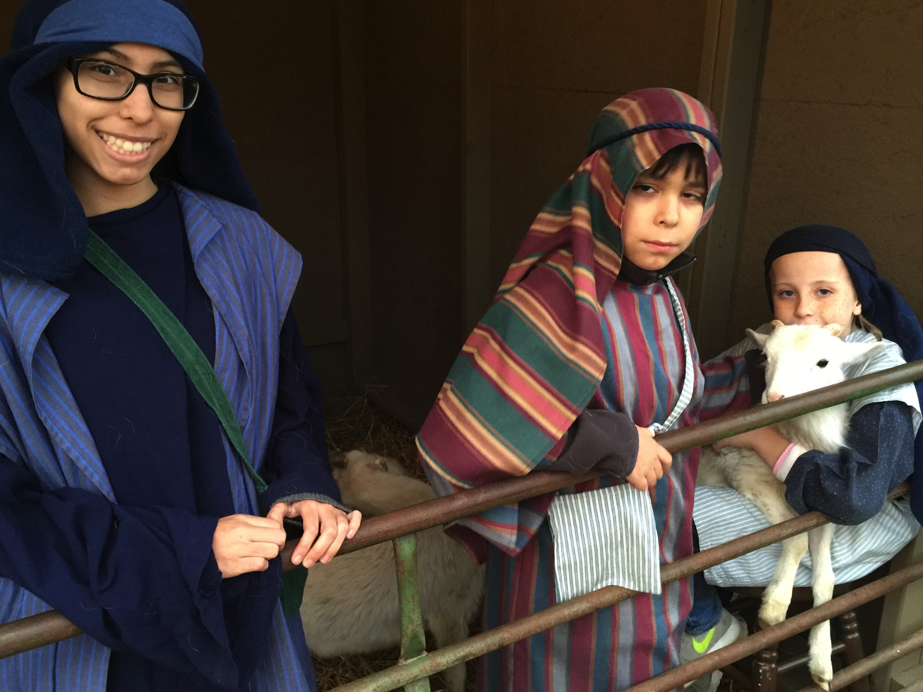

Slide 32
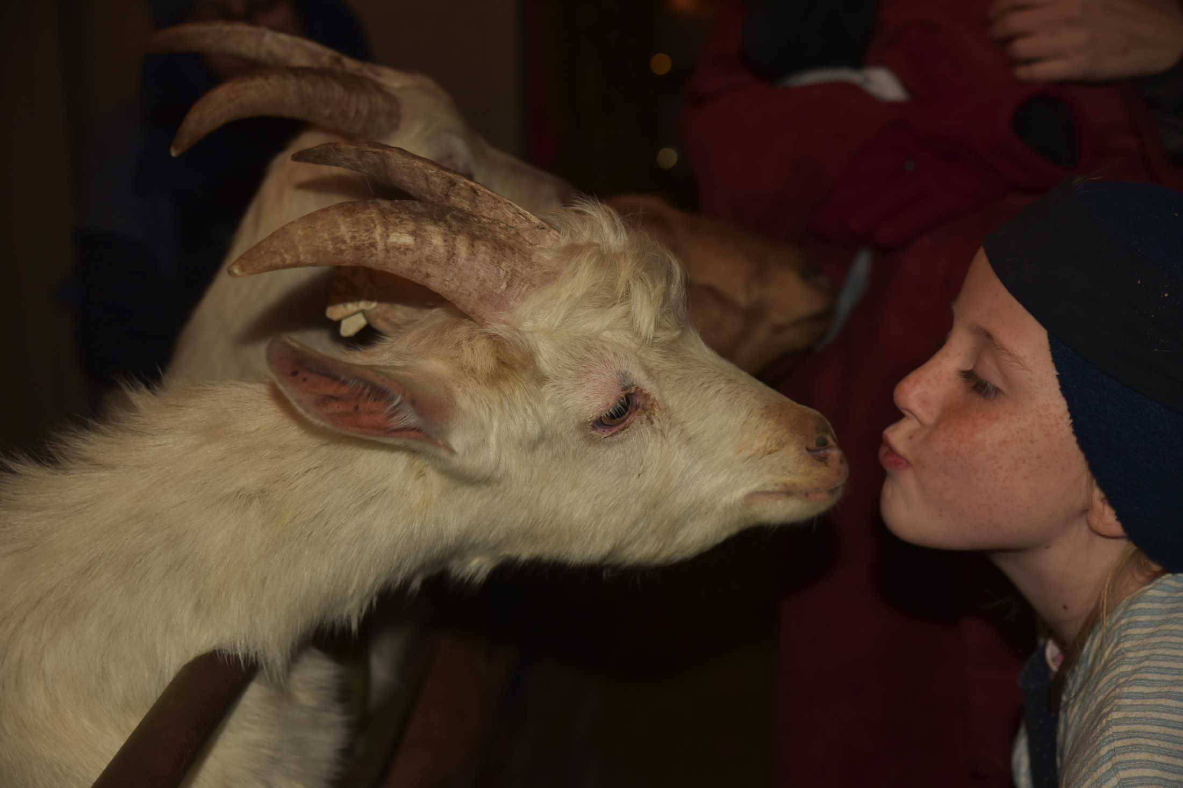

Slide 34
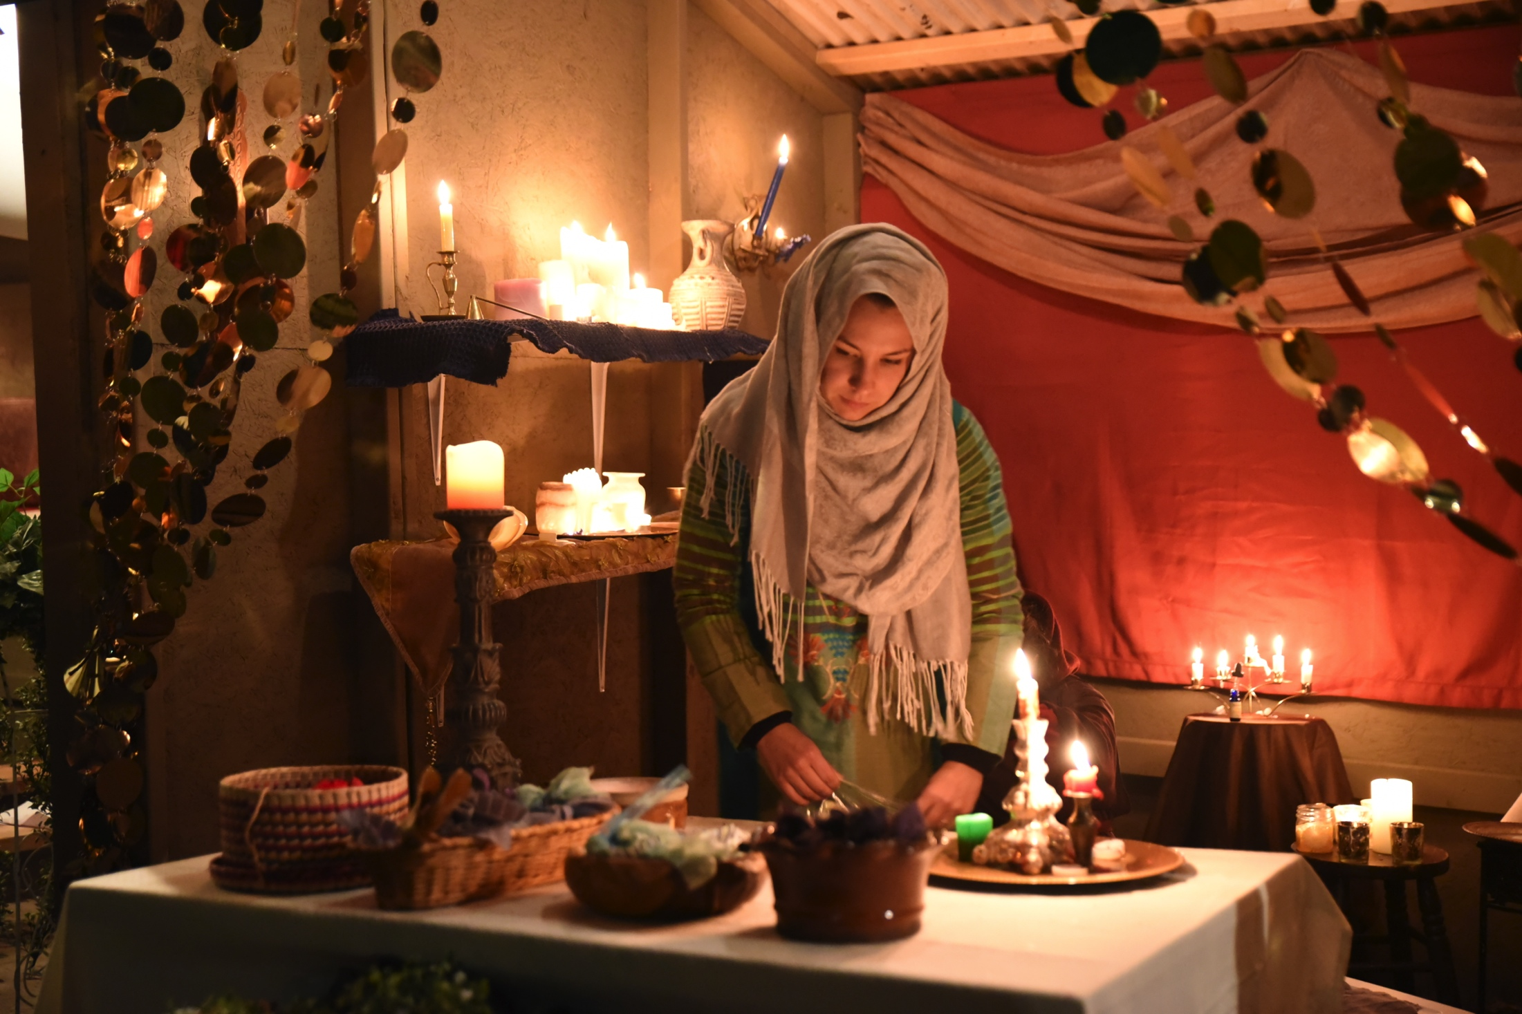

Slide 35
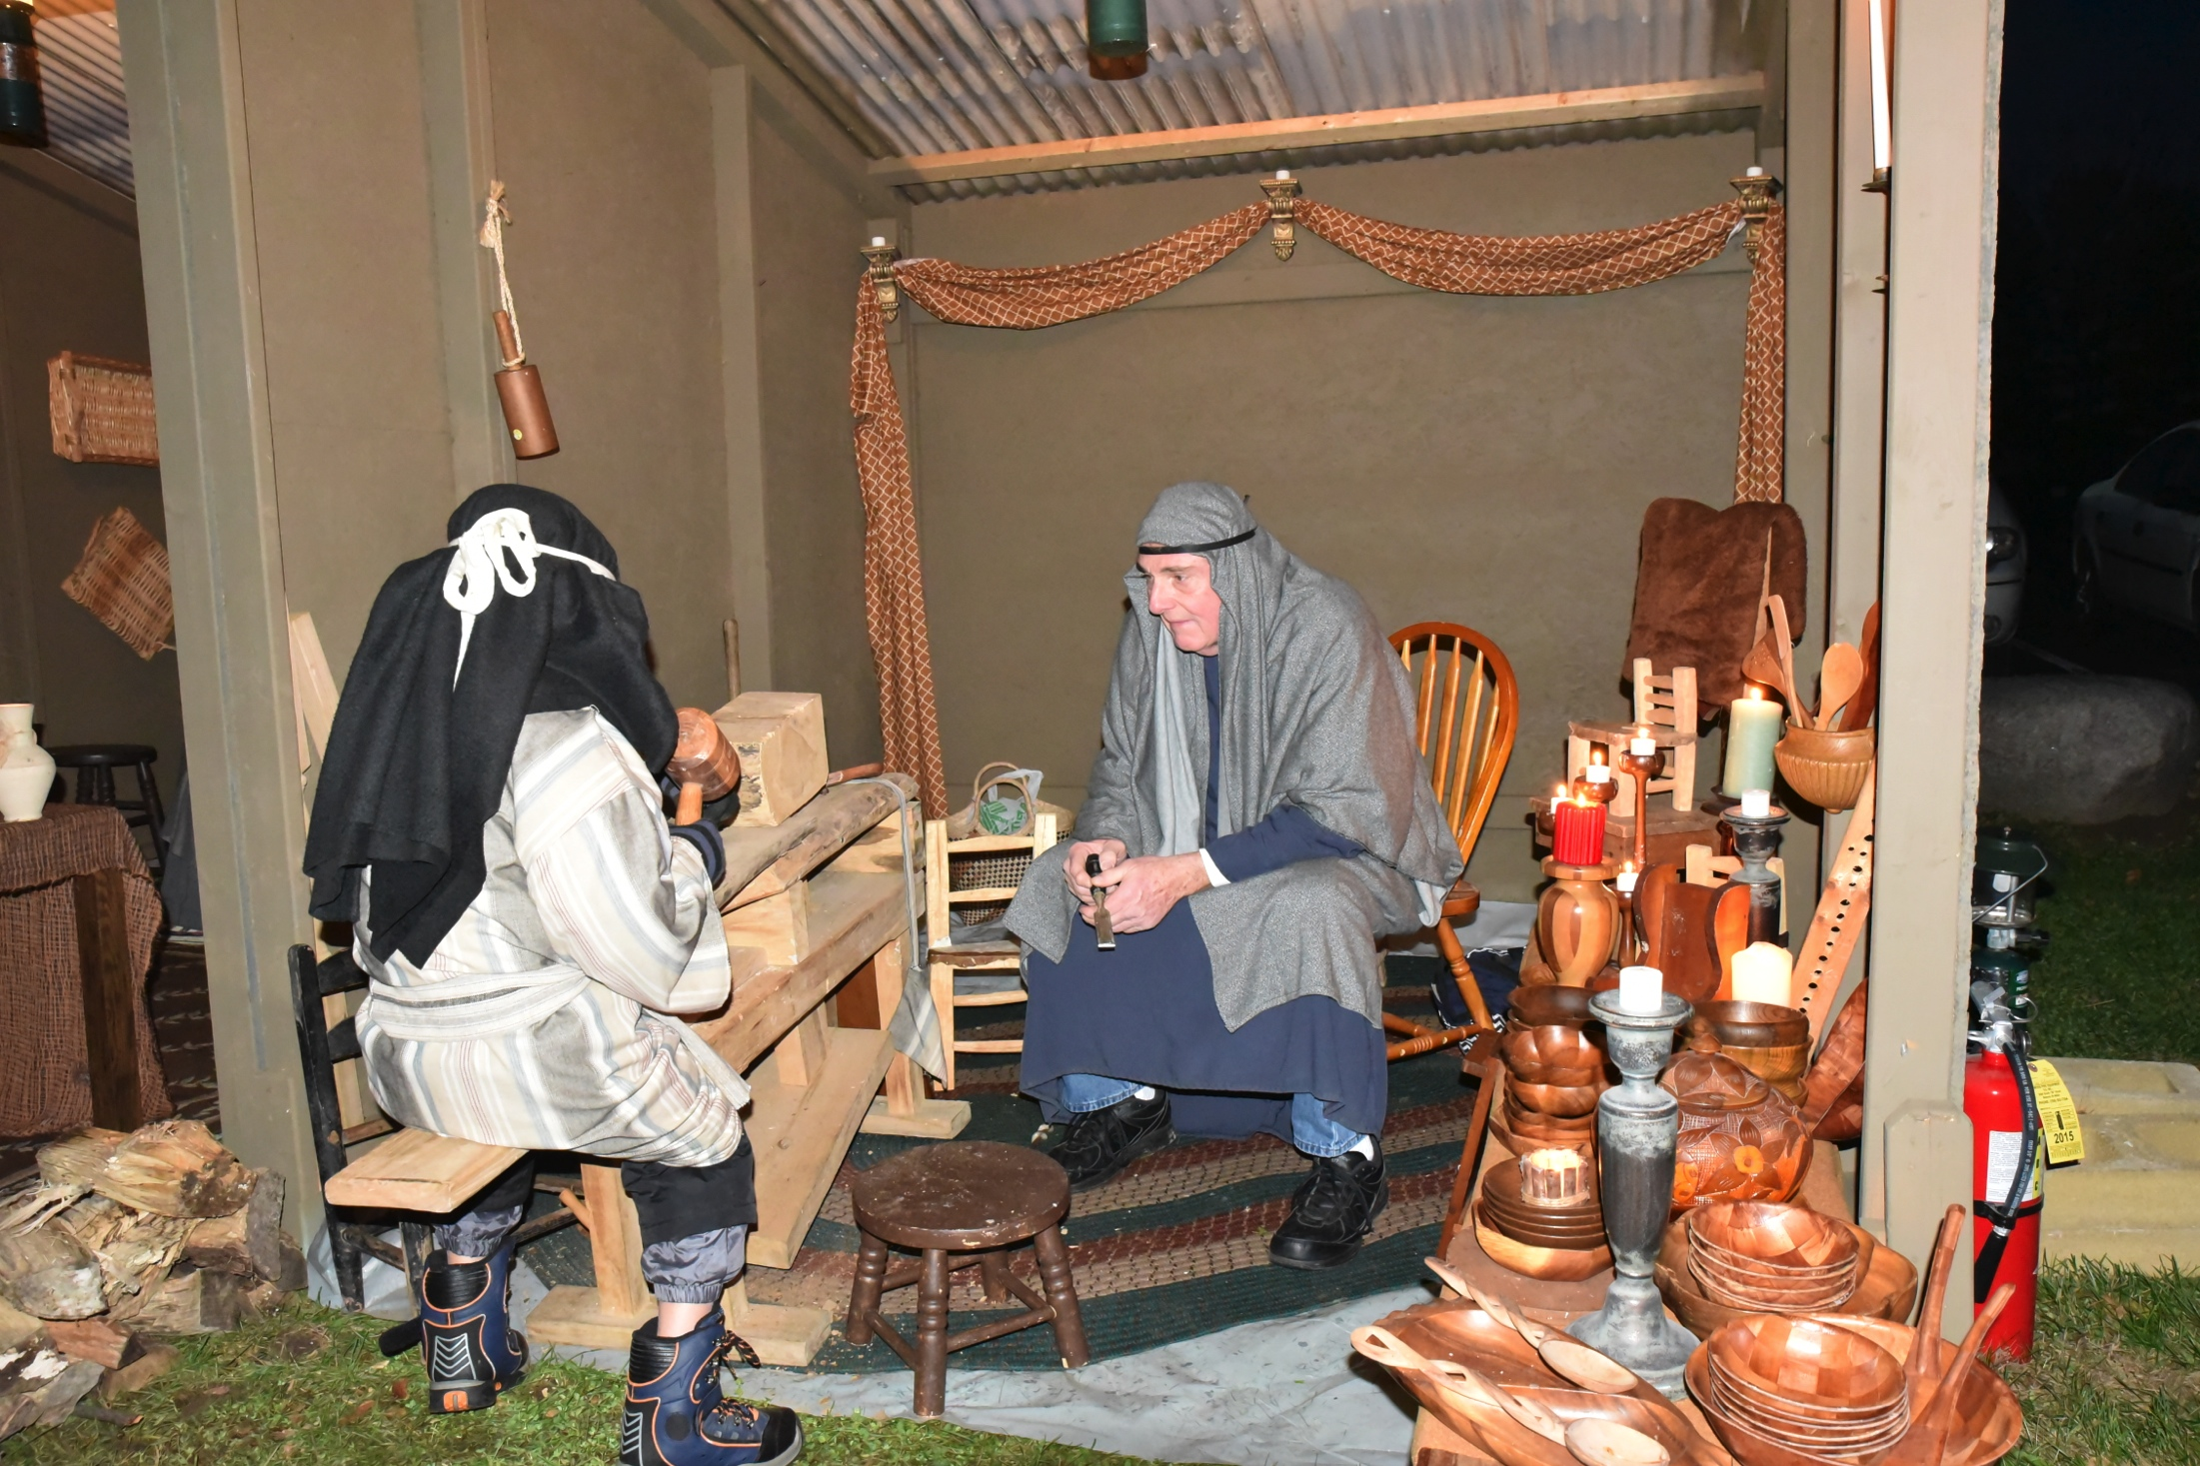

Slide 36
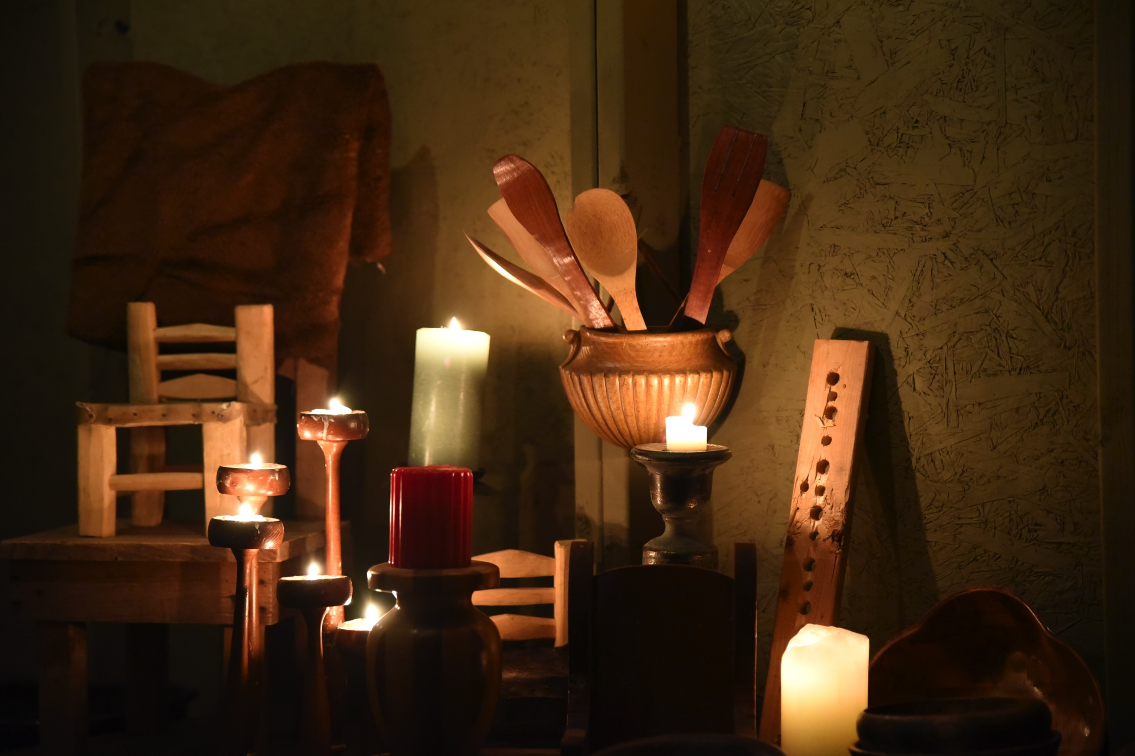

Slide 37
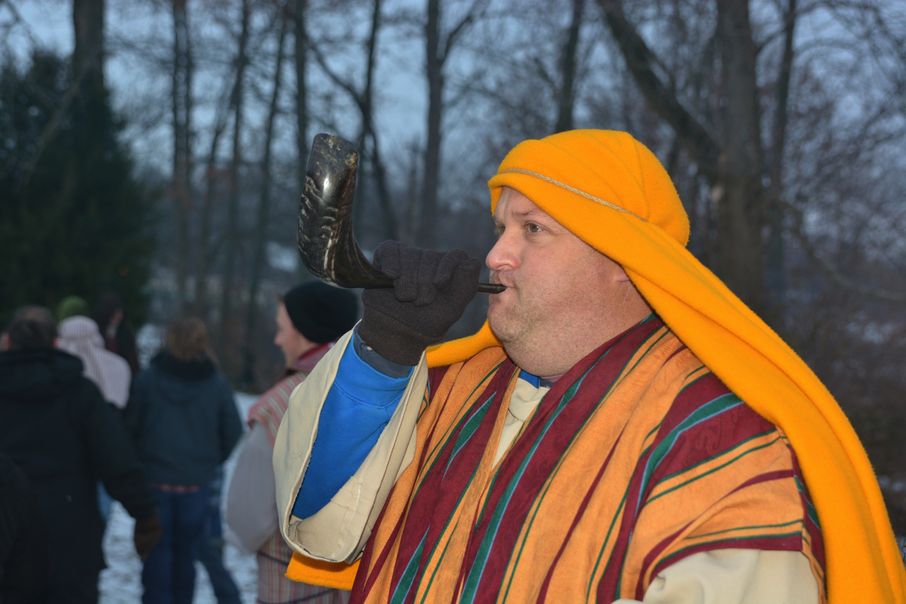

Slide 38
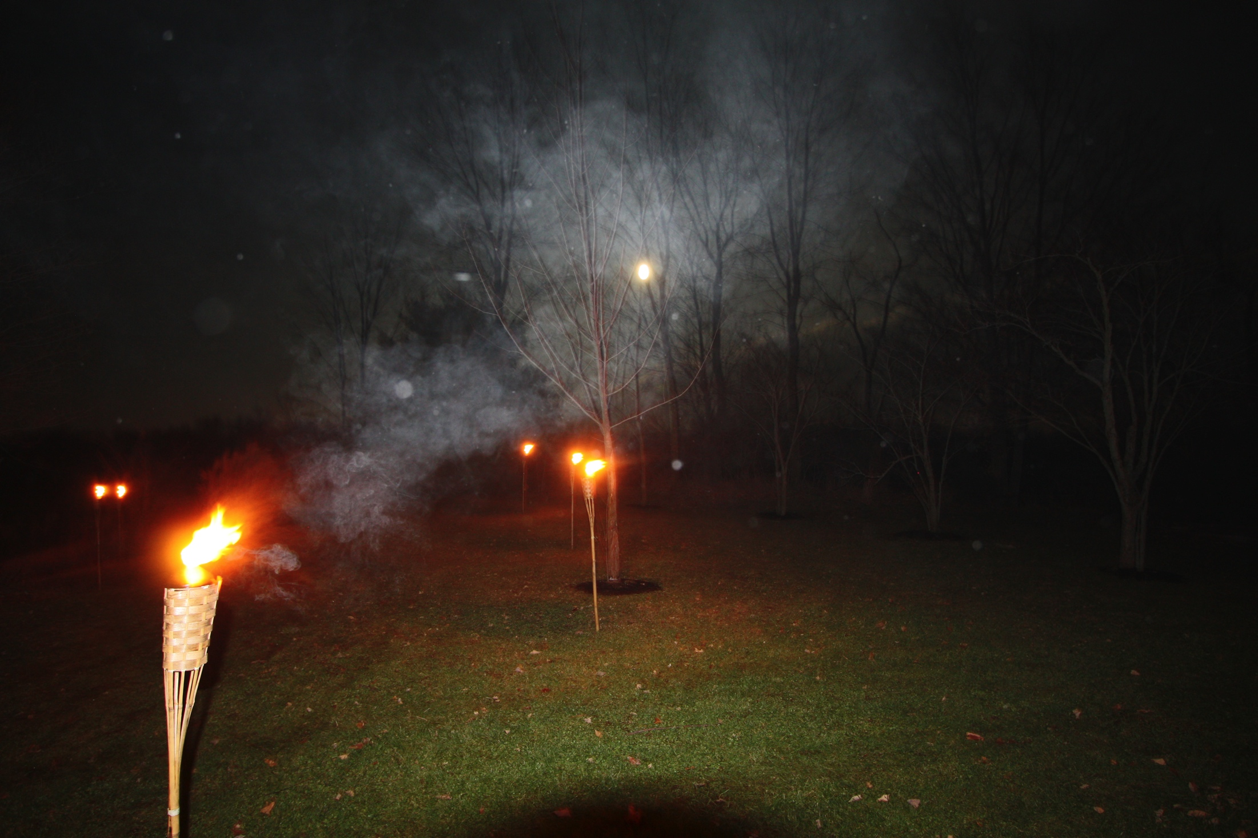

Slide 39
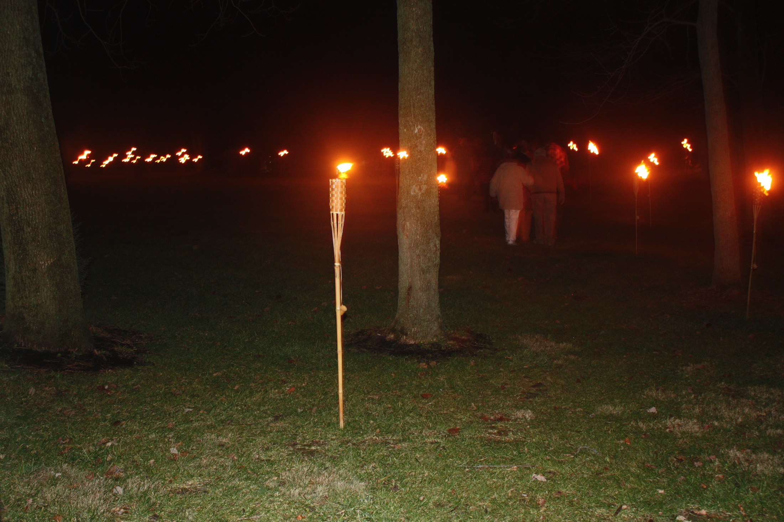

Slide 40
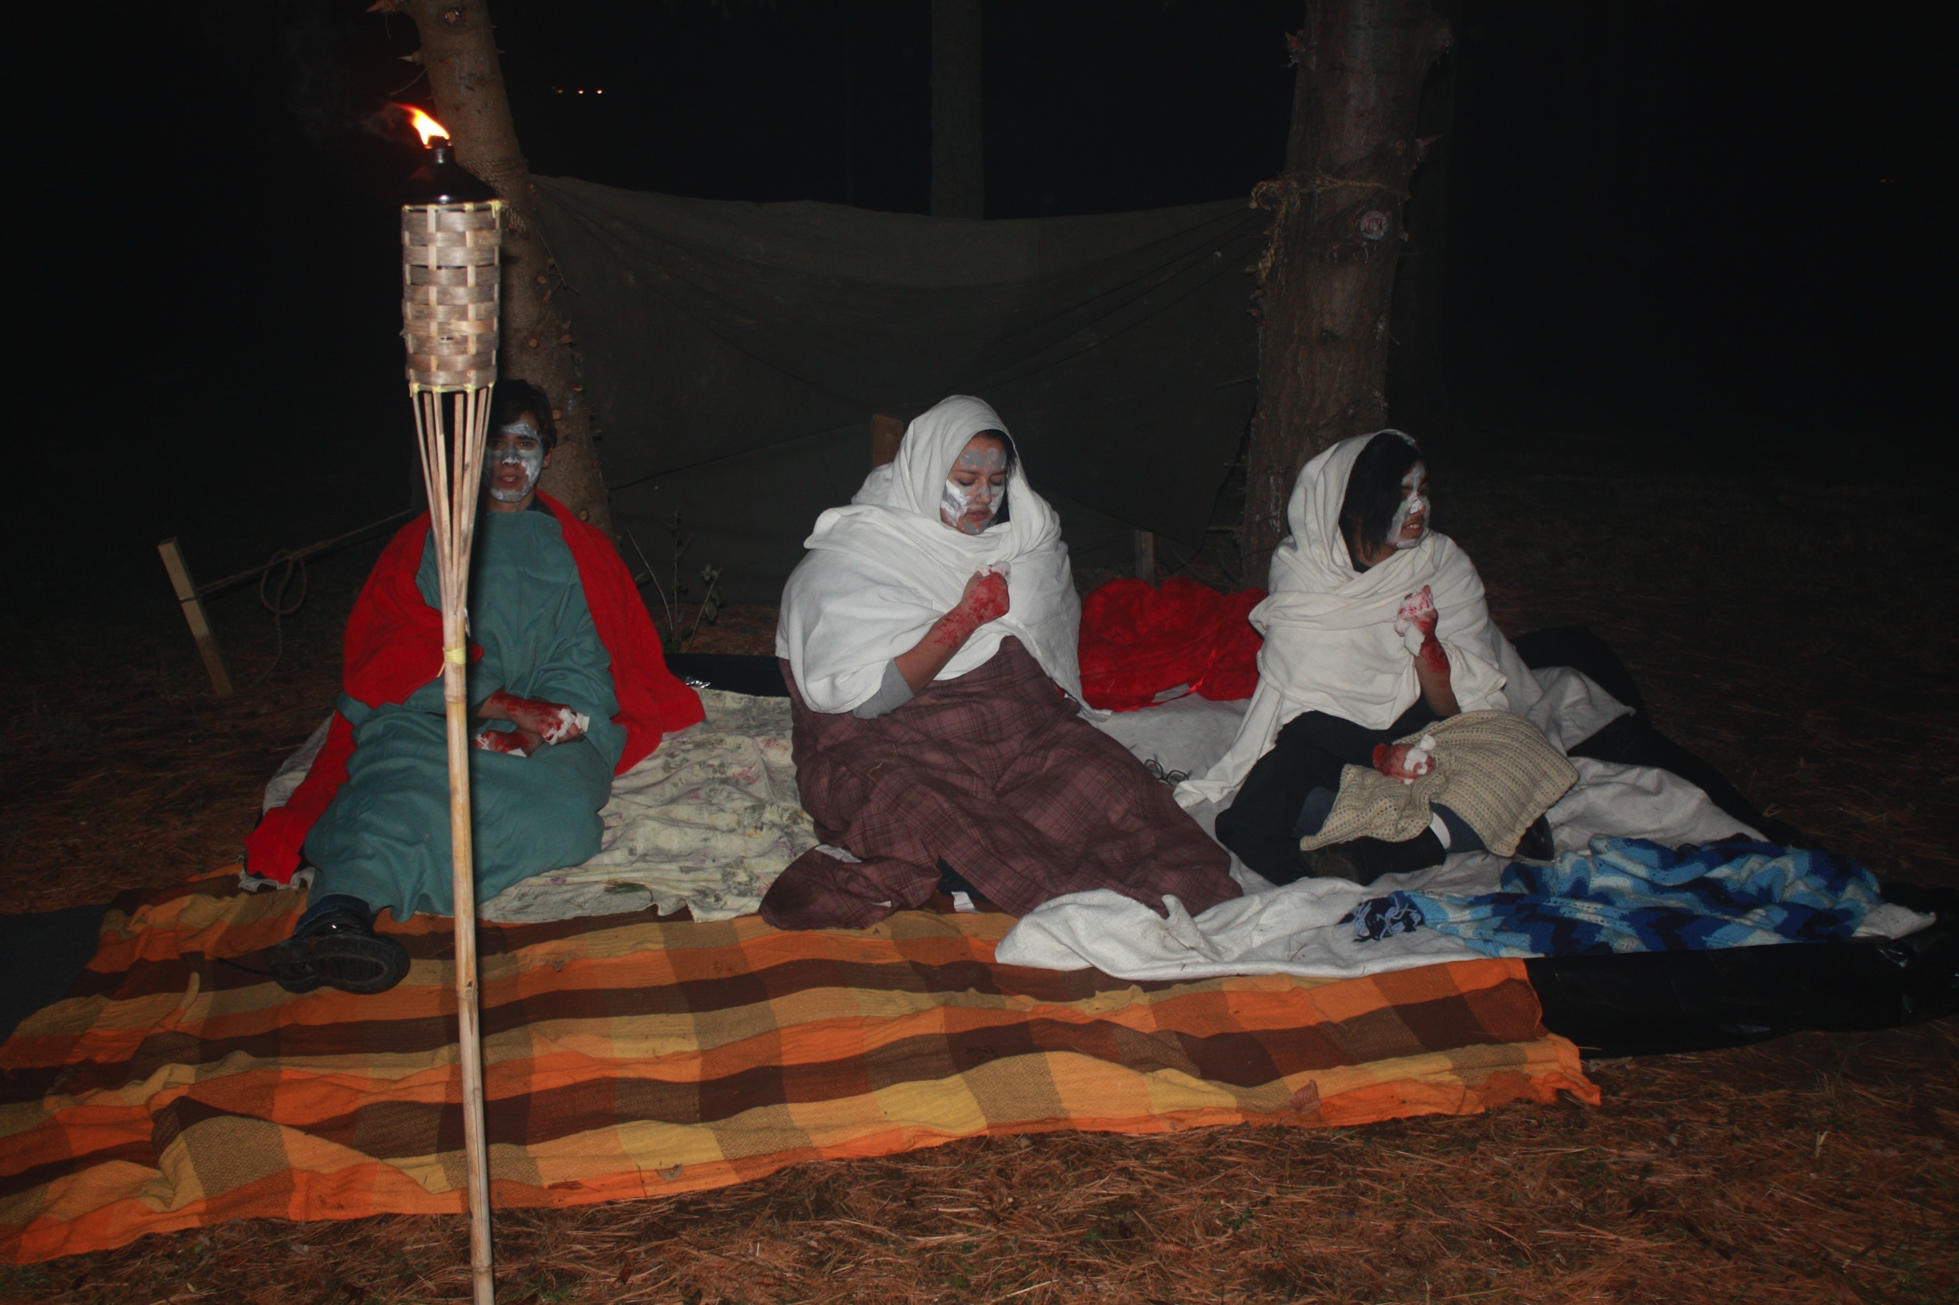

Slide 41
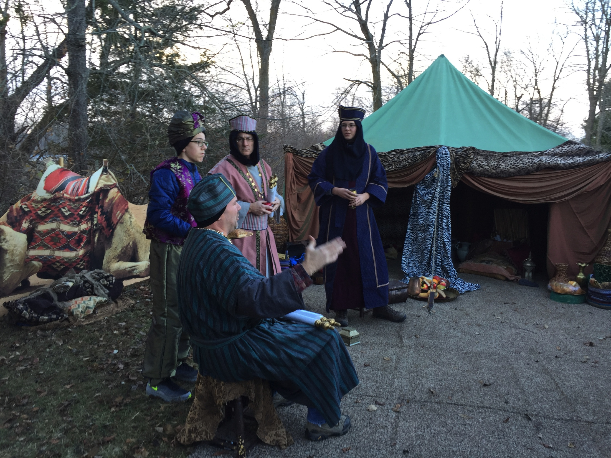

Slide 42
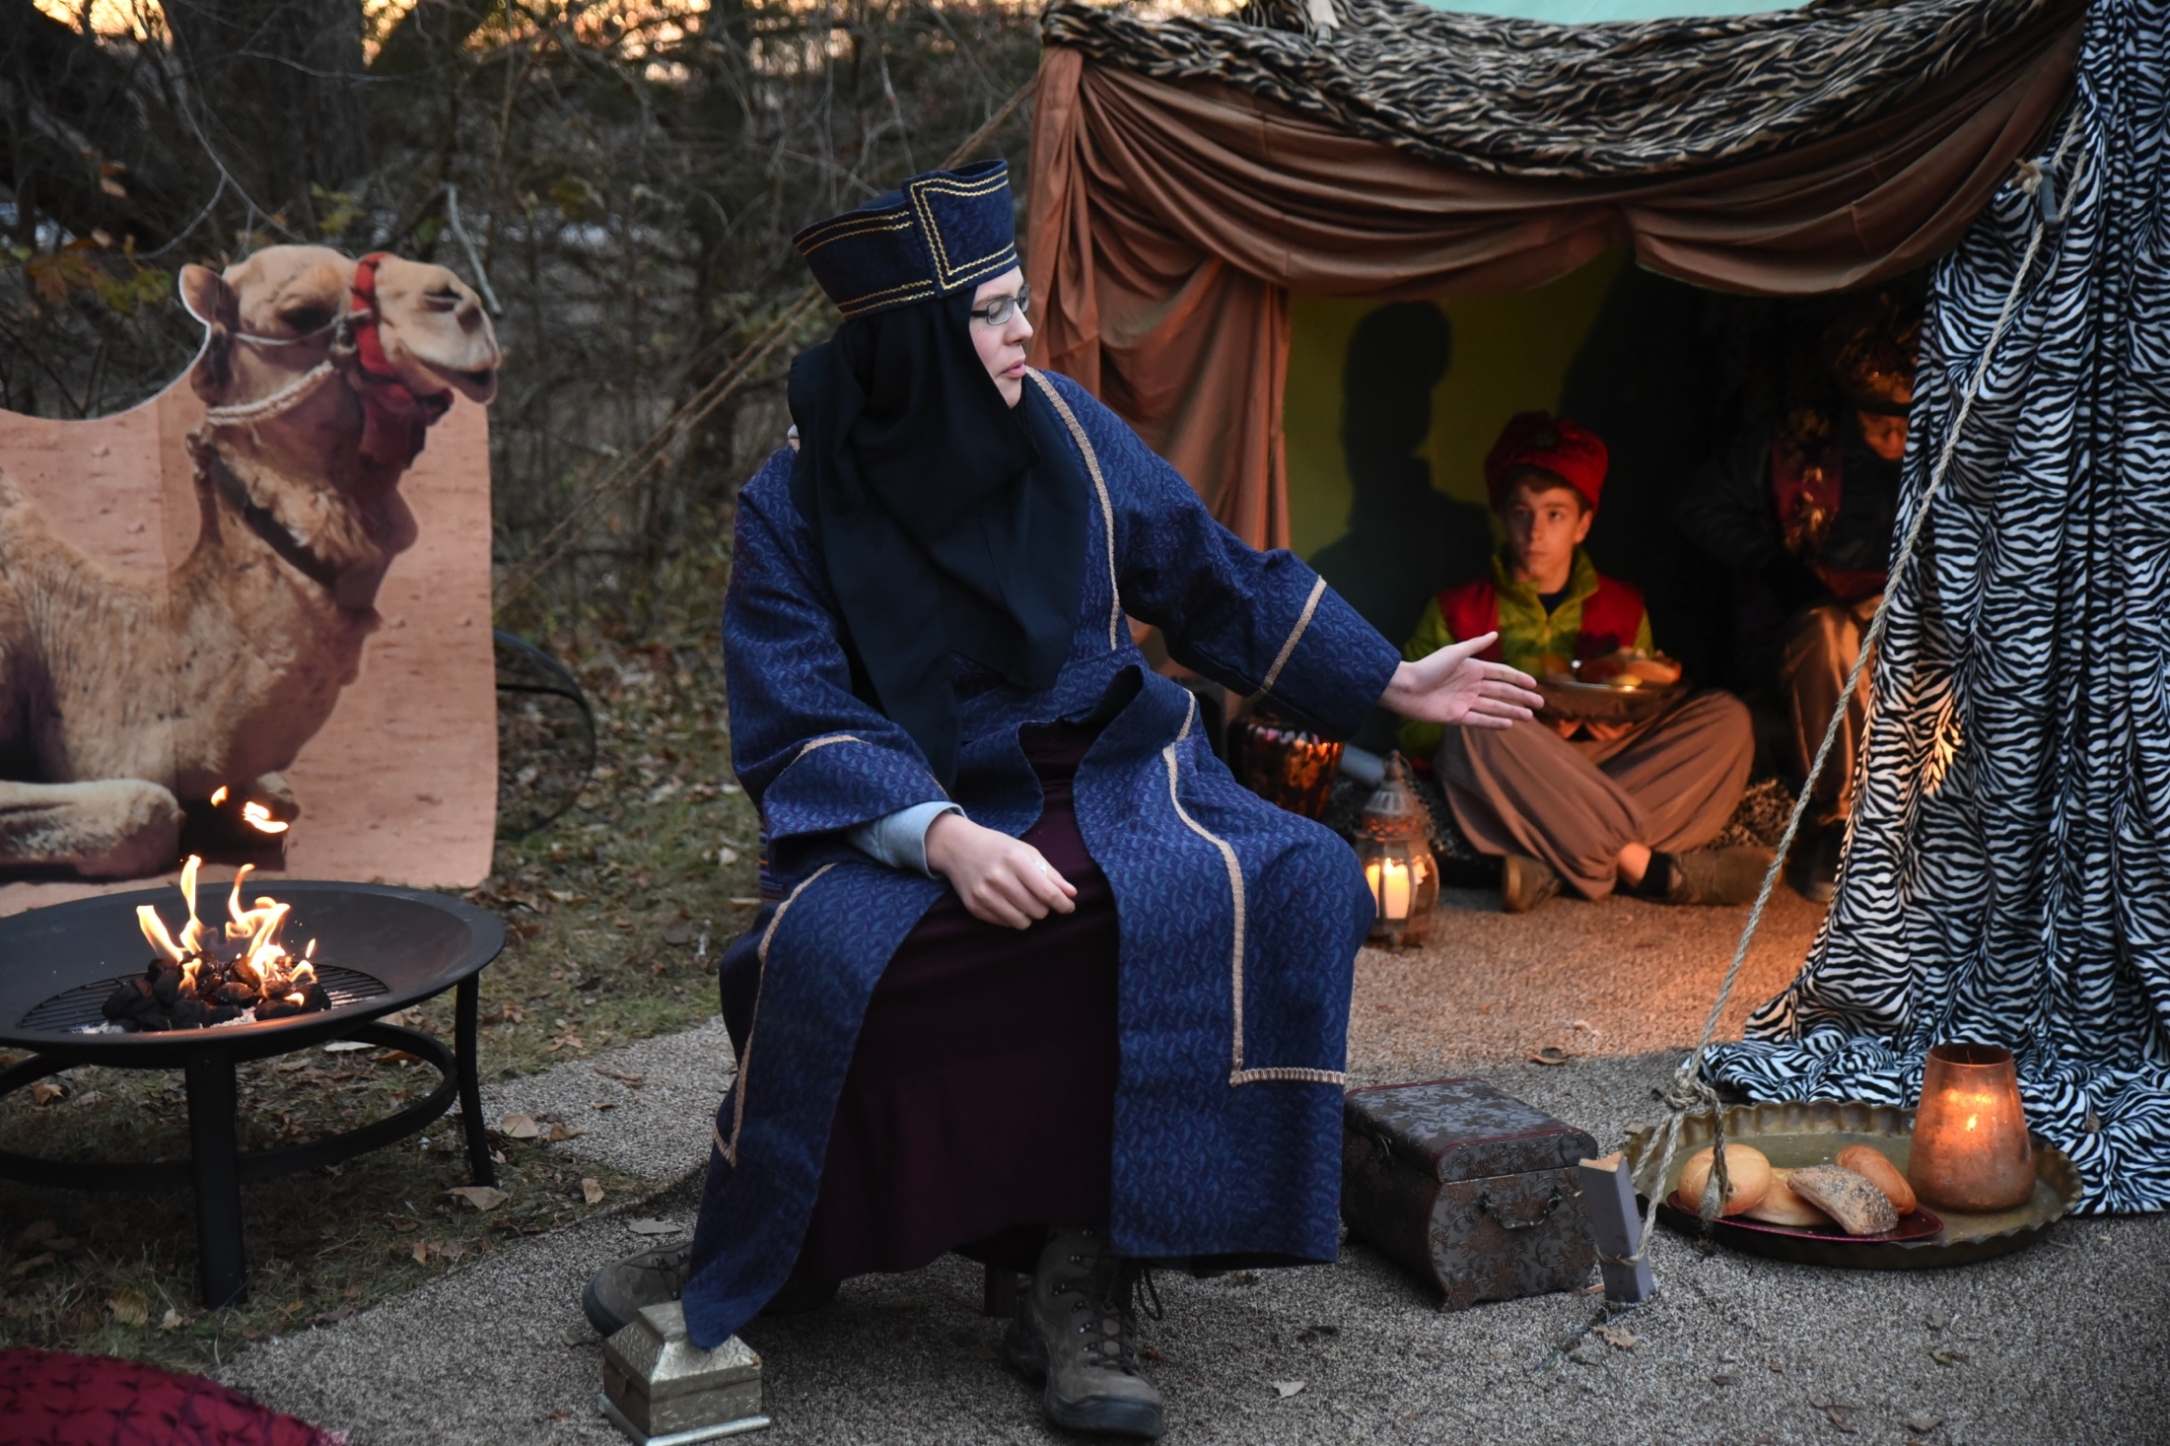

Slide 43
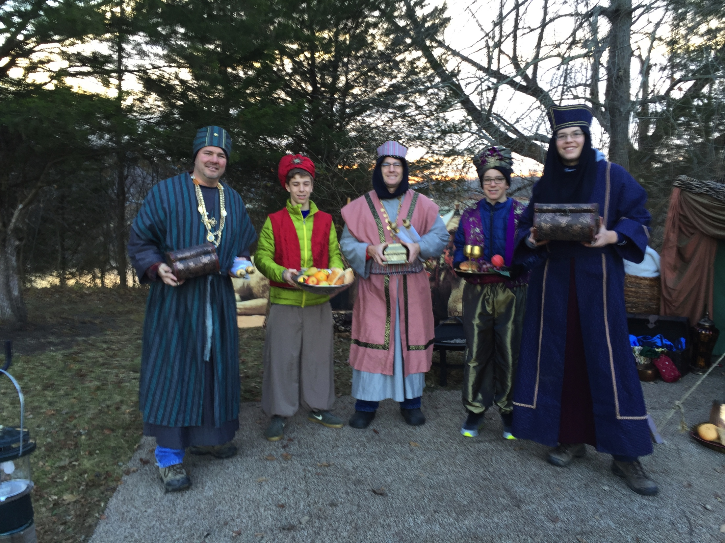

Slide 44
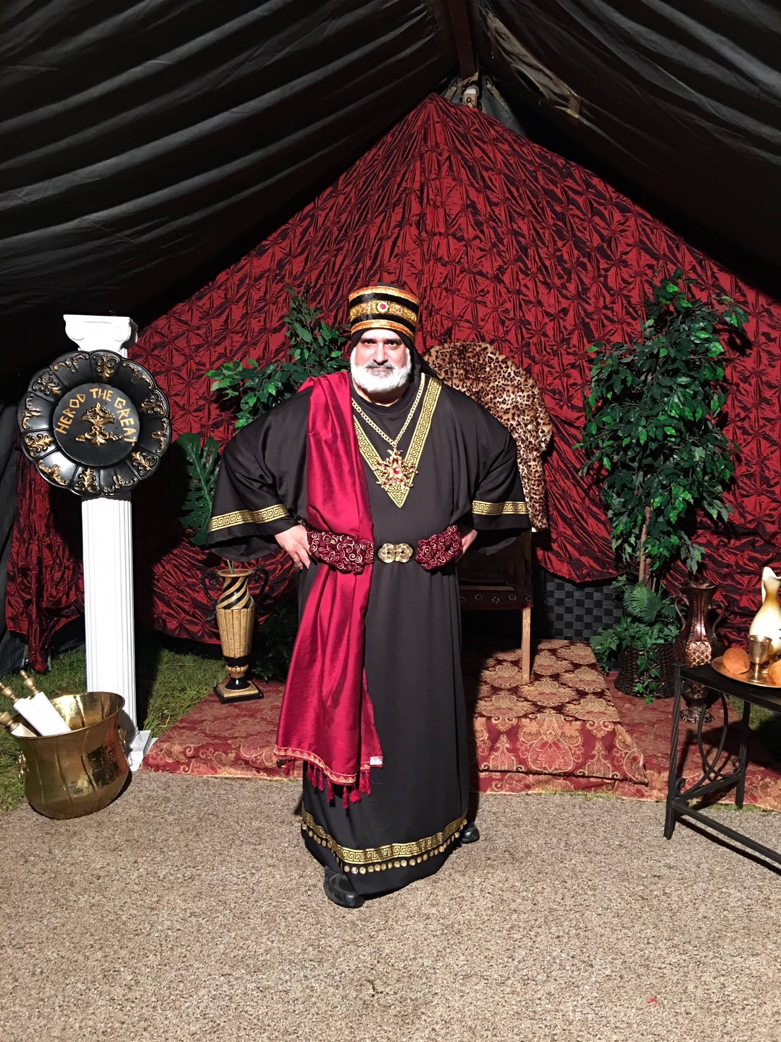

Slide 45
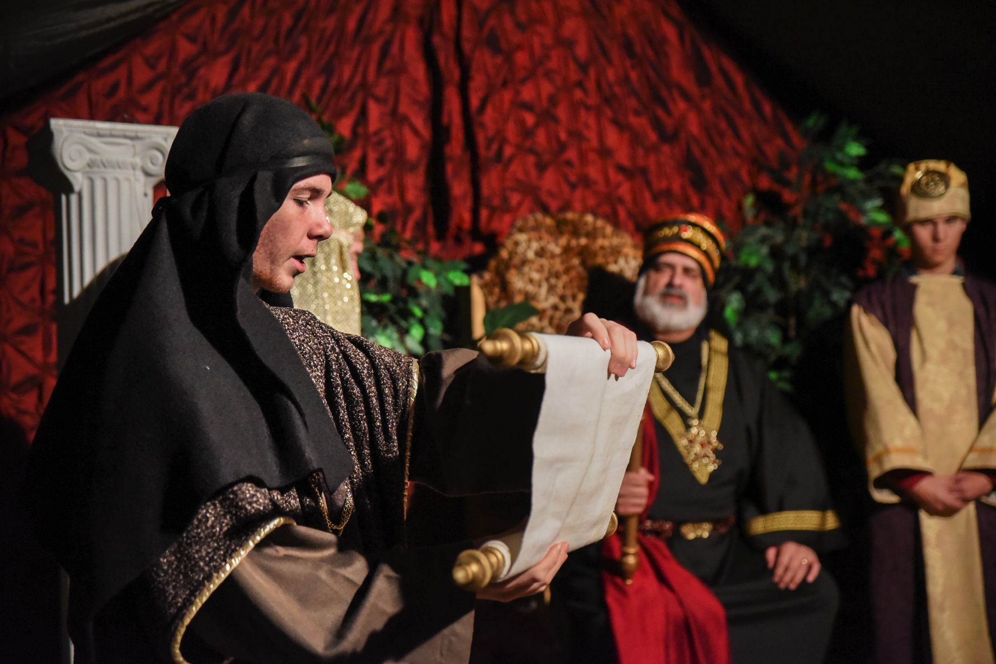

Slide 46
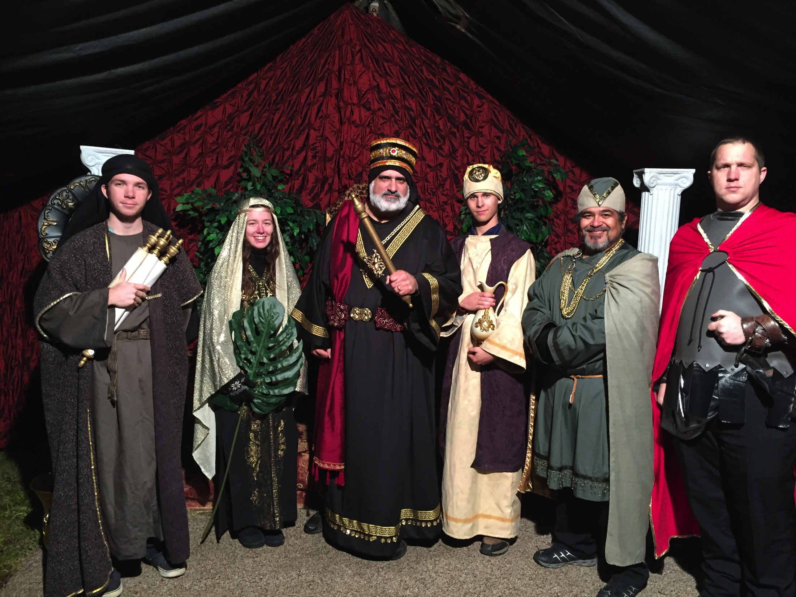

Slide 47
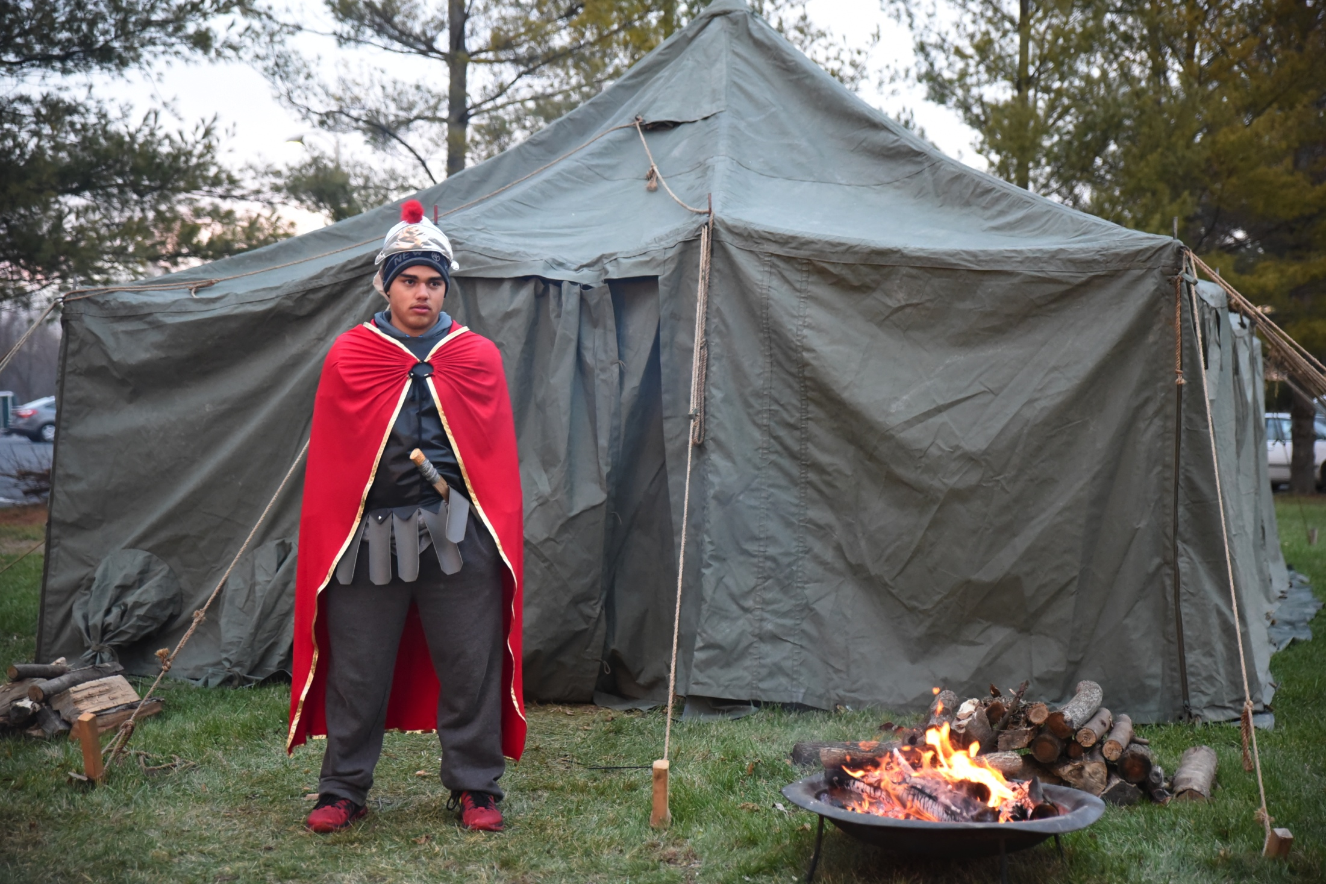

Slide 48
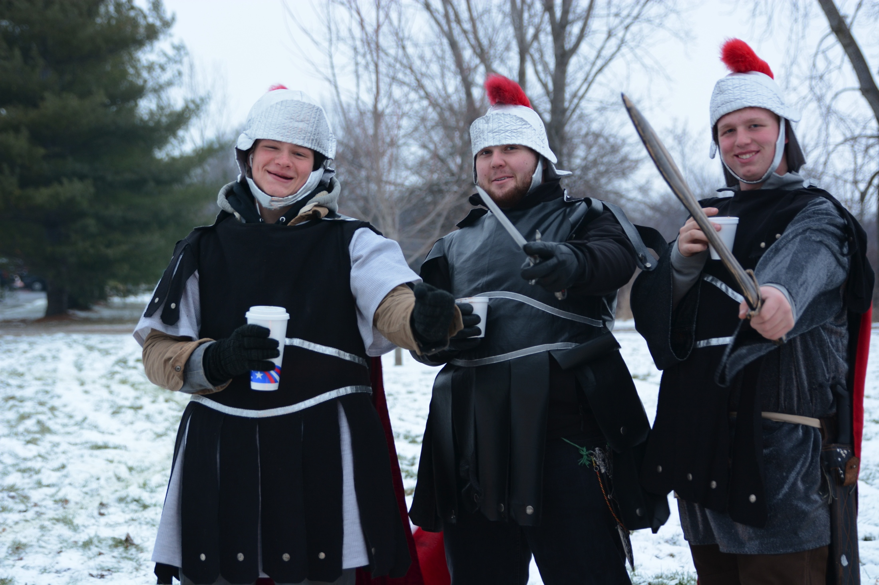

Slide 49
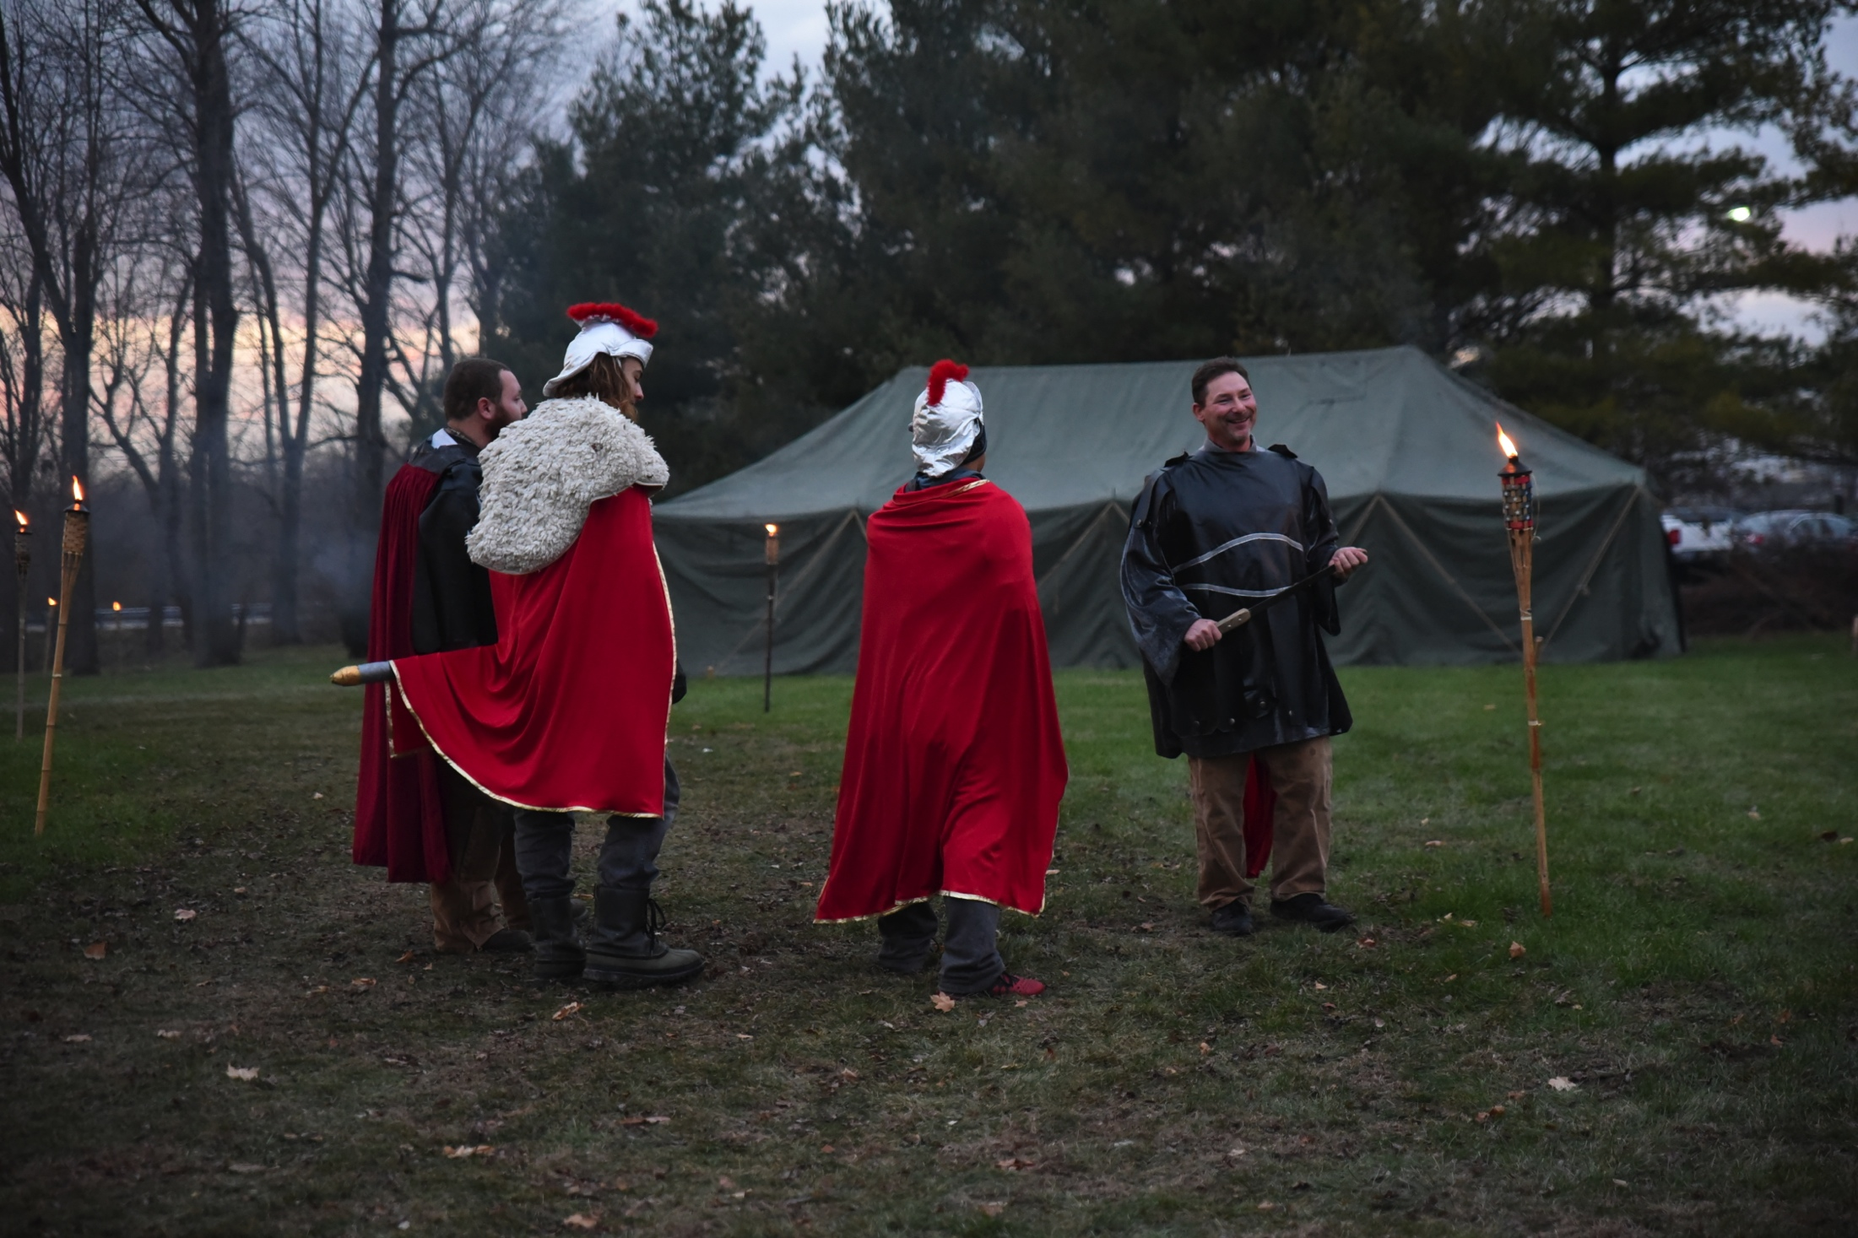

Slide 50
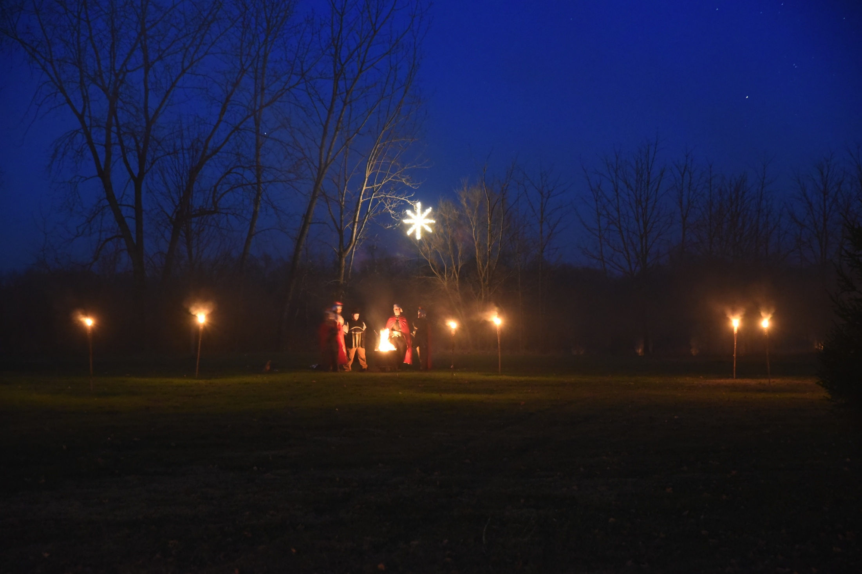

Slide 51
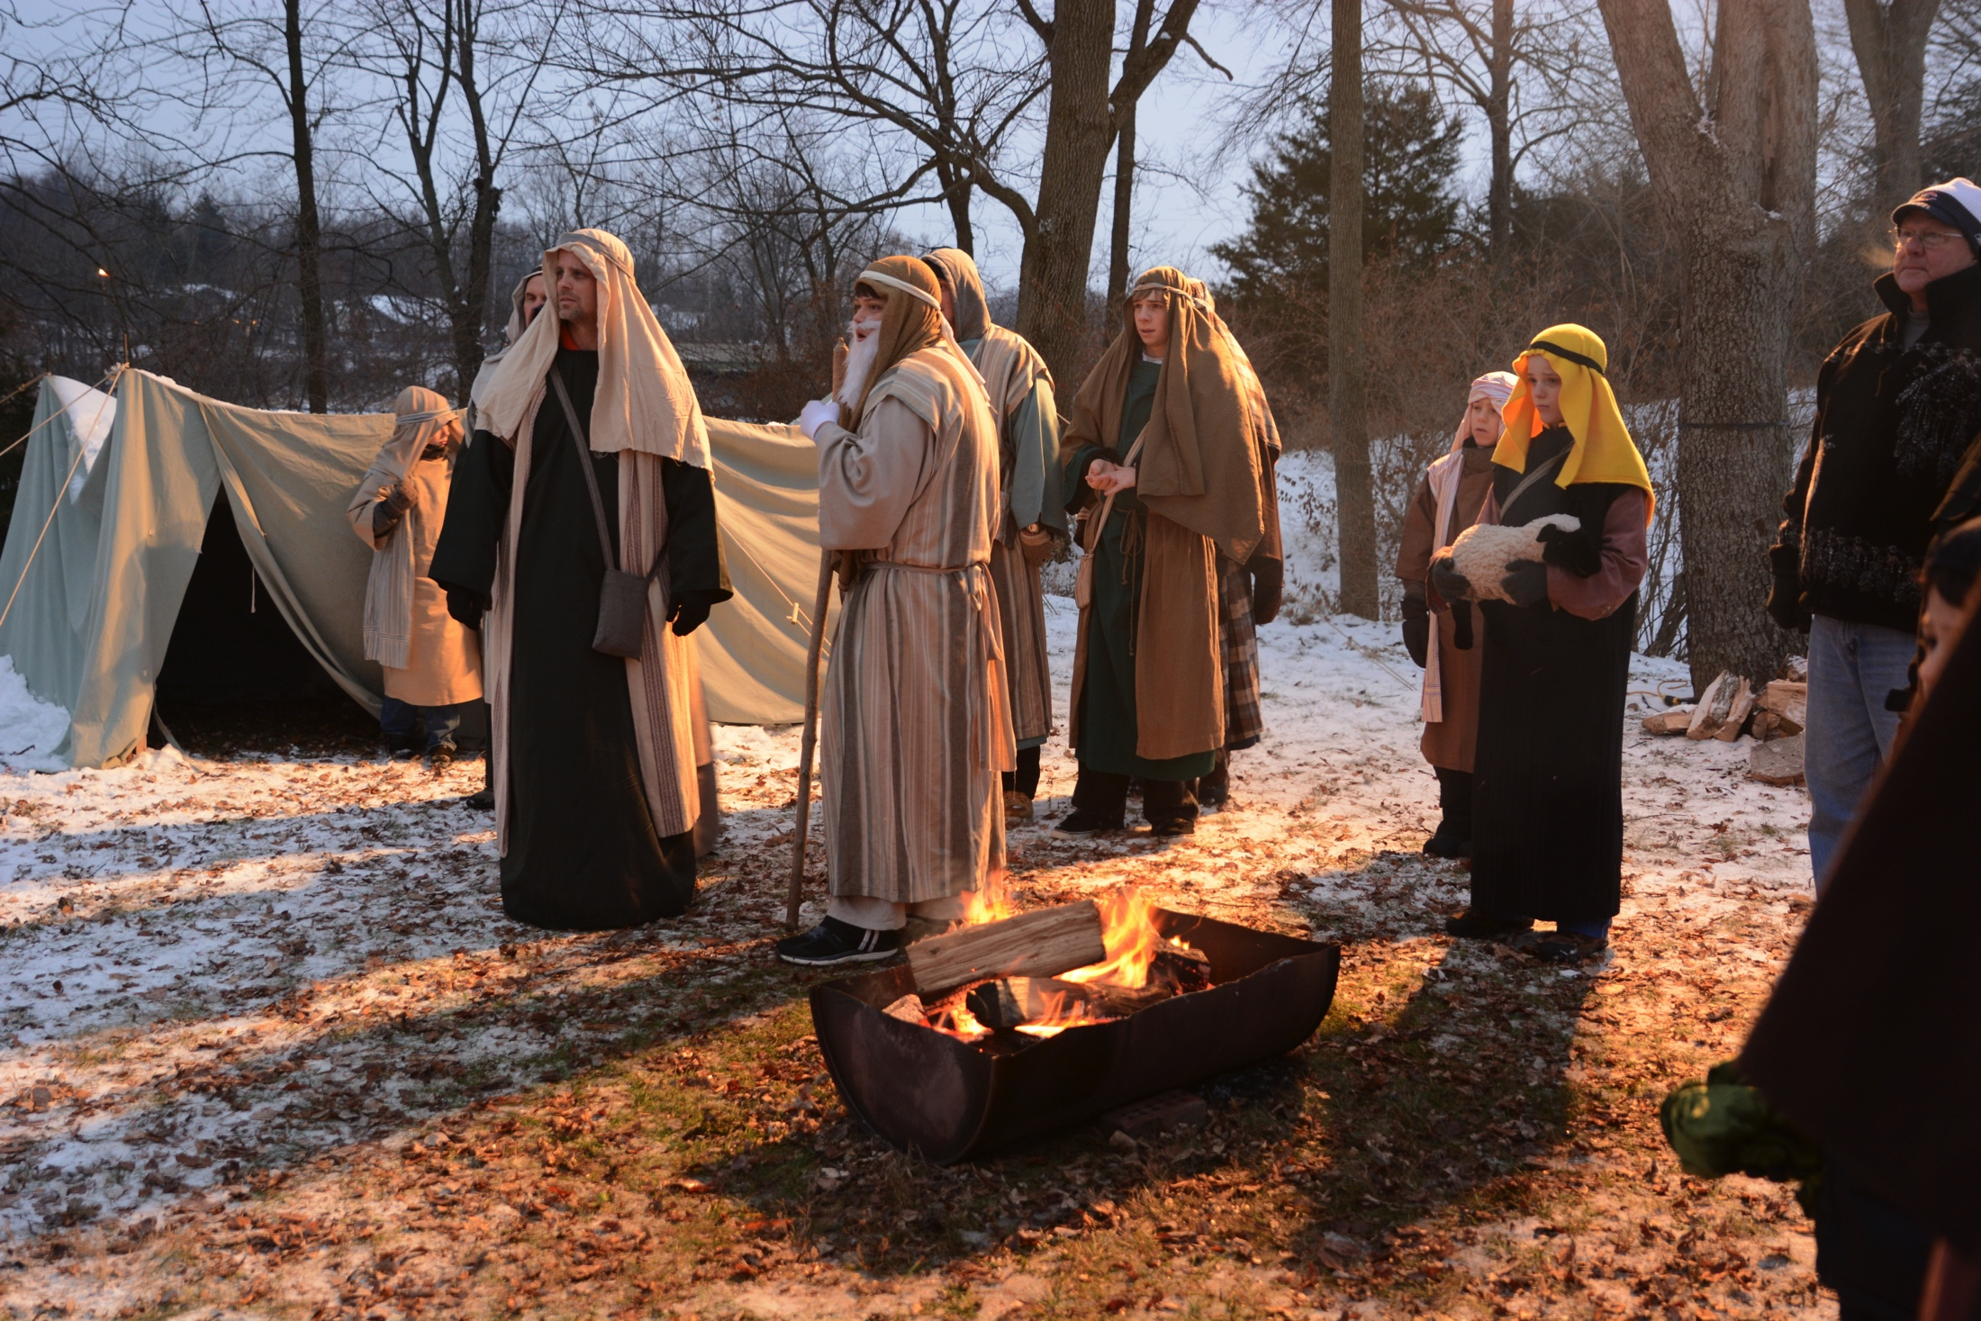

Slide 52
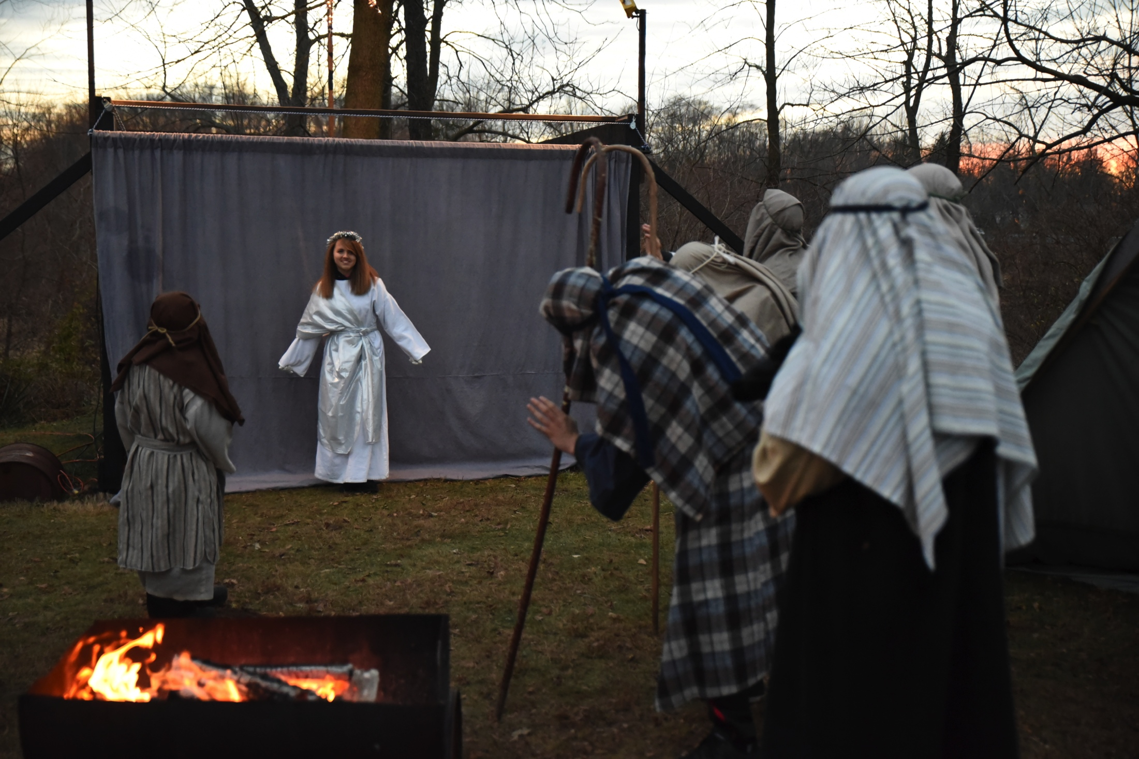

Slide 53
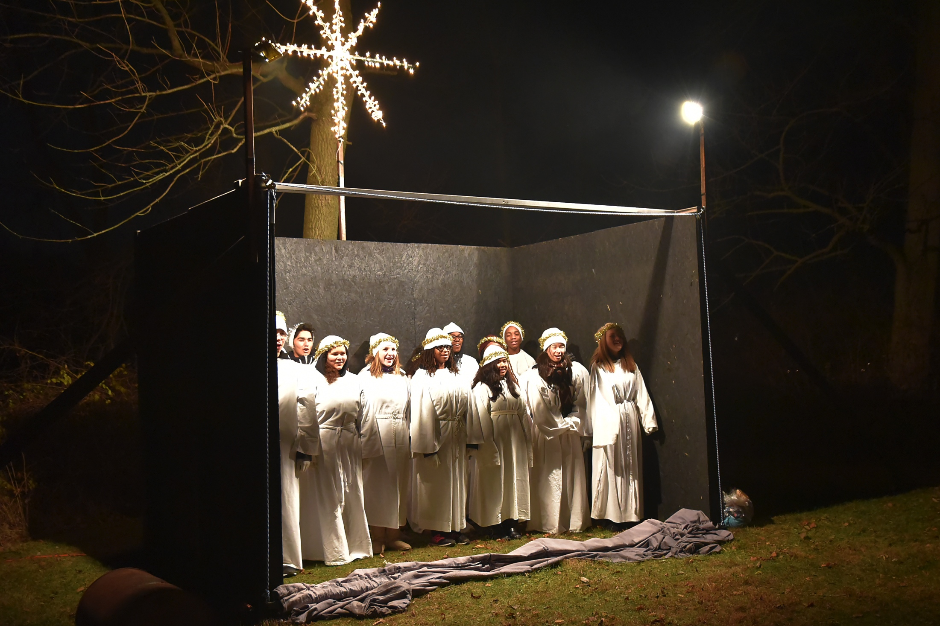

Slide 54
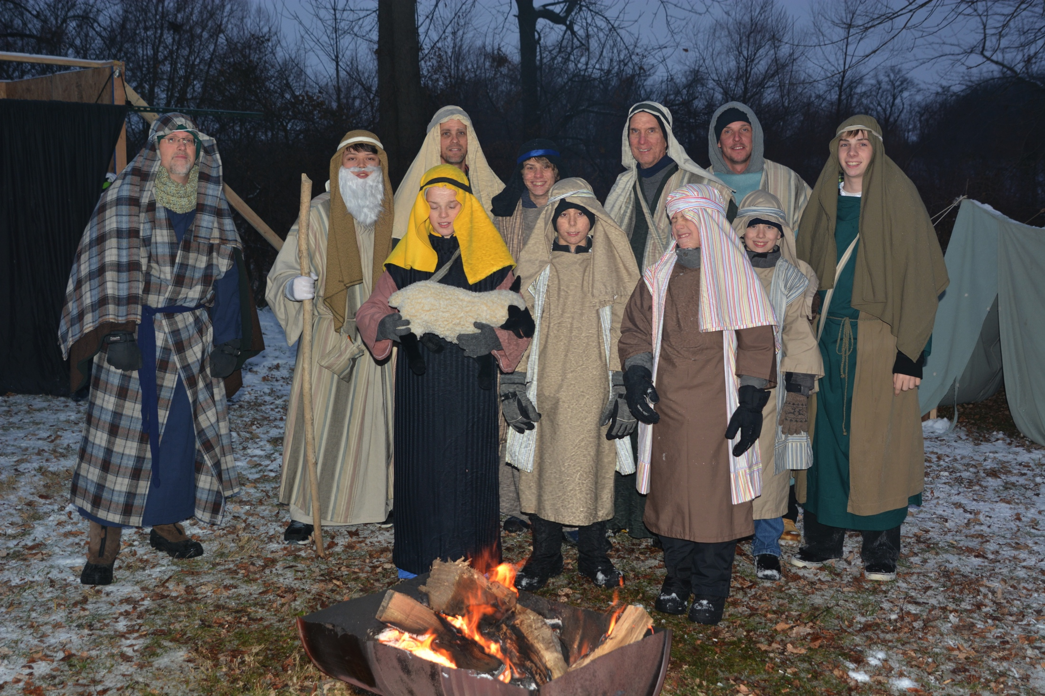

Slide 55
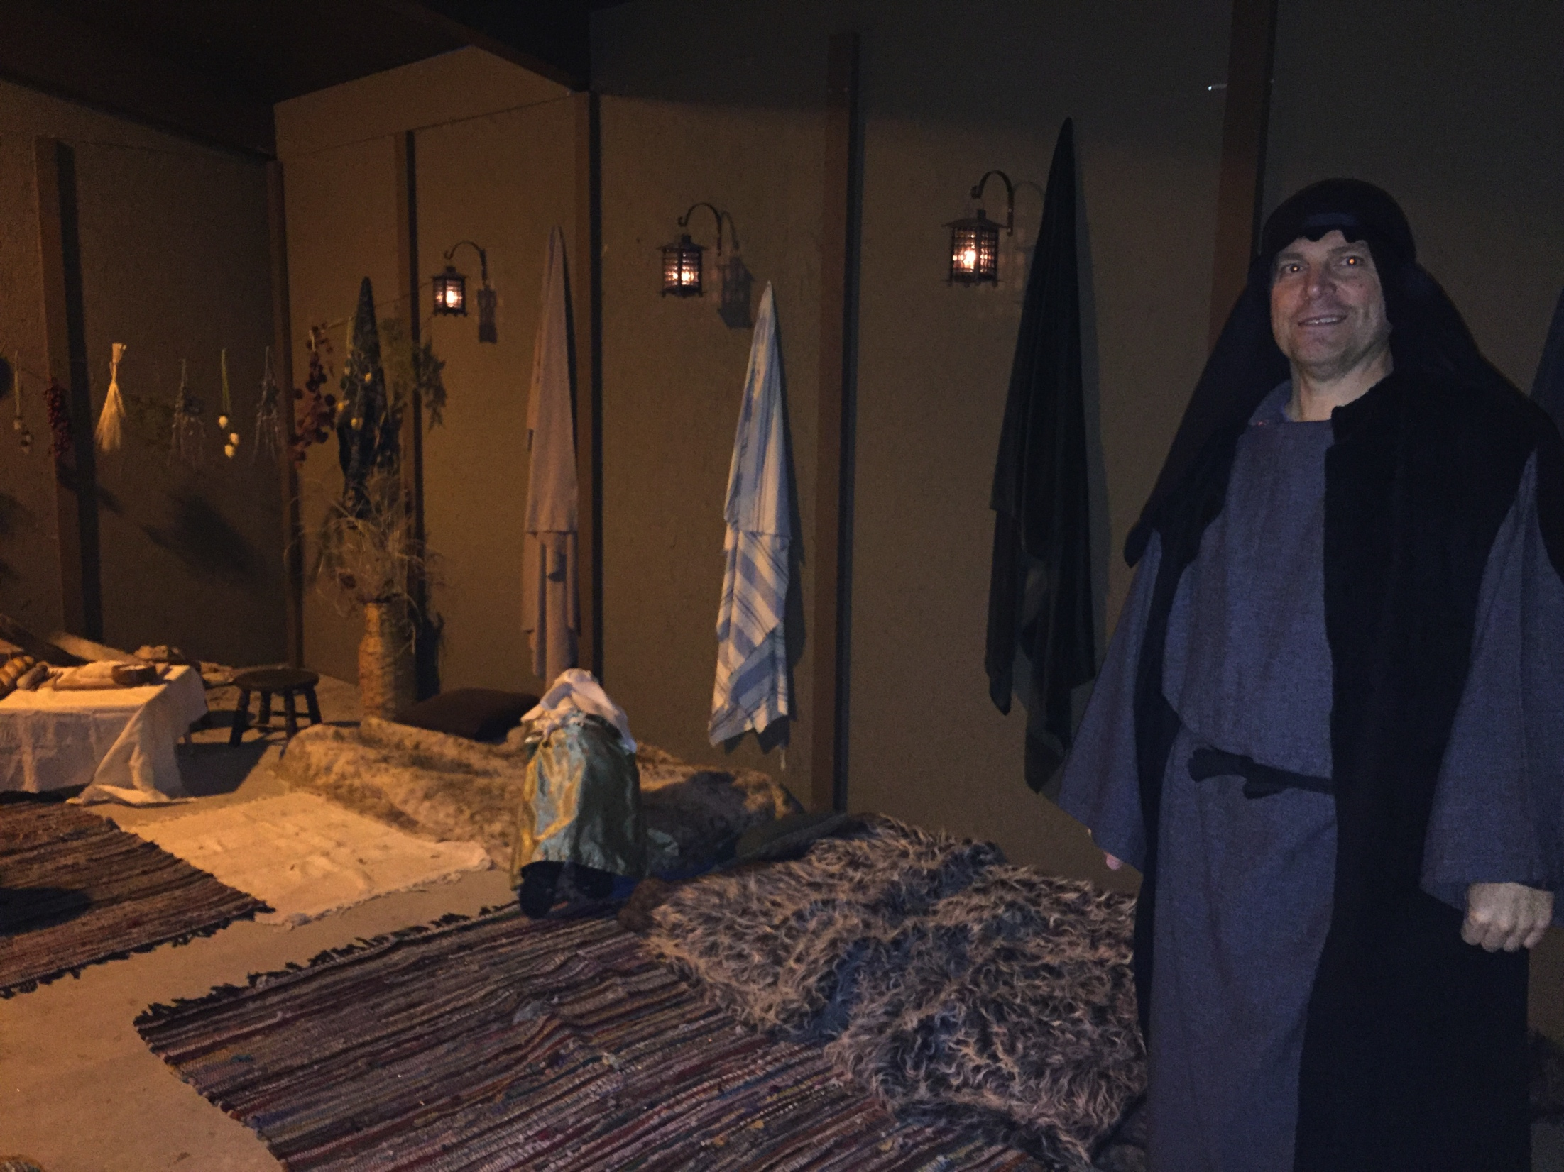

Slide 56
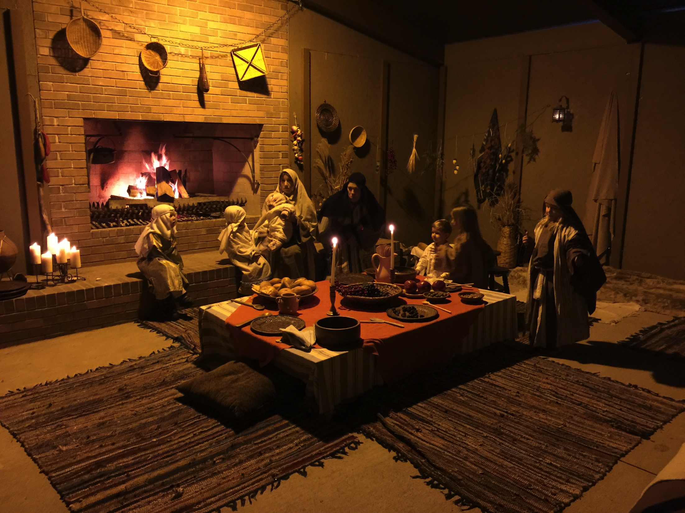

Slide 57
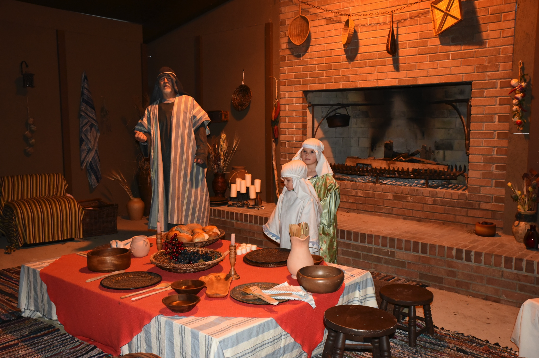

Slide 58
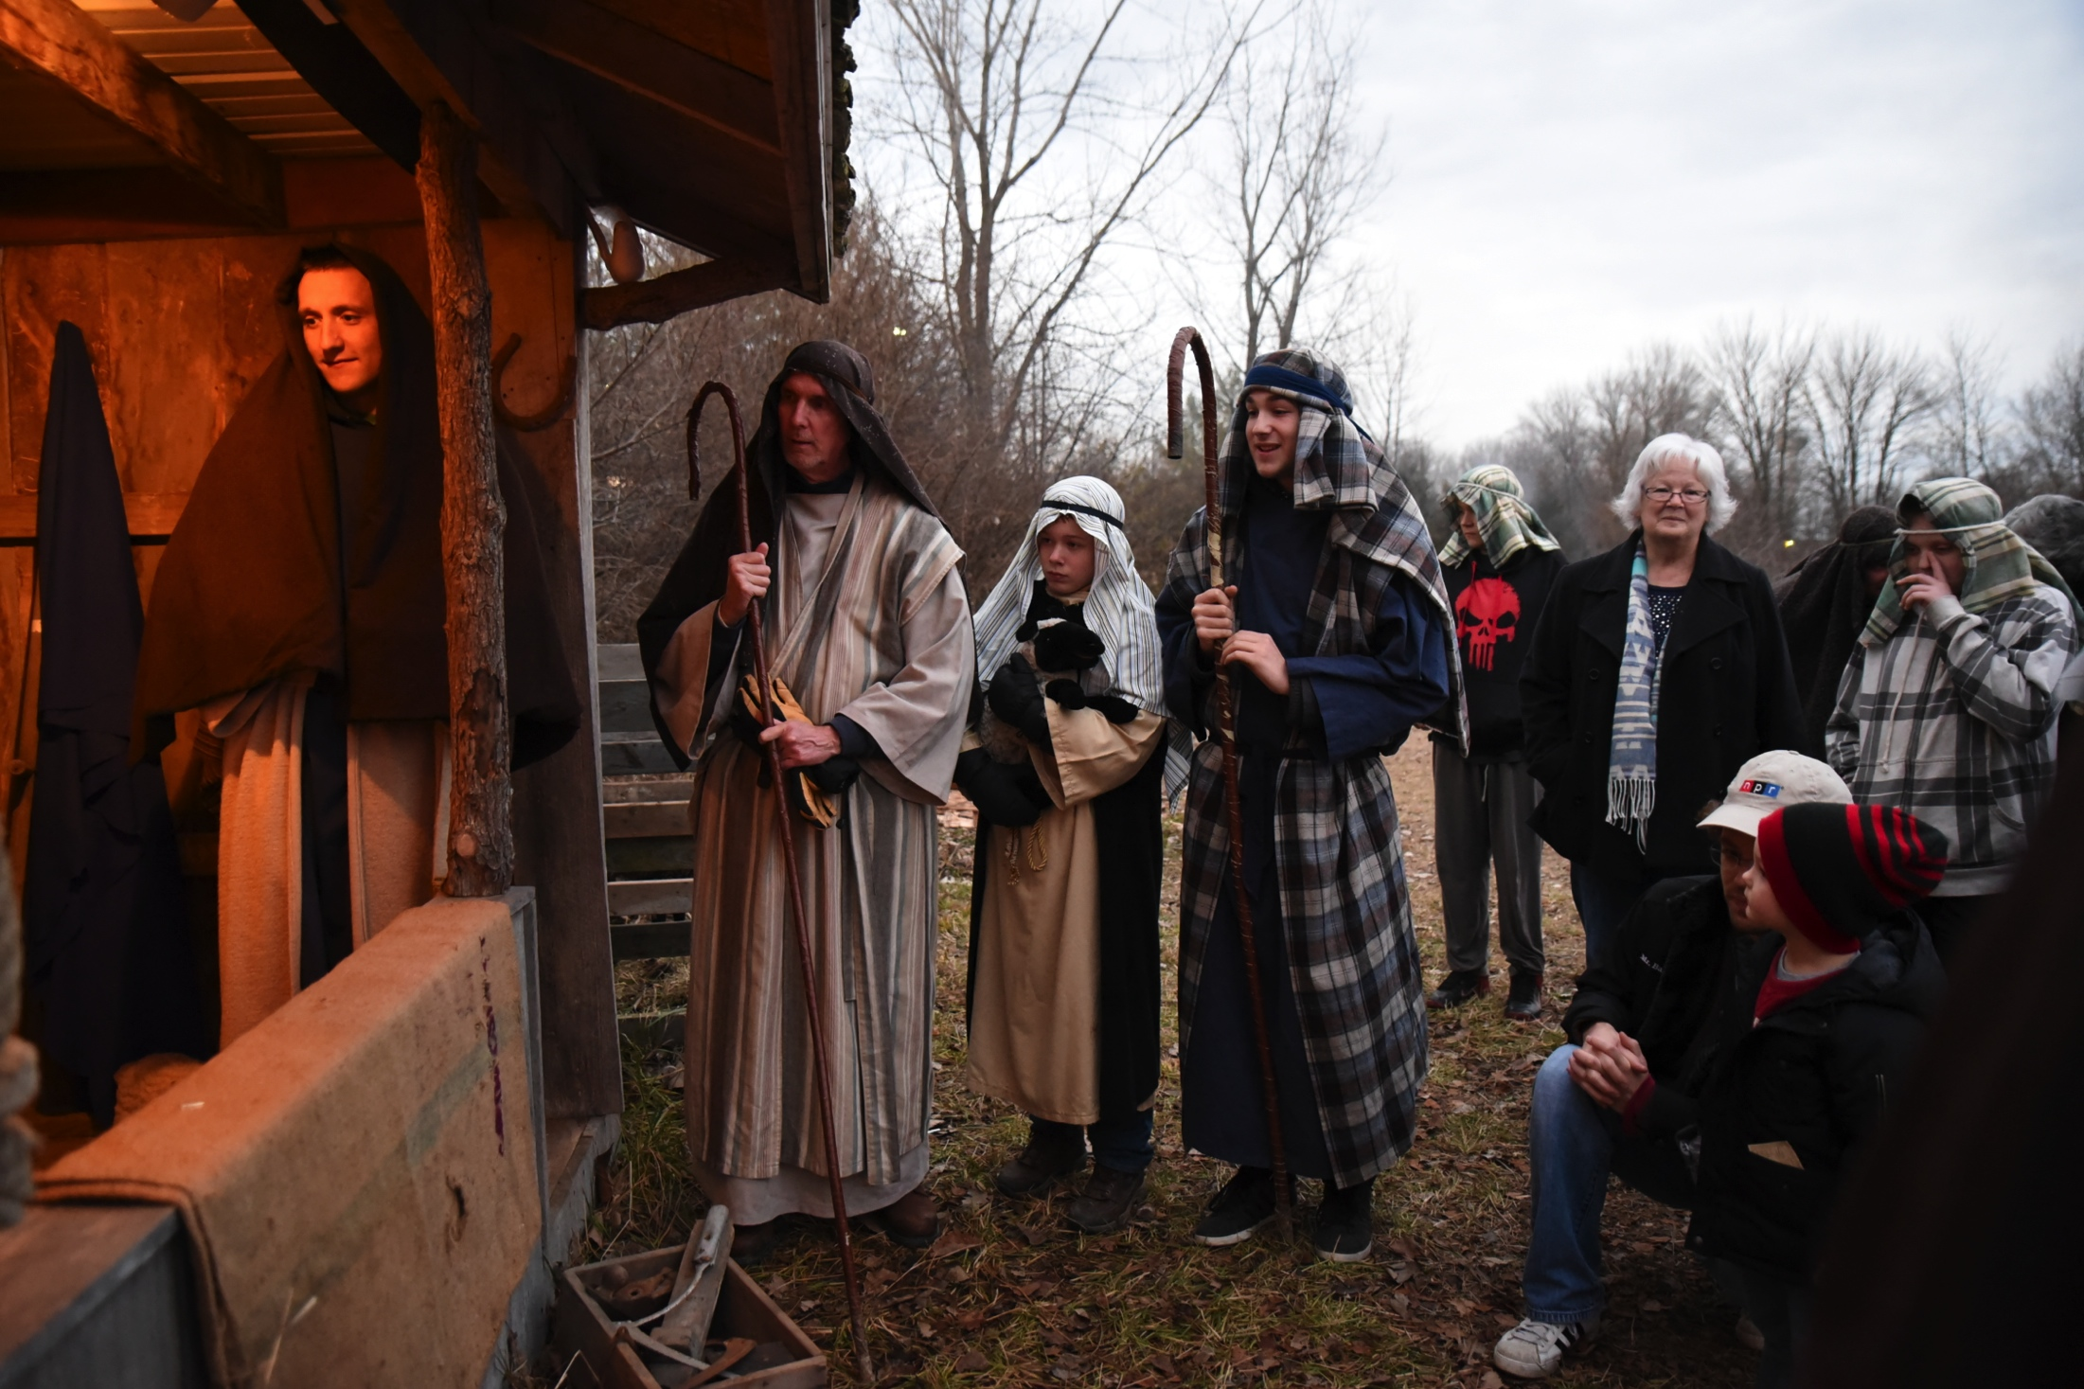

Slide 59
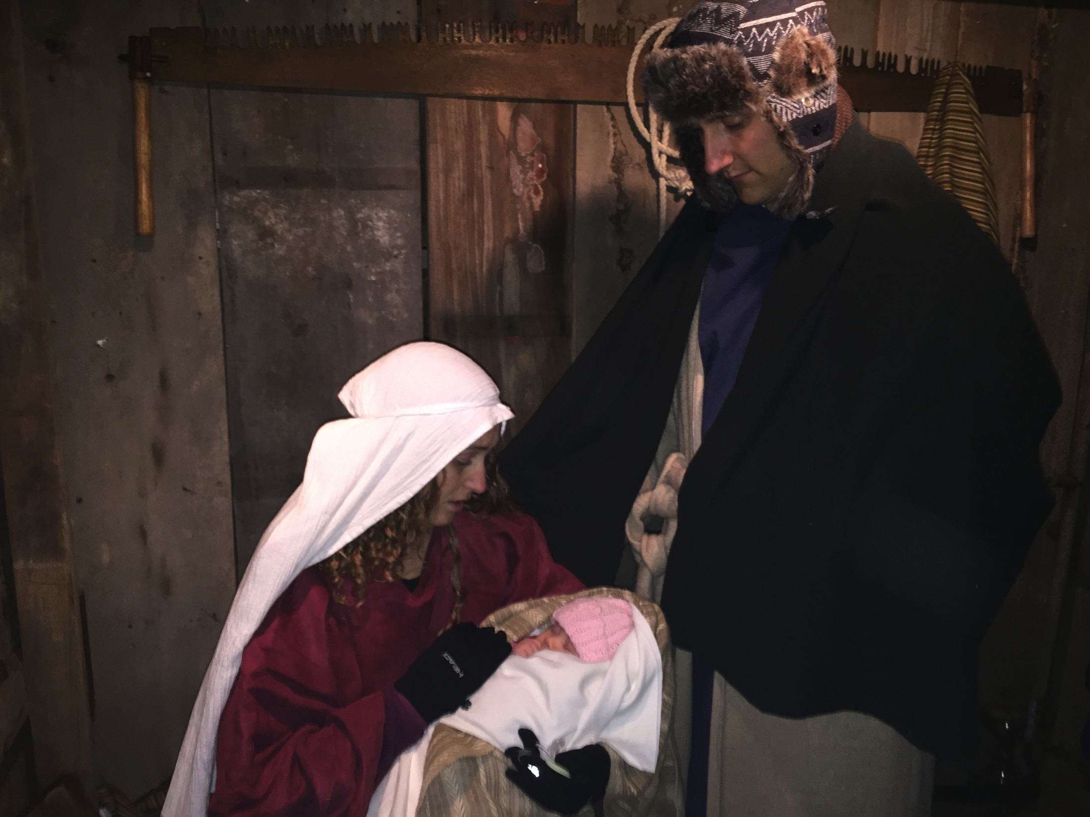

Slide 60
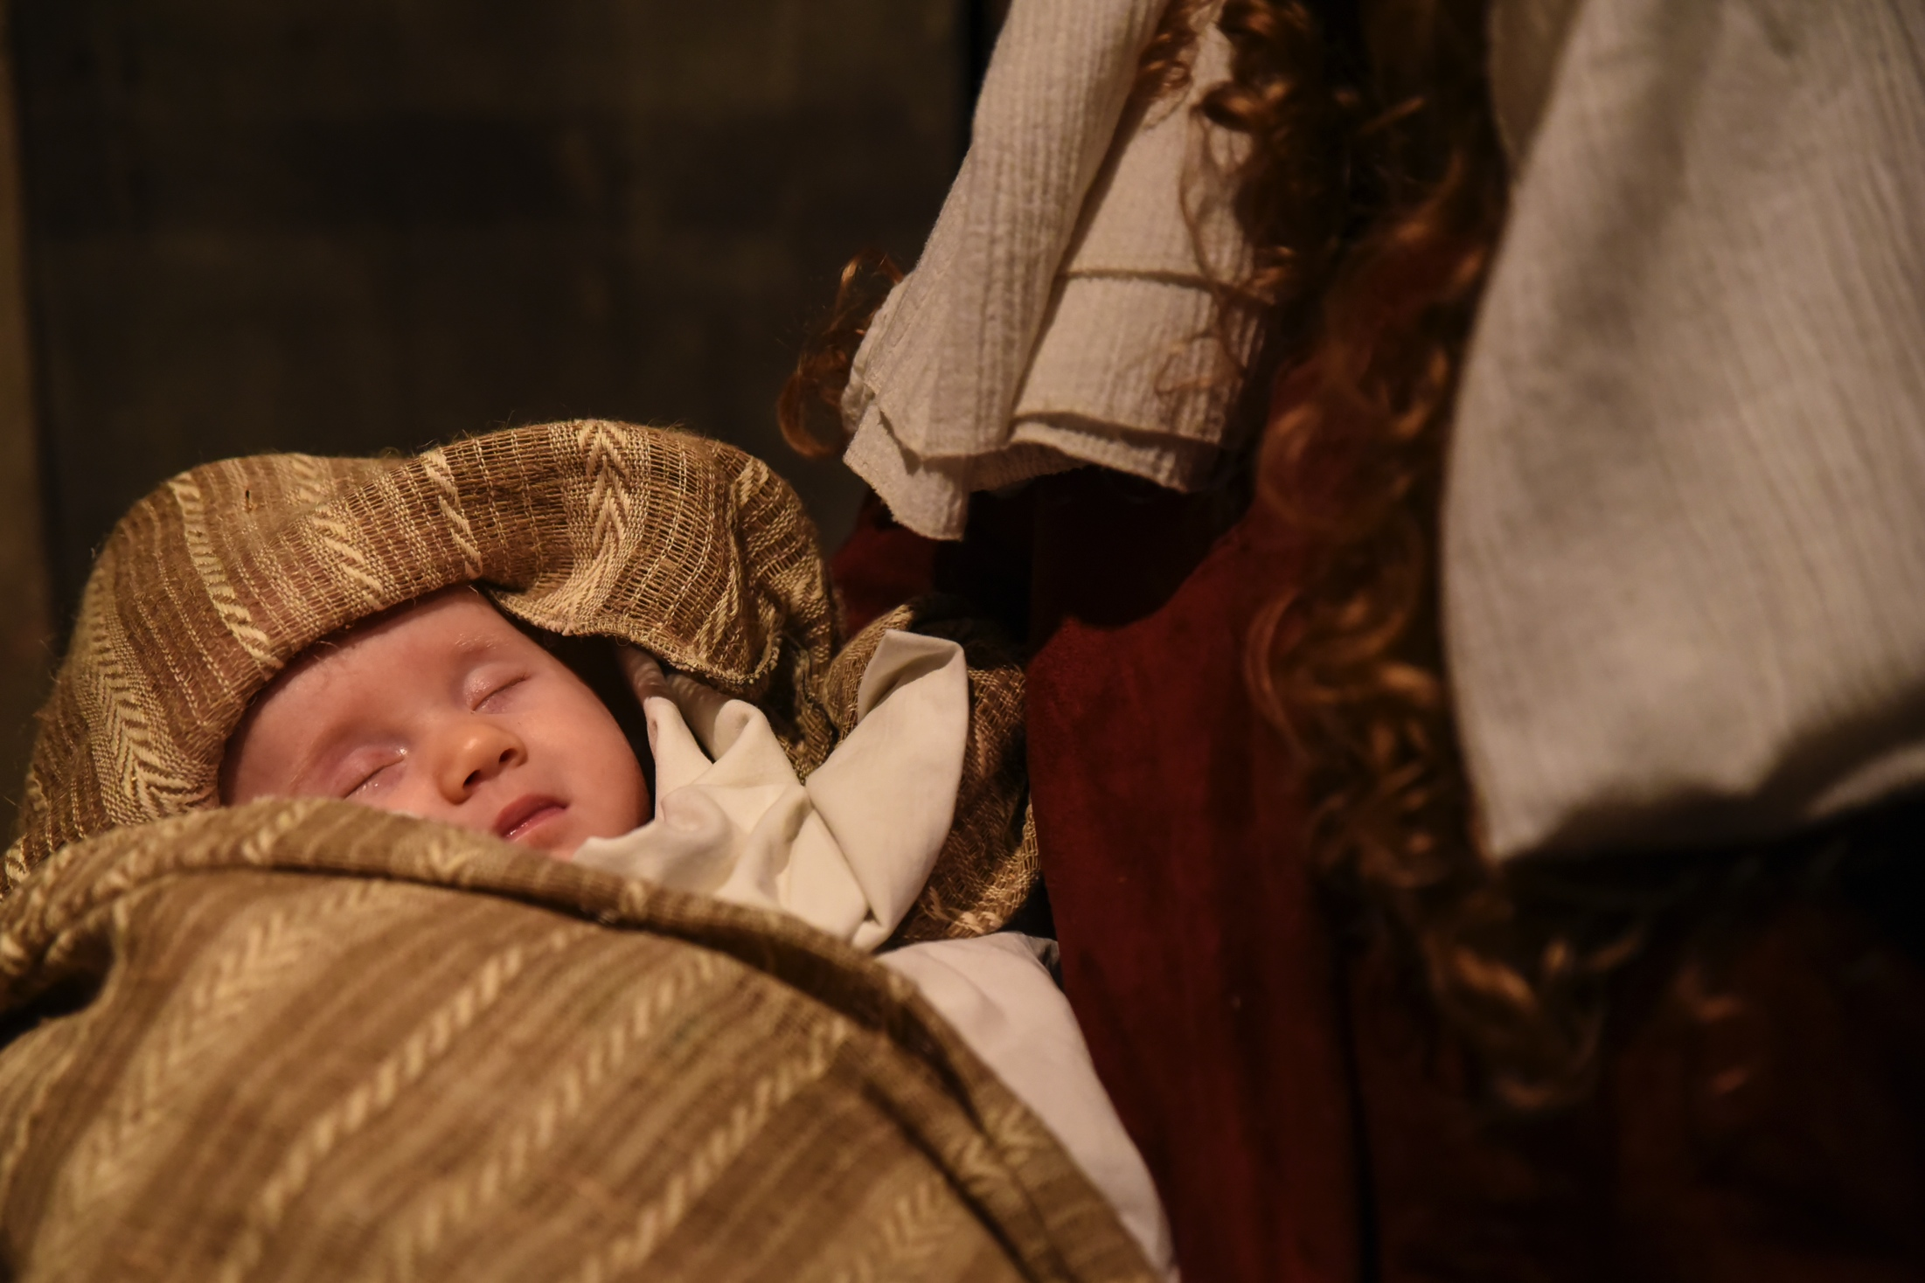

Slide 61
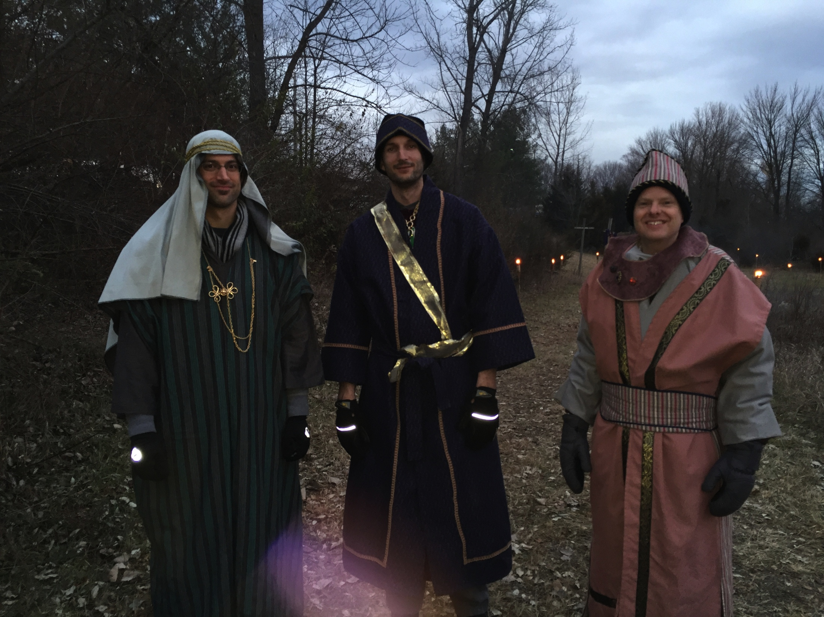

Slide 80
Pack-up

