Slide 1
Pathfinder Community Club
–Pathfinder Club Director Maurice Small

Slide 3
Pathfinder Community Club
How To Start A Community Pathfinder Club
Creating Awareness
Involvement
Exposure

Slide 4
This World Gone Crazy
Political Bashing
Community Violence
Families Are Hurting
Drug & Substance Abuse
Self Esteem
Looking for LOVE in ALL the WRONG PLACES
Sex “Friends With Benefits”

Slide 5
Families Are Looking For Change
Attitude Change In Their Sons & Daughters
Leadership, Commitment, Endurance, Respect, Team Work, Can Do Attitude
Spiritual Change
JESUS’S LOVE

Slide 6
Pathfinder TLT Program For His Daughter
Story - Pathfinder Ministry Awareness

Slide 7
Pathfinder Youth Ministry
Instructs
Counsels
Develops
Creates

Slide 8
Eagles Pathfinder Club
3 Basic Rules
On Time - You Are Late / Early - You Are On Time
One Mess Up - All Mess Up
One Movement / One Sound

Slide 9
Community Network
Churches
Law Enforcement
Homeless Shelters
Food Banks
Community Leaders
Special Event Committees

Slide 10
Homeless Family Shelter , Texas City, Tx.
Story - Create A Foundation For Pathfinder Club In Homeless

Slide 11
When Jesus Was On Earth HE Was Involved In The Community, HE Met Their Needs By Healing & Feeding.

Slide 12
Reaching & Transforming
Son’s & Daughter’s
Transformed into GOD’S Top Guns / Special OP’s

Slide 13
Need For Pathfinder Community Club
Brings God’s Love
Brings Families Together Through Their Son’s & Daughter’s
Community will take notice of Pathfinders Mission & Love

Slide 14
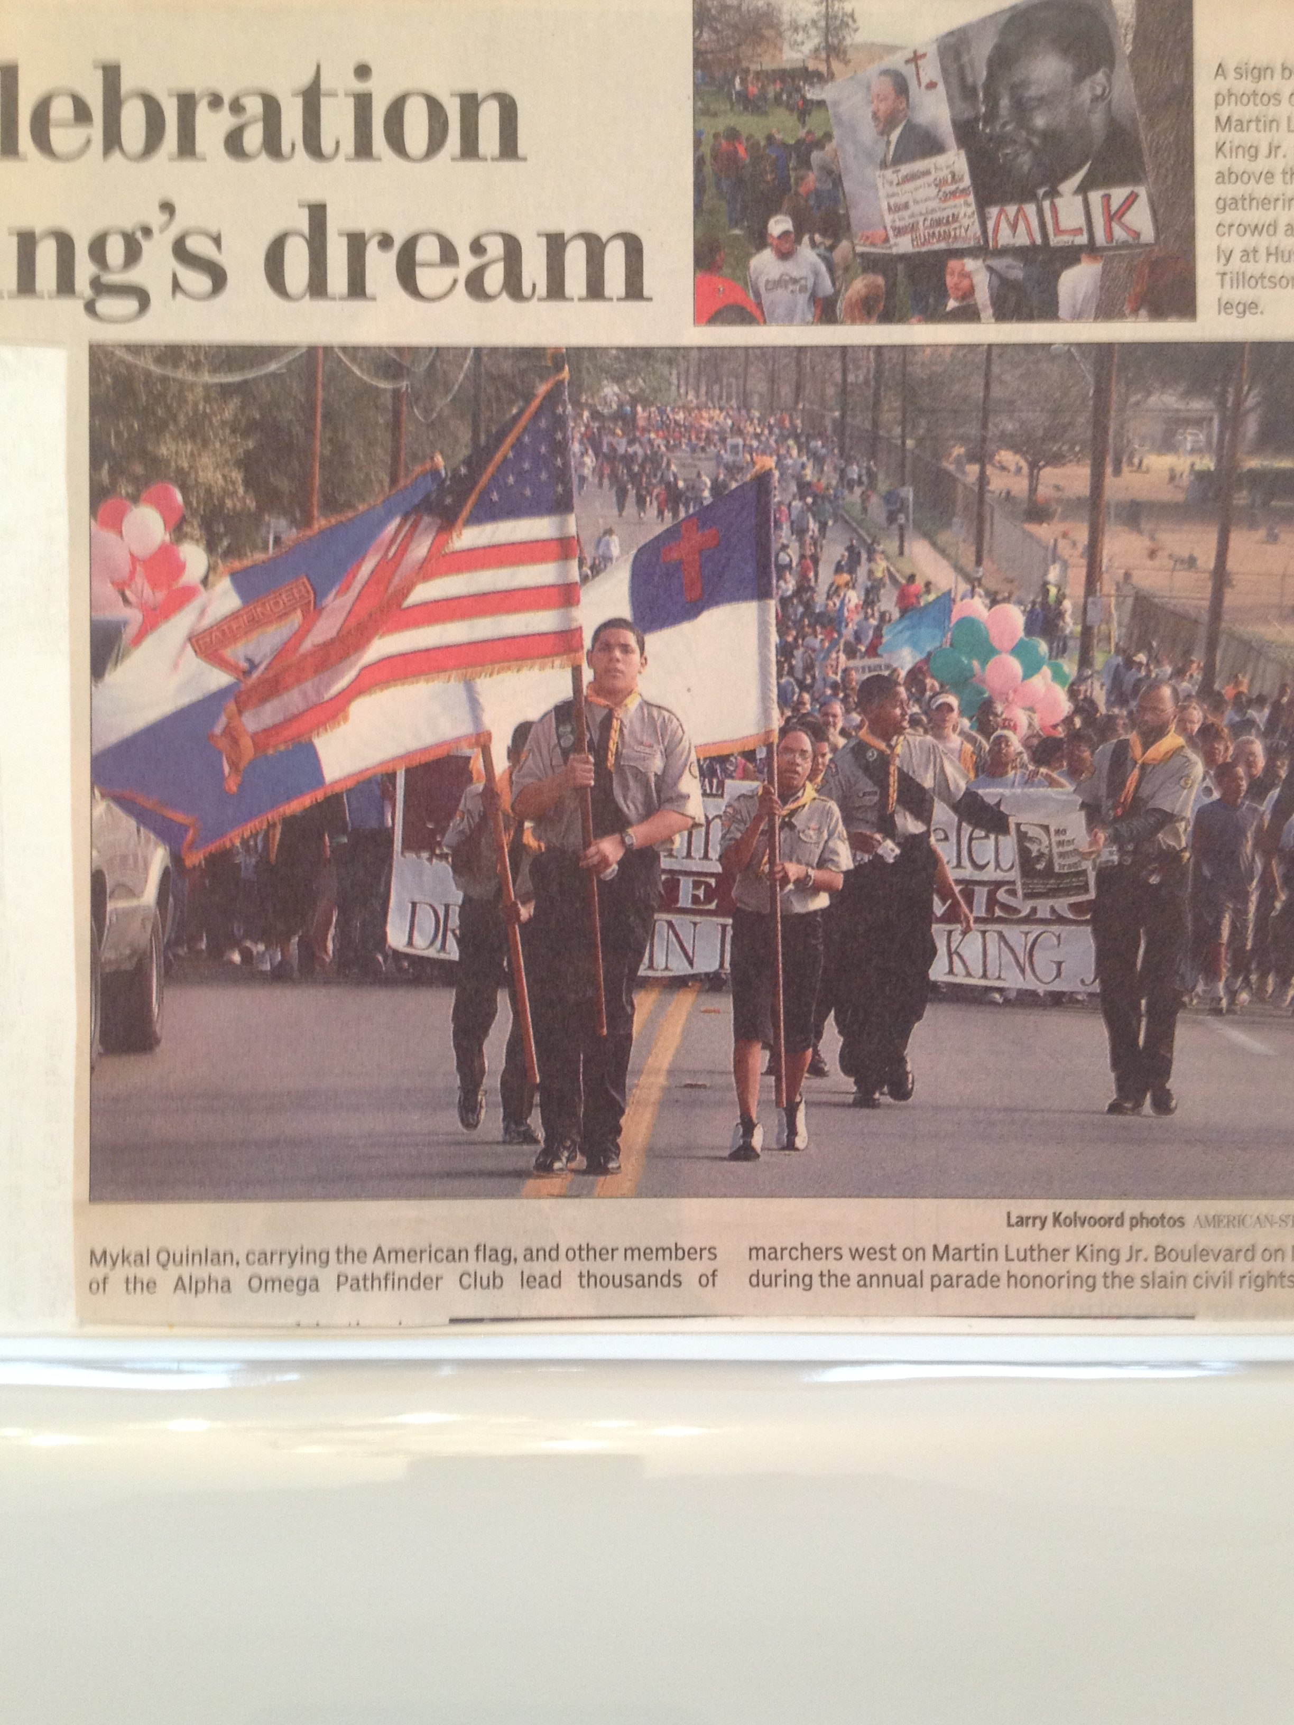

Slide 15
The Late Dr. E.E. Cleveland
Author, Civil Rights Advocate & Evangelist of the Seventh Day Adventist Church

Slide 16
“Now That’s Evangelism”
Dr. E. E. Clevelend

