Slide 1
Outreach Through Music
Outreach Gospel Choir

Slide 3
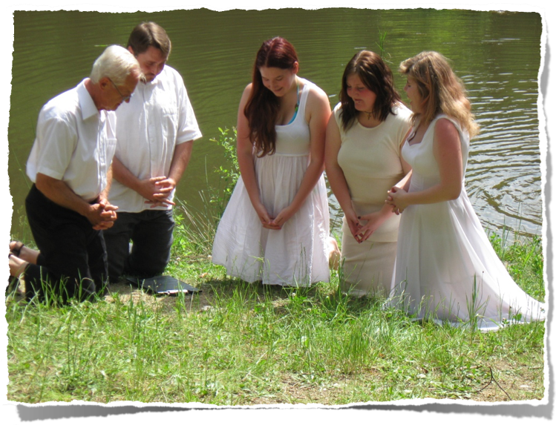

Slide 4
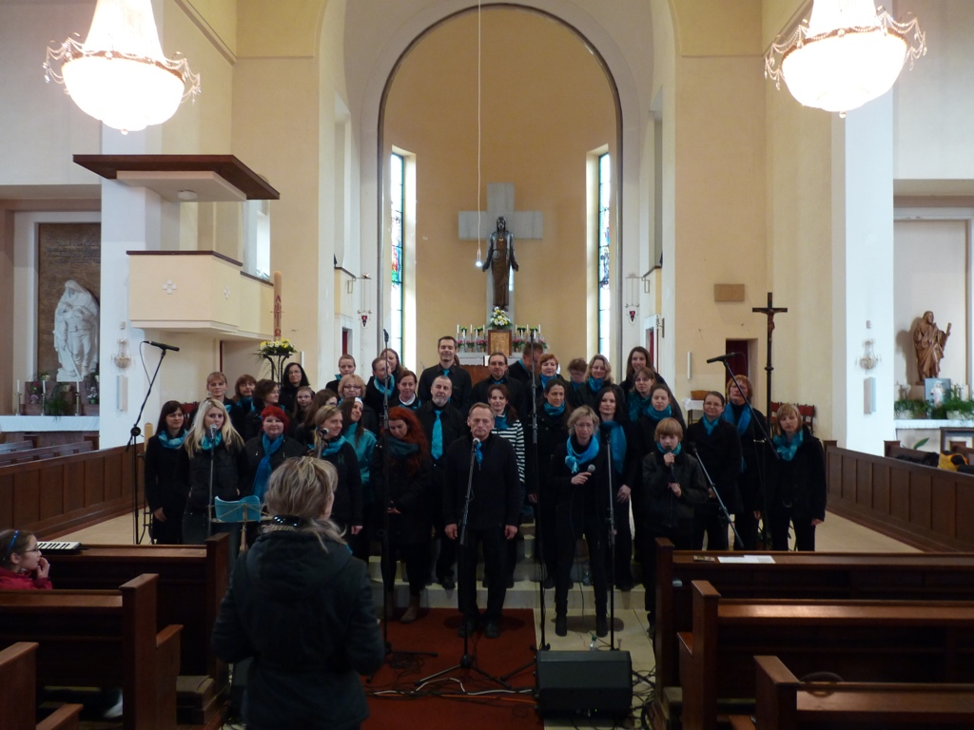

Slide 5
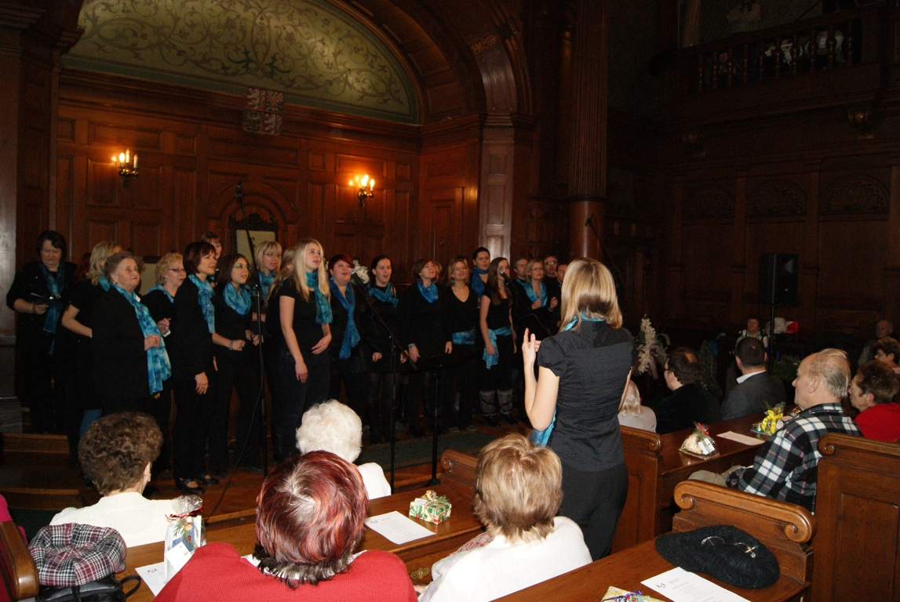

Slide 6
