Slide 1

It’s Never Out of Your Reach

Slide 2
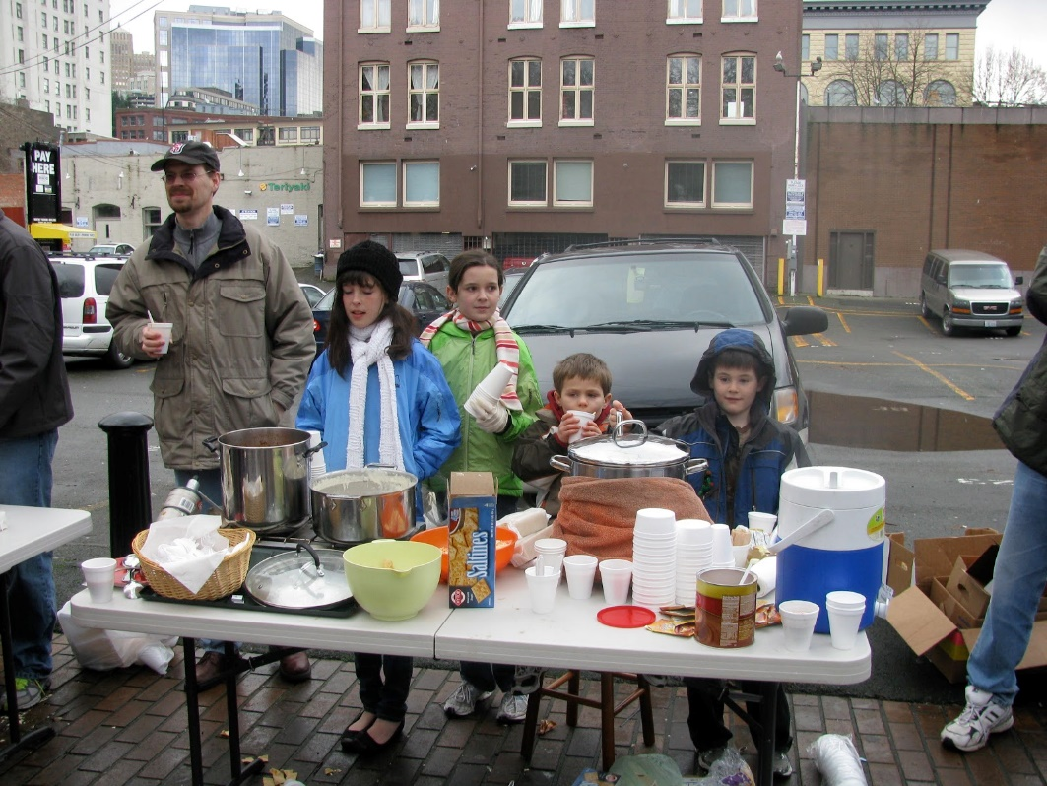
What is Outreach?
Outreach is an activity of providing services to populations who might not otherwise have access to those services.
A key component of OUTREACH is that the groups providing it are not stationary, but mobile, in other words they are meeting those in need of OUTREACH services at the location where those in need are.

Slide 3

What is Outreach?
Matthew 28: 16-20
Then the eleven disciples went to Galilee, to the mountain where Jesus had told them to go. When they saw him, they worshiped him; but some doubted. Then Jesus came to them and said, “All authority in heaven and on earth has been given to me, Therefore go and make disciples of all nations, baptizing them in the name of the Father and of the Son and of the Holy Spirit, and teaching them to obey everything I have commanded you.

Slide 4
What does Spirit of Prophecy say about Outreach
MYP Chapter 58 The Youth Called to Be Laborers
There are many Christian youth that ca do a good work if they will learn lessons in the school of Christ from the great Teacher. Even though pastors, evangelists, and teachers should neglect the seeking of the lost, let not the children and youth neglect to be doers of the word

Slide 5
Identifying the needs
What are needs?
How do to I meet the needs?
Food
Clothes
Love
Jesus
Pray
Motivate
Organize
Move

Slide 6

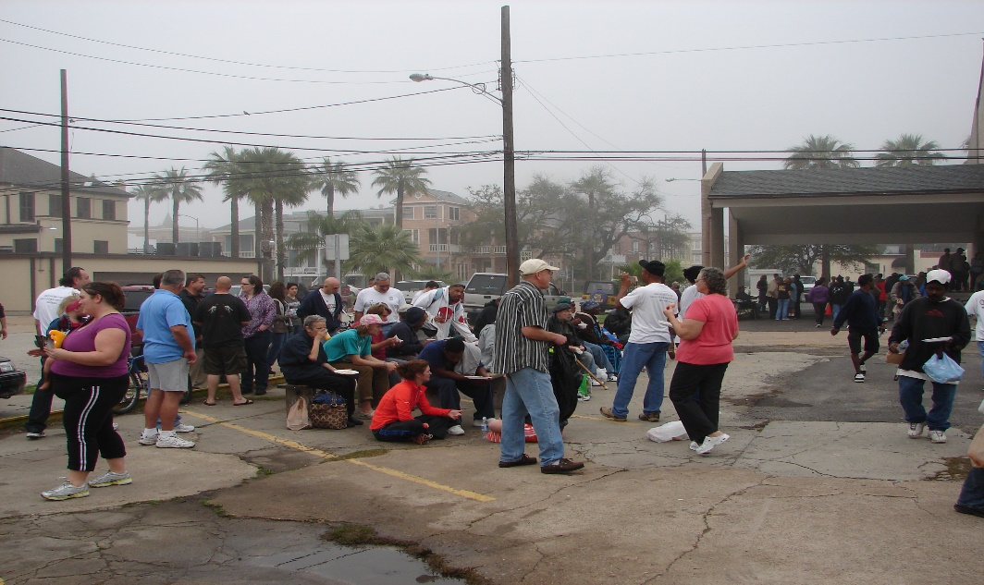
Taking it from the Church to the Streets…

Slide 7
Feeding God’s People…
We have chosen several way to provide food….
Brown Bag Ministries
Soup and Sandwiches Service
Bar B Que Blessing
Homeless Shelter Sanctuary

Slide 8
Clothing God’s People…
New ways to fill the closets of the without.
Emptying Closets
Reaching out to business
Fund Raising (Cloud Funding)

Slide 9
Showing for Love to God’s People
Love takes less money and more effort…
Movie Night
Prayer Corners
Community Clean up
Game Night

Slide 10
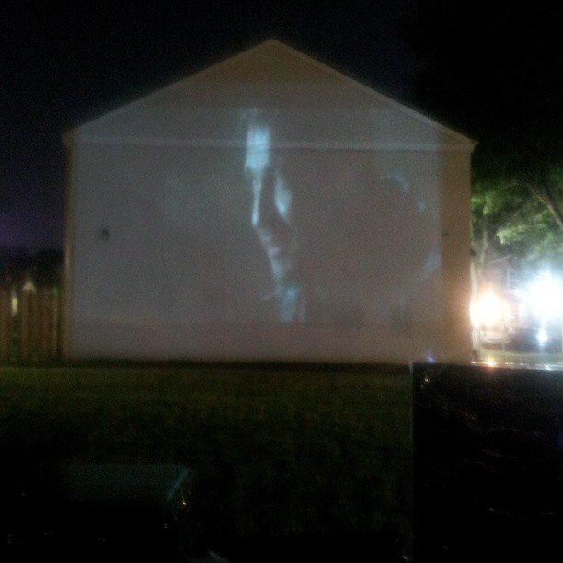
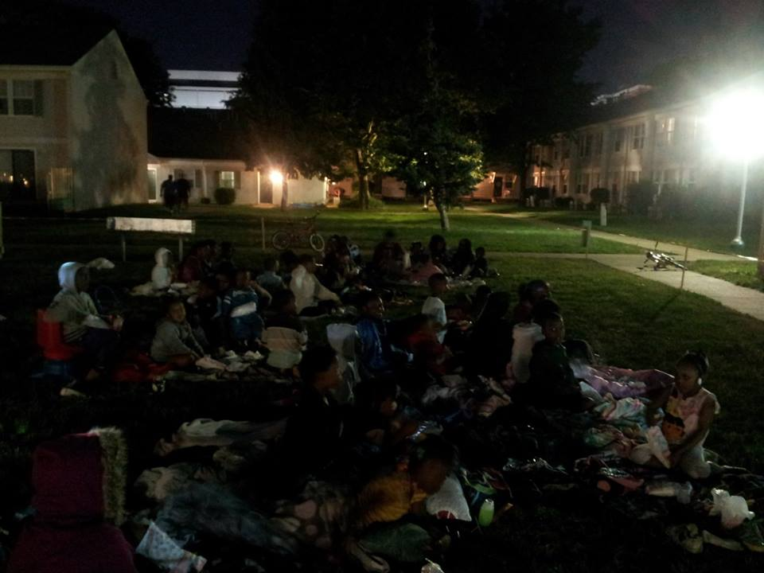
Outreach works when we reach out..

Slide 11
Questions
What are three things thats keeping the church from doing outreach?
How can youth be used as outreach leaders?
Can you identify 3 needs in your area?
What can you do to address needs in the next 30 days?

