Slide 1
It’s Never Out of Your Reach…
Subtitle

Slide 2
It’s Never Out of Your Reach
What is Out Reach?
What does the Bible say about Out Reach?
How to do EFFECTIVE Out Reach?
Can Out Reach been fun?
How to use Out Reach to grow my Pathfinder Group?
Ten new ways to do Out Reach using your Pathfinder Group..

Slide 3
It’s Never Out of Your Reach…

Slide 4
What is Outreach?
Outreach is an activity of providing services to populations who might not otherwise have access to those services.
A key component of OUTREACH is that the groups providing it are not stationary, but mobile, in other words they are meeting those in need of OUTREACH services at the location where those in need are.

Slide 5
What is Outreach?
Matthew 28: 16-20
Then the eleven disciples went to Galilee, to the mountain where Jesus had told them to go. When they saw him, they worshiped him; but some doubted. Then Jesus came to them and said, “All authority in heaven and on earth has been given to me, Therefore go and make disciples of all nations, baptizing them in the name of the Father and of the Son and of the Holy Spirit, and teaching them to obey everything I have commanded you.

Slide 6
What does the Bible say about outreach?
Jeremiah 1:7 But the Lord said to me, “Do not say. ‘I am only a youth’; for to all whom I send you, you shall go, and whatever I command you, you shall speak.

Slide 7
What does the Bible about outreach?
Romans 10:14 How then will they call on him in whom they have not believe in him of whom they have never heard? And how are they without someone preaching?

Slide 8
What does the Bible say about outreach?
1 Peter 2:9 But you are a chosen race, a royal priesthood, a holy nation, a people for his own procession, that you may proclaim the excellences of him who called you out of darkness into his marvelous light.

Slide 9
How do you do EFFECTIVE outreach?
Remembering that outreach is taking what is needed to those who needs it, in order to do effective outreach we must recognize the needs of the people in our area.

Slide 10
What does Spirit of Prophecy say about Outreach?
MYP Chapter 58 The Youth Called to Be Laborers
There are many Christian youth that ca do a good work if they will learn lessons in the school of Christ from the great Teacher. Even though pastors, evangelists, and teachers should neglect the seeking of the lost, let not the children and youth neglect to be doers of the word.

Slide 11
What does Spirit of Prophecy say about Outreach?
MYP Chapter 59 Responsibility for Soul Winning
Upon the youth there rest a grave responsibilities. God expects much from the you men(women) who live in this generation of increased light and knowledge. He desires to use them in dispelling the error and the superstition that cloud the minds of many. They are to discipline themselves by gathering up every jot and tittle of knowledge and experience.

Slide 12
What are the needs?

Slide 13
What are the needs?
Food: One of the most basic need of all men is food.
There are several different ways the feeding those in need can be done with your local pathfinder group.
Providing warm bowls of soup in the winter.
Bar B Que hot dogs and burgers.
Preparing food baskets for Thanksgiving and Christmas
Can food drive
Now with each of these ministries you provide some Christ Centered information to the people along with prayer and conversation.

Slide 14
What are the needs?

Slide 15
What are the needs?
Shelter: A place to lay your head with out have to worry about being exposed to cold, heat, or violence.
Placing old useable tents in area where they can be safe and close together. (There are companies the will donate tents for this effort)
Convince your church to open their doors as a warming shelter on those nights when its going to be below freezing.
Find resources for the homeless where shelter is provided and available.

Slide 16
What is the need?

Slide 17
What are the needs?
Clothing: People without know they are with out before someone tells them and as young people we know how people talk about us when we are not in the latest and the greatest fashion, so imagine how the person feels who can’t change clothes because they don’t any anything else.
Closet Cleaning day, having young people clean there closet out one donate good clothe that might not be in style of fit anymore.
Coats for Kids in a great program that can provide much needed coats for youth.
Sock, Hats, Gloves, Underwear drive is another great way to provide for those who don’t have without breaking the bank.

Slide 18
What are some more needs?
Teenage Pregnancy
Fatherless Children
Father Mentor
Mother mentor
Books
Jobs
Stuffed Animal Drives
Transportation
Financial Resources
Social Media
Text Message
Surveys
Social Services

Slide 19
Can Outreach be Fun?
If this is a question you are asking, then there is another issue that needs to be addressed. Everything that you do for GOD doesn’t have to benefit you directly for you to get enjoyment out of it. If you are focusing on how to make it fun for the pathfinders then you might miss the mark on what the real goal is.
Outreach ministries are fun for those who have a passion for helping those in need.
Outreach ministries is humbling for those who take for granted what God has provided for them.
Outreach ministries can make you cry when you get to see the effects of sin on others lives.

Slide 20
How to use Outreach to grow your youth Group?
Let your youth be apart of the planning of Outreach programs.
Plan to meet the needs of the people beyond the date of the outreach program date.
Be open to new ways to do outreach.
Be Faithful and not fearful when it comes to outreach
Make outreach a year round event, not a summer activity

Slide 21
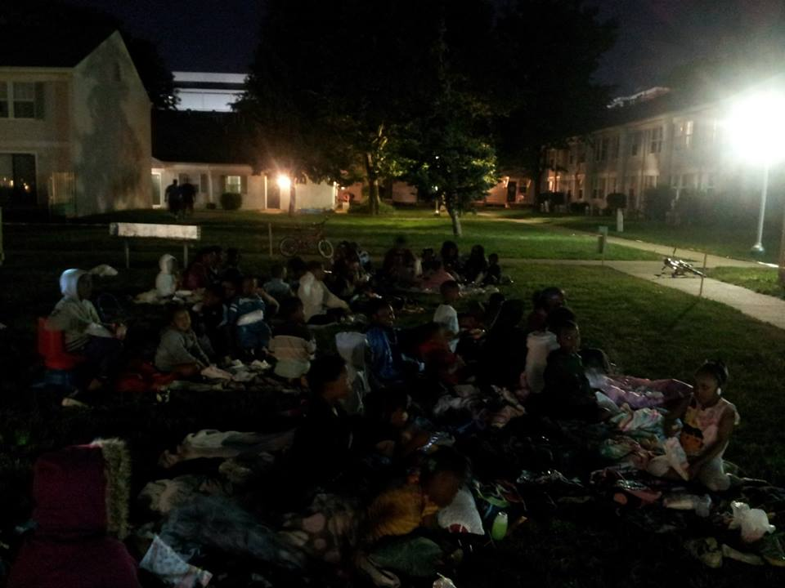
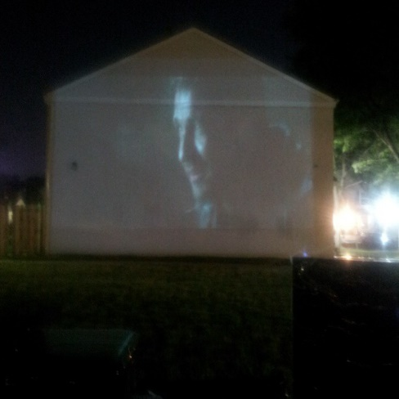
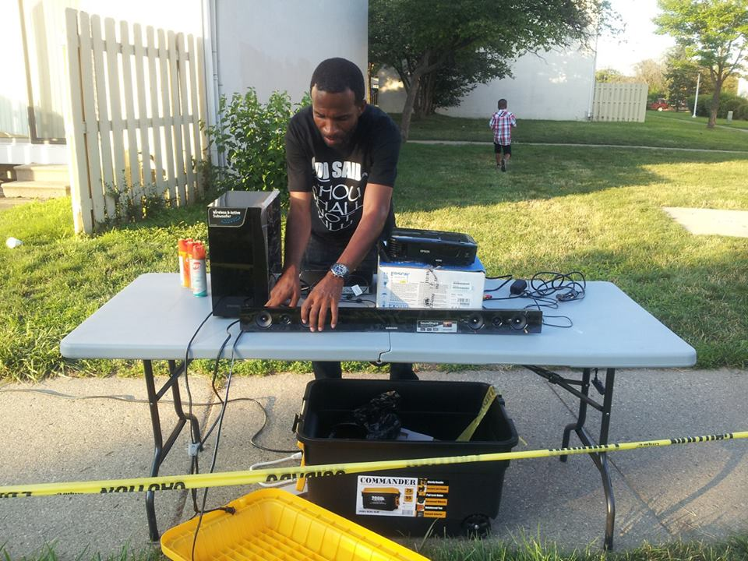
Five things New proven ways to do outreach THAT WORK!!!
Movie Night: Using a home surround sound system, a projector and a bank wall. I was able to witness t0 anywhere between 55 and 75 children every Thursday night for the summer. We gave away hot dogs, juice, and popcorn. 27 of these kids came out to a youth tent effort that same summer.

Slide 22
Five things New proven ways to do outreach THAT WORK!!!
Community Fun Day: This event was the biggest and most effective when it comes to the number of people reached. We rented bounce houses, brought a DJ (playing good music), provided all the food, provide several team games (flag football, kickball, and volleyball), and hosted a basketball tournament. In all 300 plus people came to this event.

Slide 23
Five things New proven ways to do outreach THAT WORK!!!
Community feeding: I believe in thinking outside the box and this event is the one I caught some flack about, but the one I enjoyed the most. On a nice warm Sabbath afternoon we went to a part of Detroit where a lot of house people live and with us we brought a bar b que pit, 125 hot dogs and 125 hamburgers, several boxes of chips, 300 bottles of water, and the presence of God. On that day we fed 250 people, passed out 100 Steps to Christ and 100 GLOW tracks.
The stories I could tell you about what the kids experience that day could/would change your life.

