Slide 1
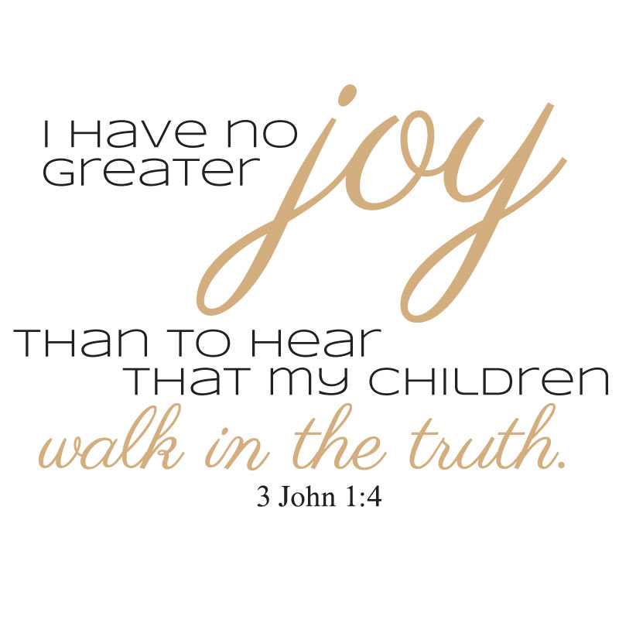
Flag Camp
^{Fun Learning About God}

Slide 2
Flag Camp
^{Fun Learning About God}
What is Flag Camp?
1) Unique Day Camp for kids (age 5-13)
- Morning Line Call & Camp Council
- Class Rotations (Bible, Nature, Crafts, Music)
- Afternoon Activities, Swimming & Field Trips
2) Staff Size (5-25)
- Young People Ideally
- Volunteers or Paid
- Counselors, Teachers, Musicians, Actors, etc
3) Flexible Setting
- Church, School, Park or Mission Trip
4) Inexpensive
- $10-$25 per day

Slide 3
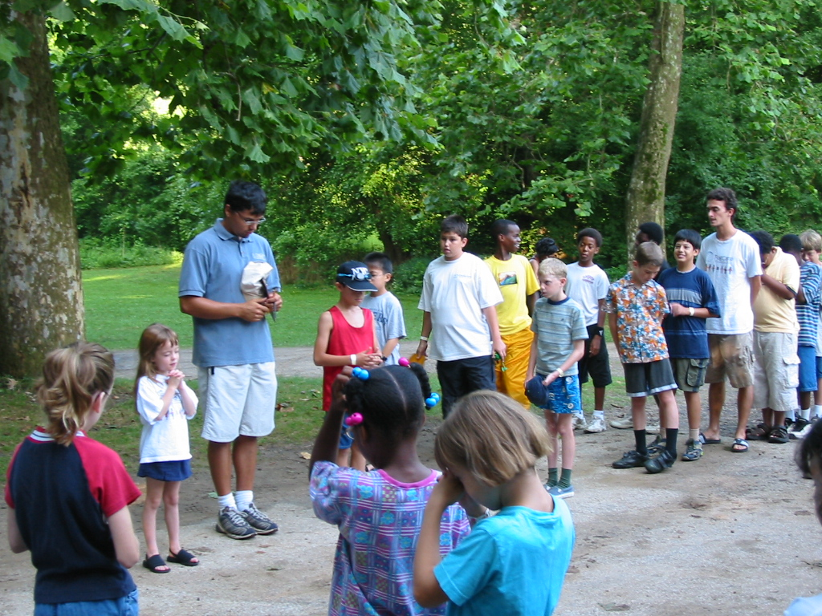
Flag Camp
^{Fun Learning About God}

Slide 4
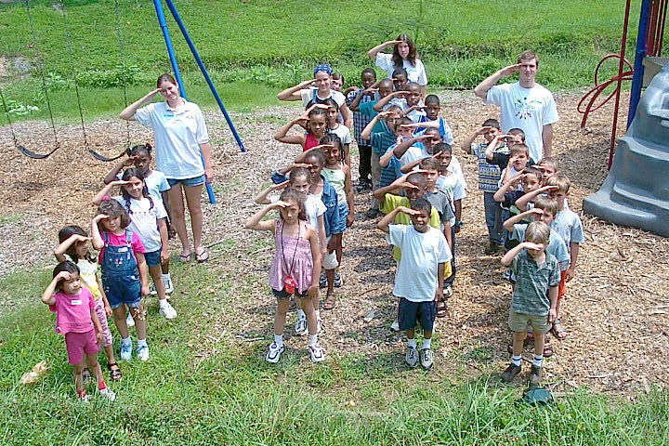
Flag Camp
^{Fun Learning About God}

Slide 5
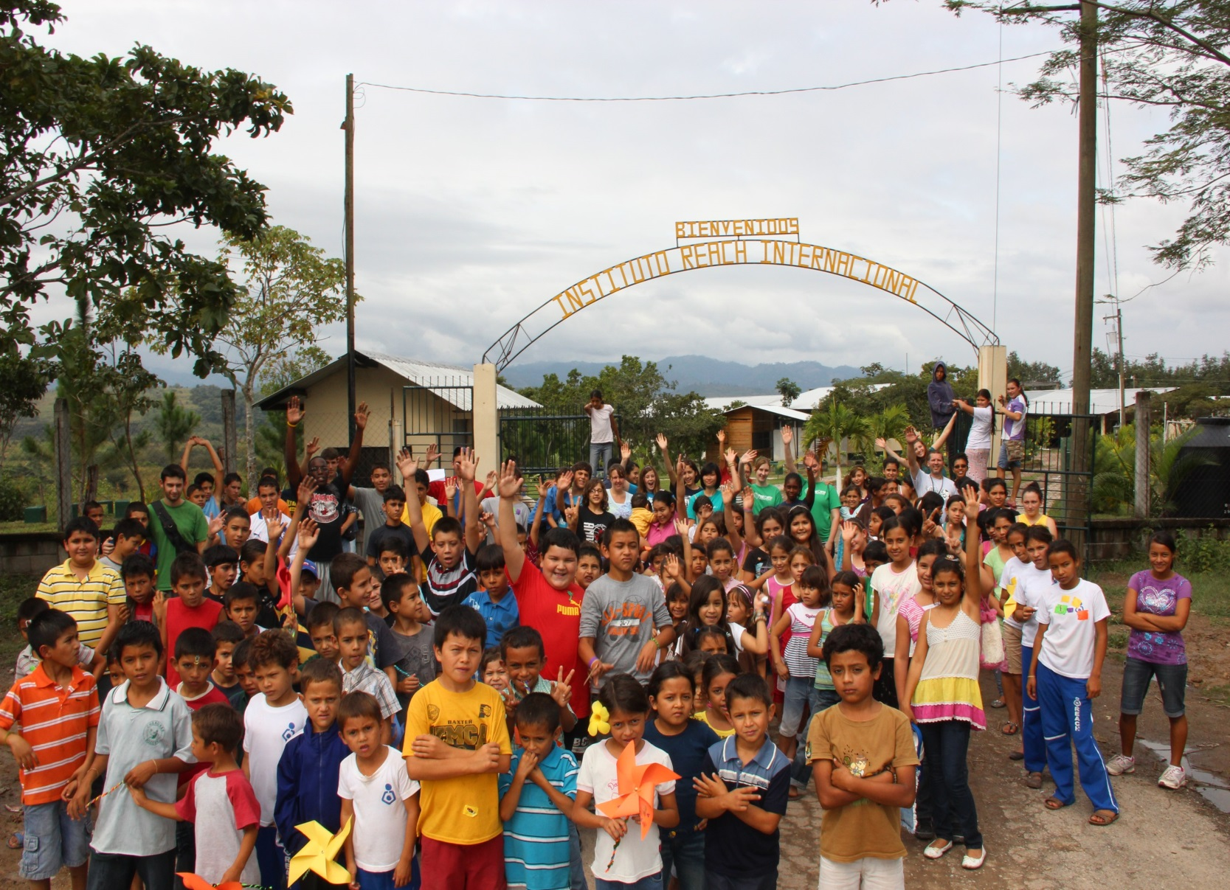
Flag Camp
^{Fun Learning About God}

Slide 6
Flag Camp
^{Fun Learning About God}
WIN – Church
  1) Share Jesus
  2) Community Outreach
  3) Youth Involvement
  4) Cost $0 - $?????
WIN – Young People
  1) Share Jesus
  2) Make a major difference in a kids life
  3) Earn money for school
WIN – Community
  1) Wholesome activities for their children
  2) Safe and loving environment
  3) Inexpensive daycare
WIN – Children
  1) Learn about Jesus
  2) Positive role models
  3) Have fun with friends ☺

Slide 7
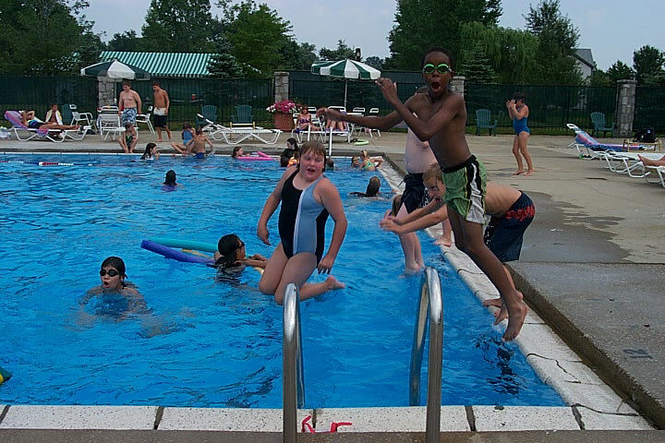
Flag Camp
^{Fun Learning About God}
2003

Slide 8
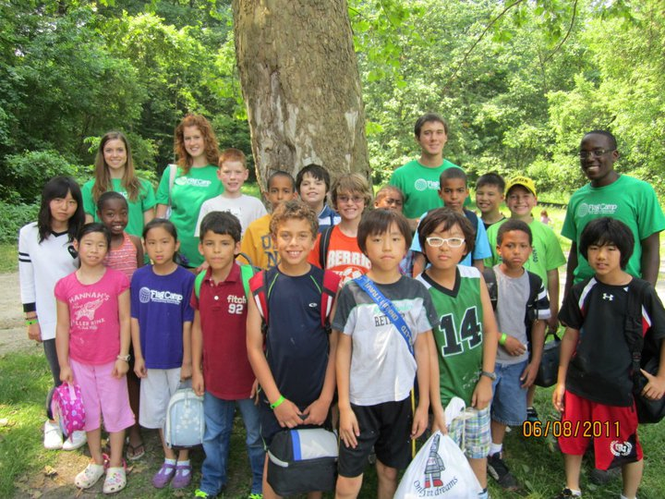
Flag Camp
^{Fun Learning About God}
2011

Slide 9
Flag Camp
^{Fun Learning About God}
The Influence of One Child Properly Trained
“No higher work was ever committed to mortals than the shaping of character. Children are not only to be educated, but trained as well; and who can tell the future of a growing child, or youth? Let the greatest care be bestowed upon the culture of your children. One child, properly disciplined in the principles of truth, who has the love and fear of God woven through the character, will possess a power for good in the world that cannot be estimated.”
Ellen White, The Signs of the Times, July 13, 1888.

