Slide 1
Mentoring Matters
By: Toson Antwan Knight

Slide 2

Caught Up Mentoring
Catching Up Morally, Academically, &
Intellectually, One Young Person at a Time!

Slide 3

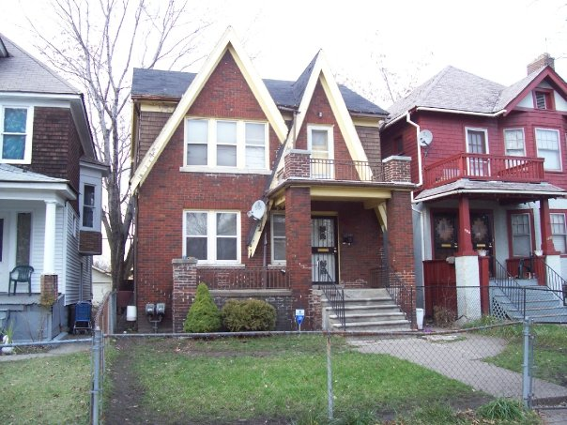
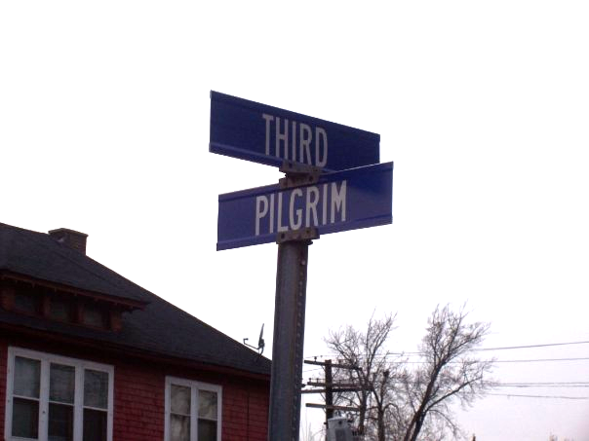


Background: Toson Knight
Grew up In Highland Park, MI

Slide 4

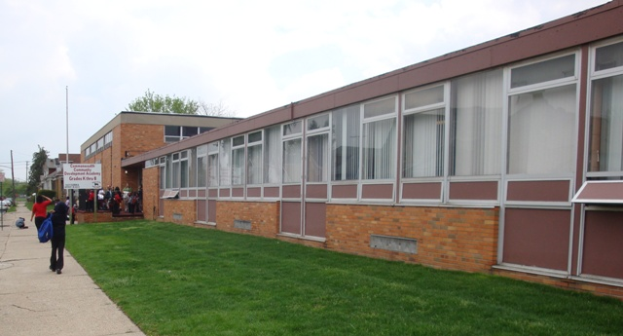



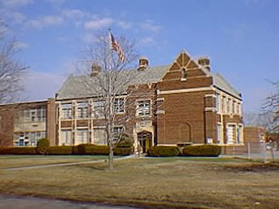


Background
Schools
Bussey Center
Brace Lederle
Academy of Southfield
Commonwealth Academy
Barber
Henry Ford Academy
Highland Park Middle
Southfield Lathrup
Peterson Warren Academy
Academy of Oak Park
Westin
Mac Arthur School

Slide 5
Startling Statistics
63% of youth suicides are from fatherless homes (Source: U.S. D.H.H.S., Bureau of the Census)
90% of all homeless and runaway children are from fatherless homes
85% of all children that exhibit behavioral disorders come from fatherless homes (Source: Center for Disease Control)
80% of rapists motivated with displaced anger come from fatherless homes (Source: Criminal Justice & Behavior, Vol 14, p. 403-26, 1978.)
71% of all high school dropouts come from fatherless homes (Source: National Principals Association Report on the State of High Schools.)
75% of all adolescent patients in chemical abuse centers come from fatherless homes (Source: Rainbows for all God`s Children.)
70% of juveniles in state-operated institutions come from fatherless homes (Source: U.S. Dept. of Justice, Special Report, Sept 1988)
85% of all youths sitting in prisons grew up in a fatherless home (Source: Fulton Co. Georgia jail populations, Texas Dept. of Corrections 1992)

Slide 6



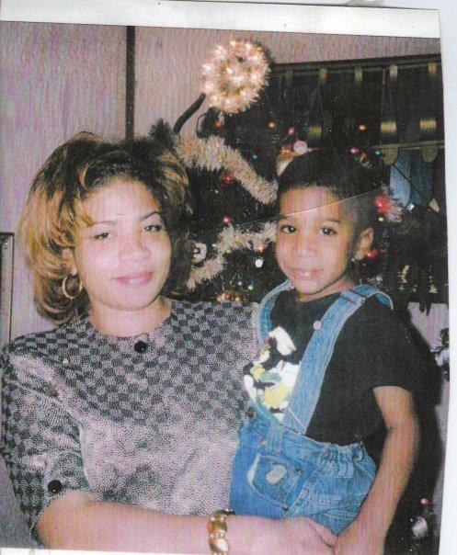


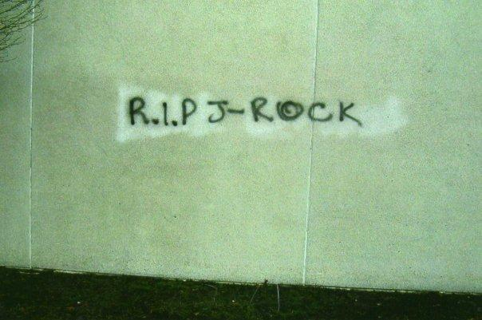
Kids Who Didn’t Have Mentors

Slide 7
A Refuge for Tempted Youth
Our homes should be a place of refuge for the tempted youth. Many there are who stand at the parting of the ways. Every influence, every impression, is determining the choice that shapes their destiny both here and hereafter. Evil invites them. Its resorts are made bright and attractive. They have a welcome for every comer. All about us are youth who have no home and many whose homes have no helpful, uplifting power, and the youth drift into evil. They are going down to ruin within the very shadow of our own doors. AH 449.1
These youth need a hand stretched out to them in sympathy. Kind words simply spoken, little attentions simply bestowed, will sweep away the clouds of temptations which gather over the soul. The true expression of heaven-born sympathy has power to open the door of hearts that need the fragrance of Christlike words and the simple, delicate touch of the spirit of Christ's love. If we would show an interest in the youth, invite them to our homes, and surround them with cheering, helpful influences, there are many who would gladly turn their steps into the upward path.8 AH 449.2

Slide 8

Bible Texts
Ecclesiastes 4:9-10 Two are better than one, because they have a good return for their labor: If either of them falls down, one can help the other up. But pity anyone who falls and has no one to help them up.
Romans 15:14 I myself am convinced, my brothers and sisters, that you yourselves are full of goodness, filled with knowledge and competent to instruct one another. (Romans 15:14)
Philippians 4:9 Whatever you have learned or received or heard from me, or seen in me — put it into practice. And the God of peace will be with you.

Slide 9

Meet Youth Where They Are
Messages Must Be:
Innovative, Tech Savvy, Clear & Precise
Use PowerPoints, Movies, Short Video Clips
Develop Relationships
Must Have a Vision
Build Relationships Between the Youth & Adults in Church

Slide 10
Youth Need:
A sense of belonging.
A sense of self-worth.
Reliable and predictable relationships
Hebrews 10:24-25 And let us consider how we may spur one another on toward love and good deeds, not giving up meeting together, as some are in the habit of doing, but encouraging one another — and all the more as you see the Day approaching.

Slide 11
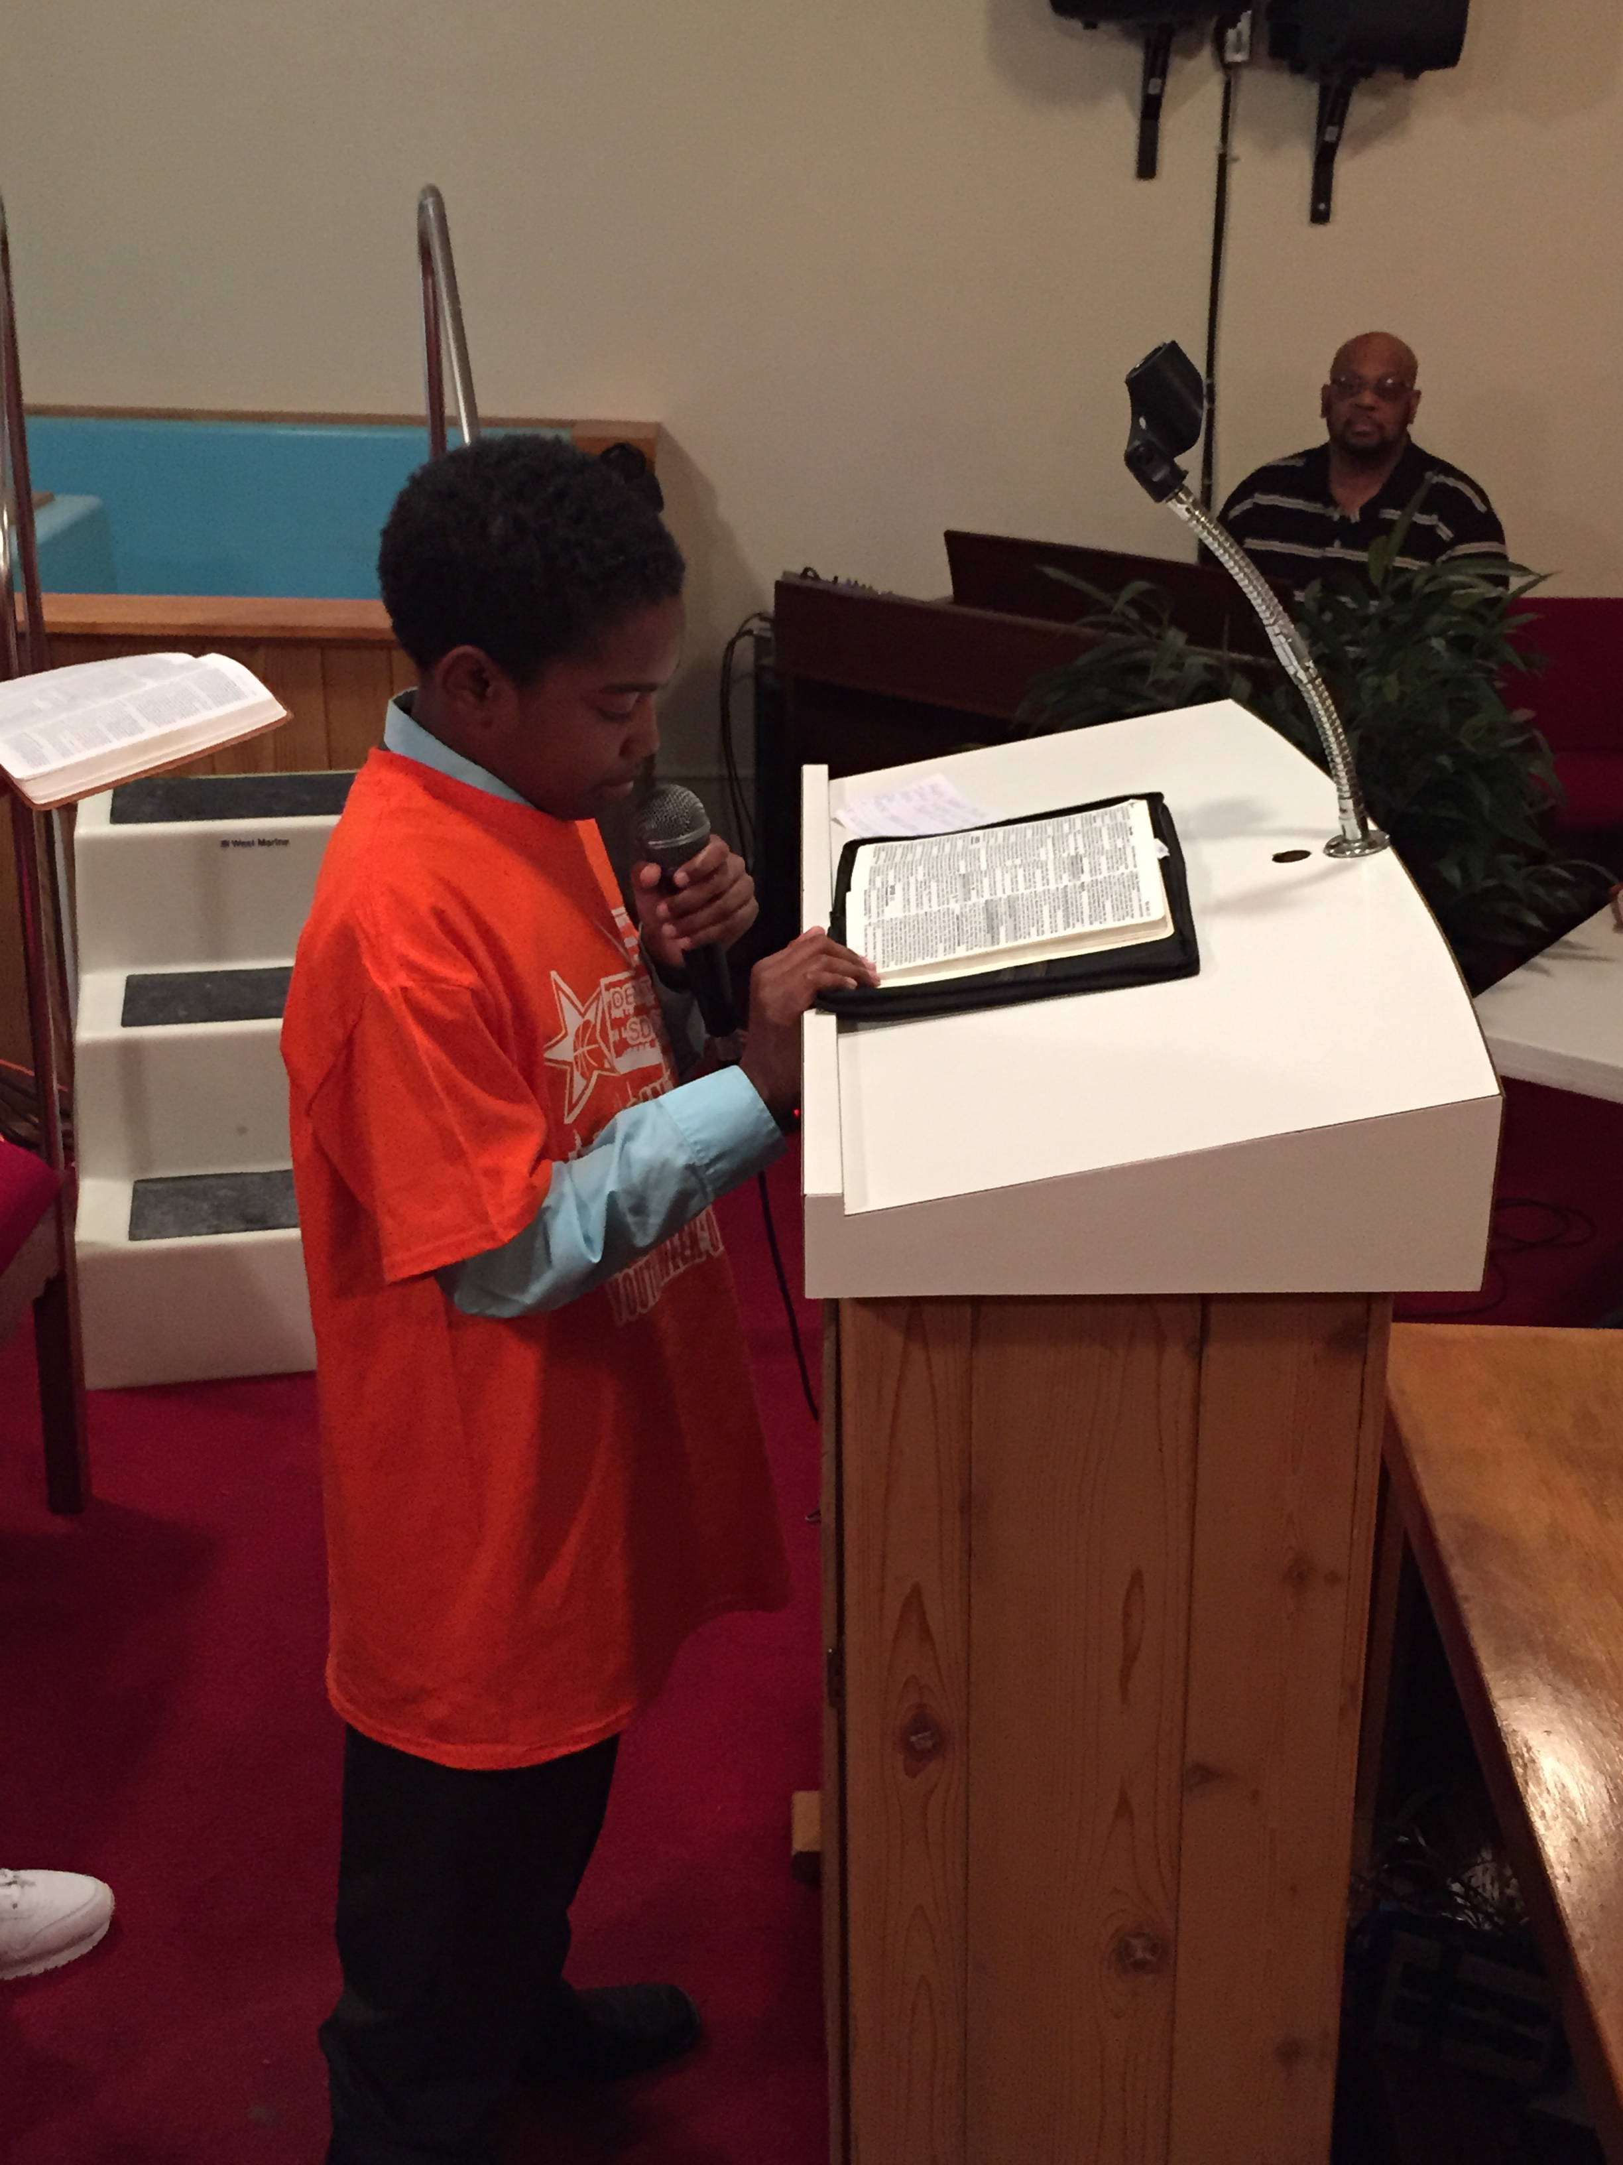
To Be loved……
Give youths opportunities to learn and then to perform tasks that are valued within the congregation.
  Scripture Reading
  Music
  Prayer
2. Look for opportunities to affirm young people—send them the message that they are special and essential to you
We can have positive, affirming interactions in various ways. For example, remember and use their names; send them birthday cards or handwritten notes any time of year. Spend time talking with them—give focused attention; if they are small children, get down on their level, eye-to-eye. Ask for their input and then use it.
1 Timothy 4:12:Don't let anyone look down on you because you are young, but set an example for the believers in speech, in conduct, in love, in faith and in purity.

Slide 12
Characteristics
Due to a lack of family ties, today’s youth are deeply committed to friendships. Friends hold immeasurably more influence than other voices in their lives.
Lack of personal relationships that is derived from high-tech toys, videos, and CDs. Another huge piece of youth culture is the Internet. It is impacting relationships and the ability of young people to socialize and build friendships. As well, the Internet has tremendous negative influence in the way it reaches into their bedrooms and corrupts them. This makes it harder for relationship needs to be met.
This generation feels less loved than any generation in 50 years, and they are striving for love. Two words describe this generation: abandoned and disconnected. Christian and secular studies also include the words connected or disconnected to describe this generation.
Over one-third of all teenagers feel extremely stressed out. This is the highest rate of any age group.
Only one in six teenagers today say they are interested in truth. Ninety-one percent of Christian young people believe truth is relative—there is no truth apart from themselves.

Slide 13
WHAT TO DO!
Pray with and for the youths. Spend time with a few youths. Many youths spend little time with adults. Try to provide a few youths with such opportunities and do not confuse taking a kid along on an adult activity as spending time with them. Get into their world—and be a mature, wise, caring and consistent presence with them where they are. It will pay big dividends in their lives.
Learn about their world. Respect the youths enough to go to the effort to get to know their concerns, culture, needs, preferences and challenges. Find out what they watch on on-line, on television and in movies; what they listen to; what they read. How do you find out? Ask them! And then listen without criticizing. The point here is not for an adult to act like a teen (teens are turned off by that!)—rather, the point is for the adult to understand the teen. A second part of this approach is to look for what is good and godly in the youth’s world and then use that as a bridge to connect your world of Christ with what is consistent with Christ in their world.
Really listen to the youths. One of the greatest desires of young people (teens in particular) is to be heard. Youths are often timid around adults, so it will take some time for them to learn to trust you with their inner thoughts. Be patient and keep an open ear.

Slide 14
Programming
Project Empower Local High Schools
Project Re-Entry Juvenile Detention Centers
Weekly Bible Studies Neighborhood Kids

Slide 15
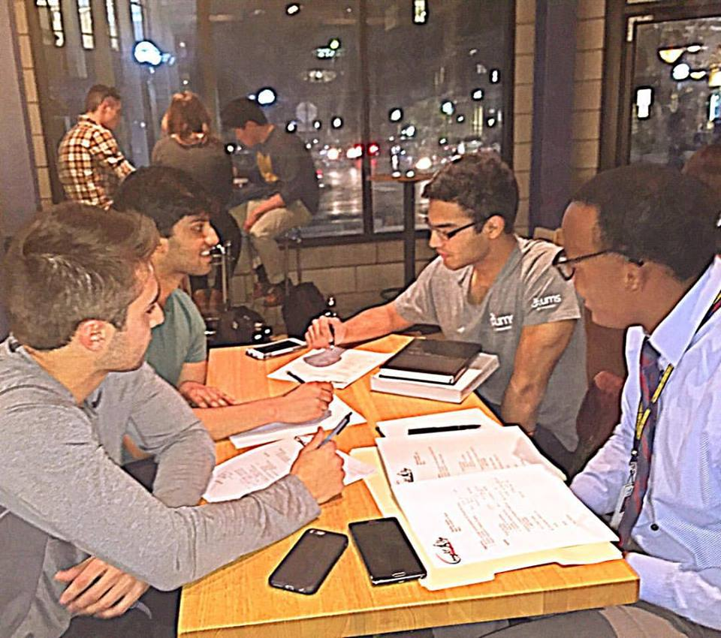
Quick Tips!
Get Help!
  2 Or More Dedicated People
Develop Relationships
Keep Cost Down
  See Budget
Organize! Plan! GO!

Slide 16
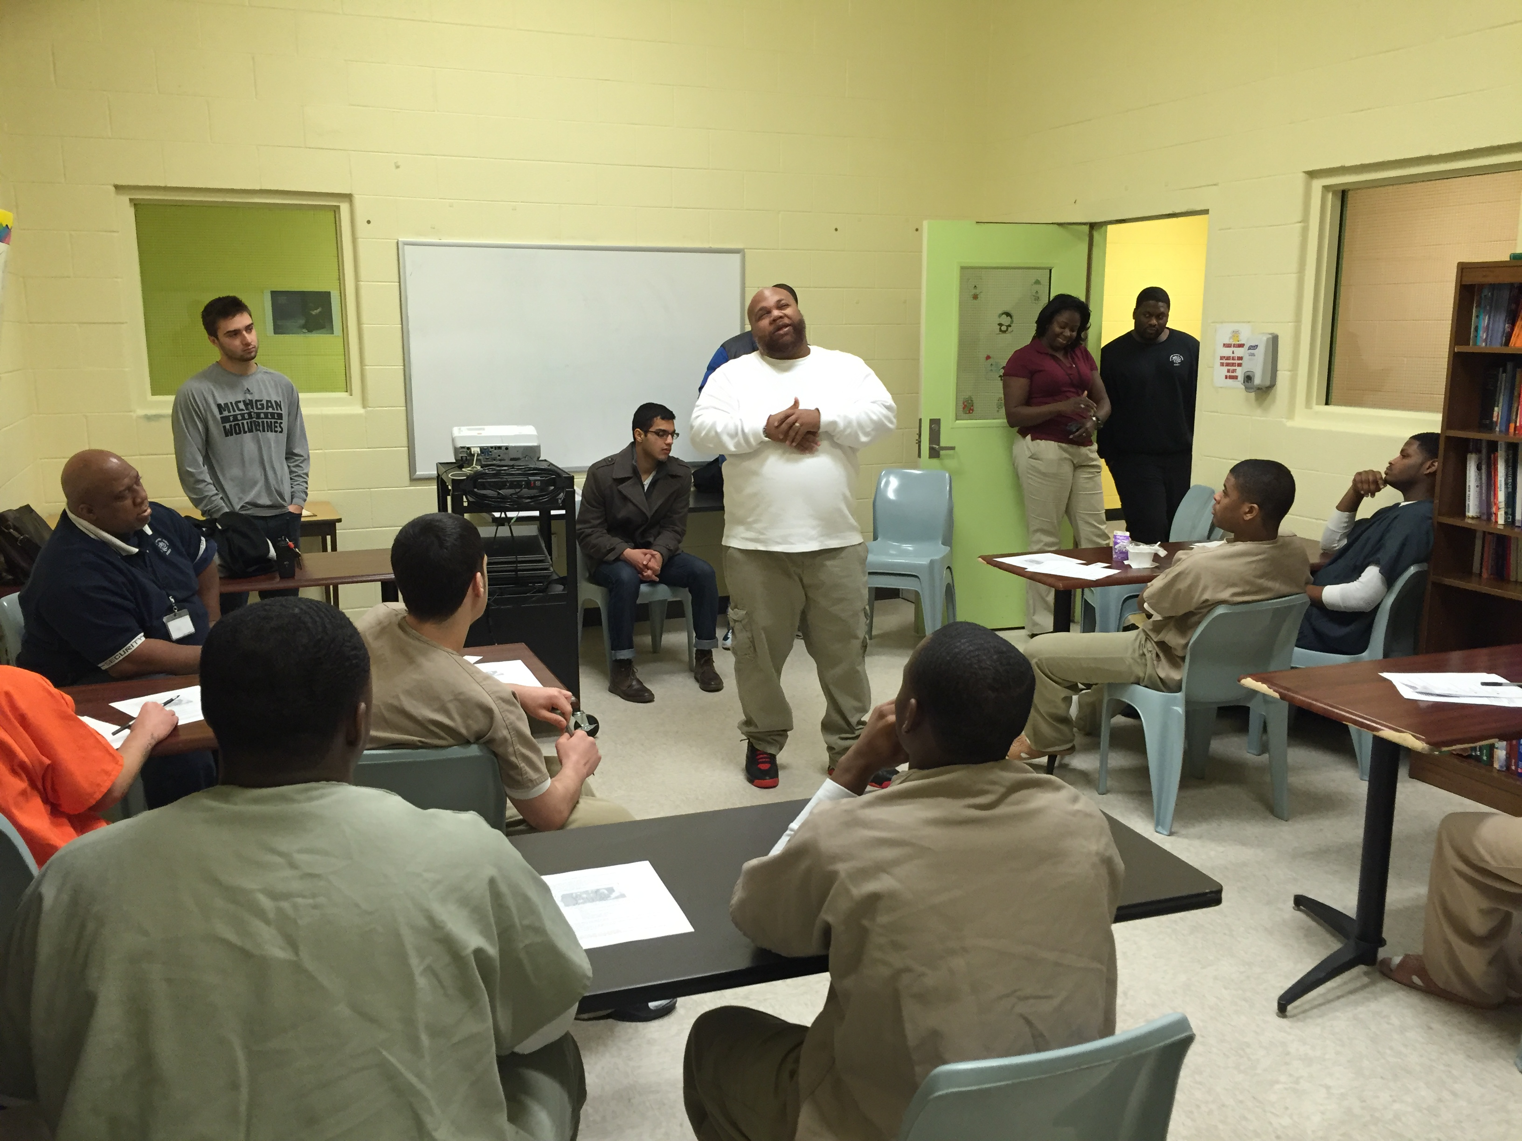
Get Help
Vet Your People
  Dedicated
  No Criminal Record
  Must be Able to Relate
Colleges
  Students need Community Service Hours or Internships
Church

Slide 17
Budget
Food-
  Pizza,
  Sandwiches
Outings
  Laser Tag,
  Basketball Games, Open Gym
Materials
  Writing Utensils
  Notebooks
Who Funds This?
  Church
  Donors
  Small Grants

Slide 18
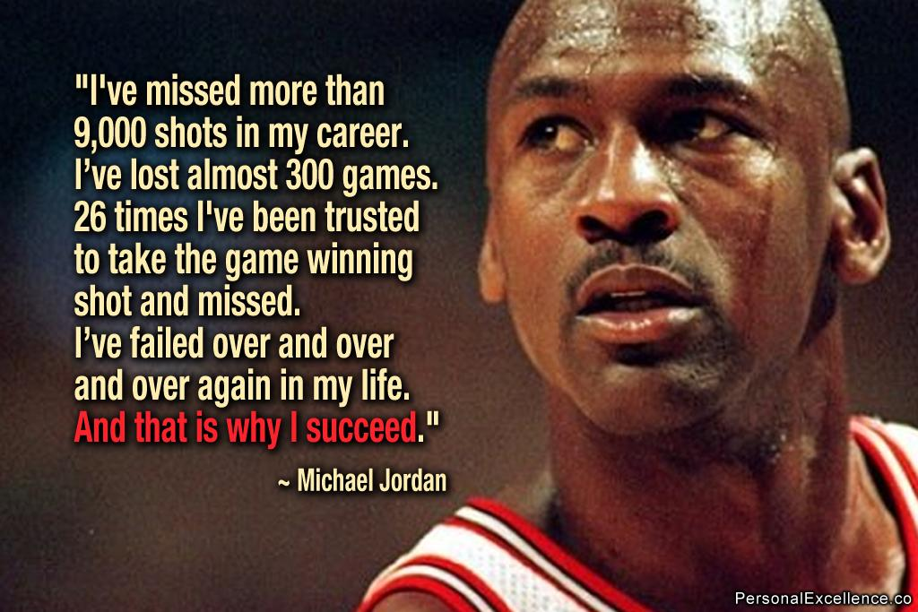
Not Always a Success

Slide 19
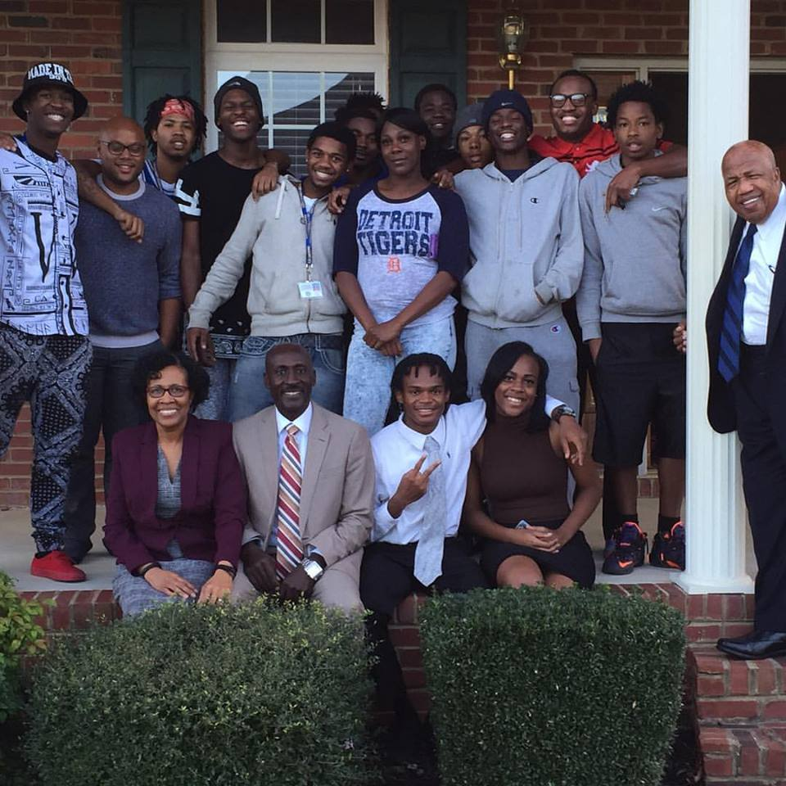

Success Stories

Slide 20


