Slide 1
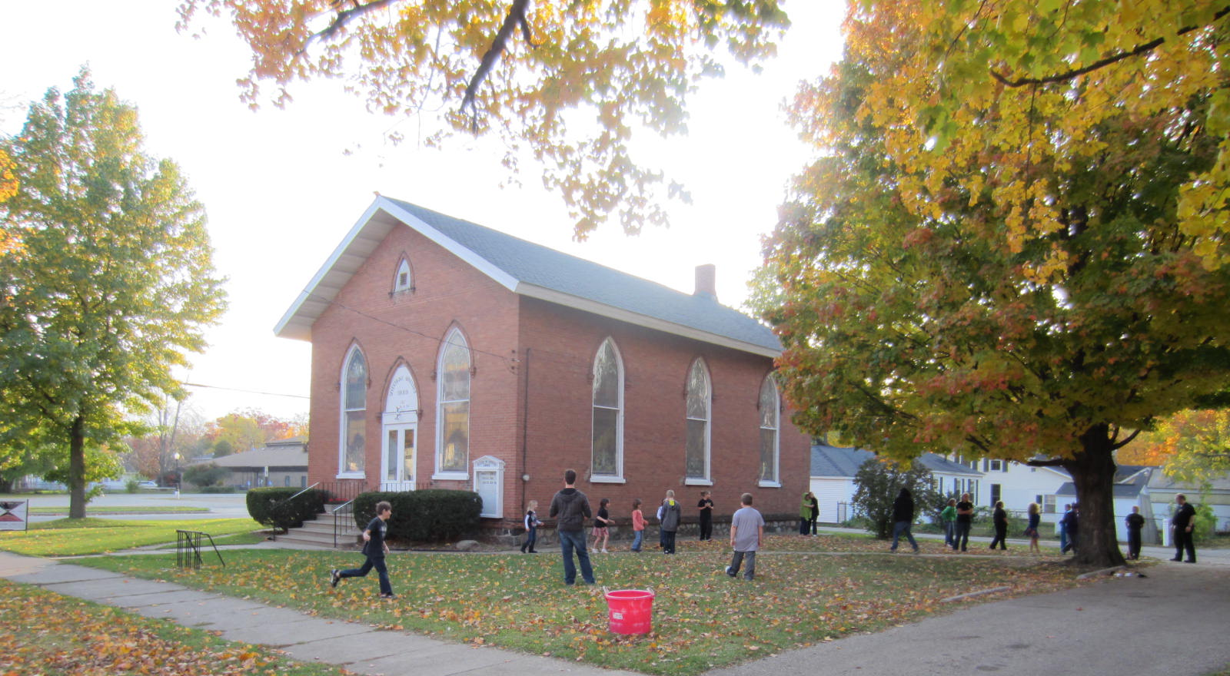
Basic Fact: Kids are growing up not knowing Jesus!
What are YOU going to do about that?
Jesus is coming SOON!

Slide 2
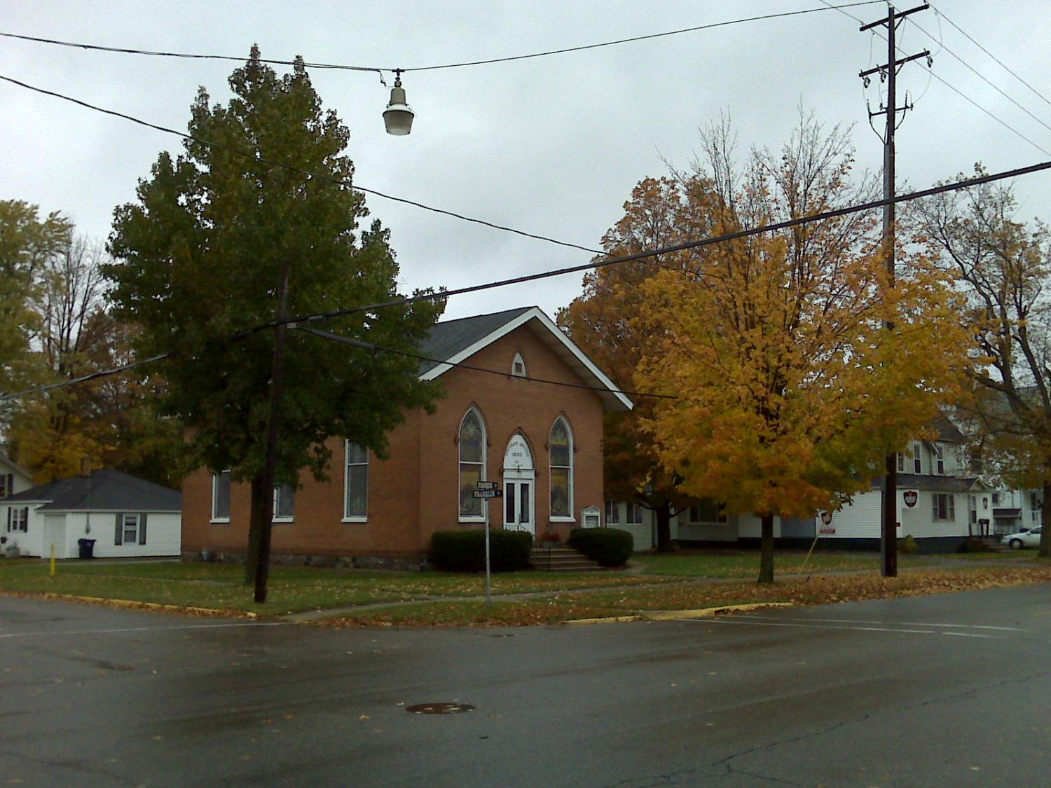
An Old Church Reaching Out in New Ways!

Slide 3
What are these New Ways?
Doing the “Jesus Method”!
GET REAL 4 Kids! Program!
RAD (Road ADoption)Routes!

Slide 4
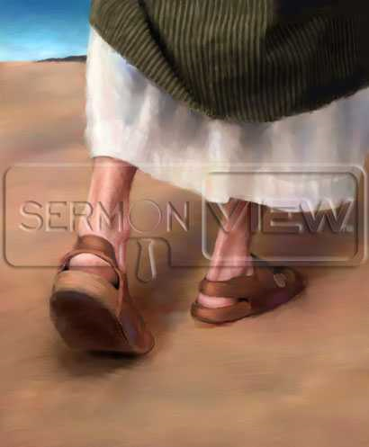
Trying on Jesus’ Shoes
At the Marriage Feast!
And the third day there was a marriage in Cana of Galilee; and the mother of Jesus was there: And both Jesus was called, and his disciples, to the marriage. And when they wanted wine, the mother of Jesus saith unto him, They have no wine. (John 2:1-3 KJVR)
Jesus saith unto them, Fill the waterpots with water. And they filled them up to the brim. (John 2:7 KJVR)
This beginning of miracles did Jesus in Cana of Galilee, and manifested forth his glory; and his disciples believed on him. (John 2:11 KJVR)

Slide 5
Trying on Jesus’ Shoes
At the Marriage Feast!
Jesus did not begin His ministry by some great work before the Sanhedrin at Jerusalem. At a household gathering in a little Galilean village His power was put forth to add to the joy of a wedding feast. Thus He showed His sympathy with men, and His desire to minister to their happiness. White, Ellen Gould: The Desire of Ages; Conflict of the Ages Series, Volume 3; Desire of Ages. Pacific Press Publishing Association, 1898; 2002, S. 144

Slide 6
Trying on Jesus’ Shoes
At the Marriage Feast!
Jesus began the work of reformation by coming into close sympathy with humanity. While He showed the greatest reverence for the law of God, He rebuked the pretentious piety of the Pharisees, and tried to free the people from the senseless rules that bound them. He was seeking to break down the barriers which separated the different classes of society, that He might bring men together as children of one family. His attendance at the marriage feast was designed to be a step toward effecting this. White, Ellen Gould: The Desire of Ages; Conflict of the Ages Series, Volume 3; Desire of Ages. Pacific Press Publishing Association, 1898; 2002, S. 150

Slide 7
Trying on Jesus’ Shoes
Jesus did all this! What about us?
Verily, verily, I say unto you, He that believeth on me, the works that I do shall he do also; and greater works than these shall he do; because I go unto my Father. And whatsoever ye shall ask in my name, that will I do, that the Father may be glorified in the Son. If ye shall ask any thing in my name, I will do it. If ye love me, keep my commandments.
(John 14:12-15 KJVR)

Slide 8
Basic Fact: Asking tough questions can help bring answers!
Does your church have young people in it?
Does your church reach out to the kids and youth in your community?
If Jesus came to your church, would there be people who would try to keep the kids away?
What was Jesus’ method of reaching people and getting them to follow him?

Slide 9
Trying on Jesus’ Shoes
How did Jesus do it?
Same way we are!
“Christ’s method alone will give true success in reaching the people. The Saviour
mingled with men as one who desired their good.
He showed His sympathy for them,
ministered to their needs,
and won their confidence.
Then He bade them, "Follow Me”.”
The Ministry of Healing, p. 143. {ChS 119.3} Emphasis and numbers supplied

Slide 10
Trying on Jesus’ Shoes
Jesus saw in every soul one to whom must be given the call to His kingdom. He reached the hearts of the people by going among them as one who desired their good. He sought them in the public streets, in private houses, on the boats, in the synagogue, by the shores of the lake, and at the marriage feast. He met them at their daily vocations, and manifested an interest in their secular affairs. –Christian Service P119

Slide 11
Basic Fact: Jesus taught us to LOVE one another!
This is my commandment, That ye love one another, as I have loved you.
(John 15:12 KJV) –emphasis supplied

Slide 12
How are We doing the “Jesus Method”?

Slide 13
What do we do?
Every week on Tuesdays we:
Feed them dinner
Play table games
Play Wii & Playstation games
Play games outside
Come inside for Refreshments & Worship!
Prayer time with prayer requests
Get to know parents as kids are picked up!

Slide 14
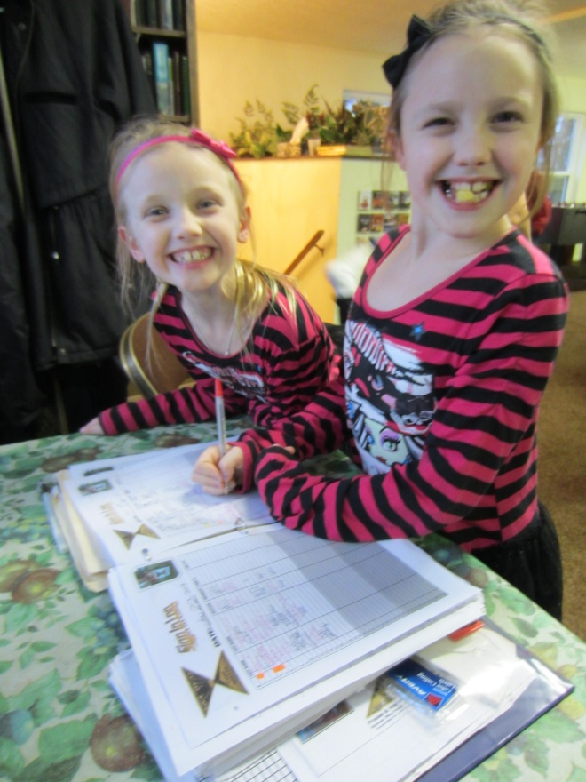
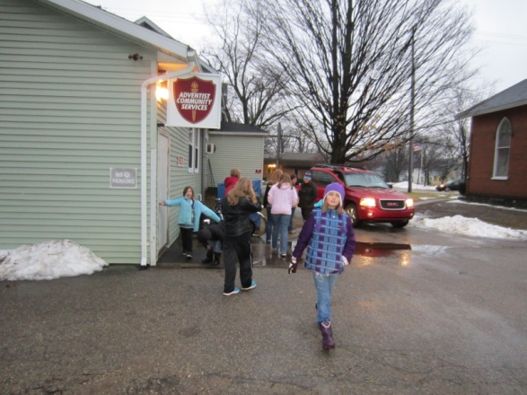
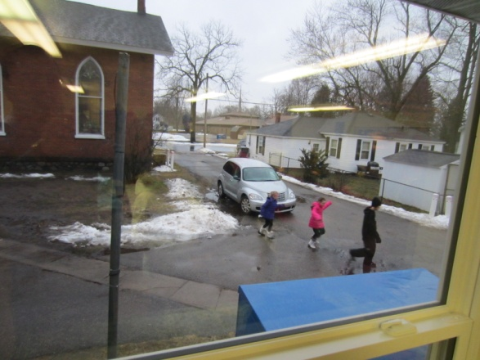
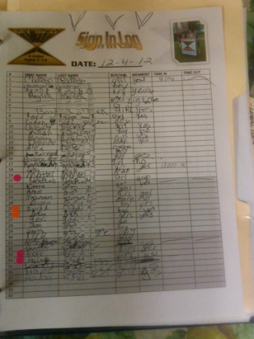
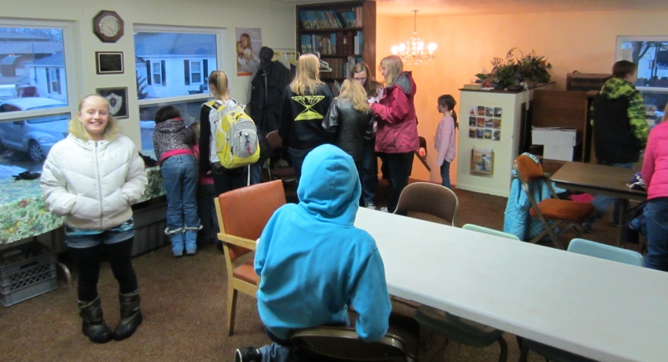
Arrive & Sign In!
Driving up and seeing kids waiting makes your day!

Slide 15
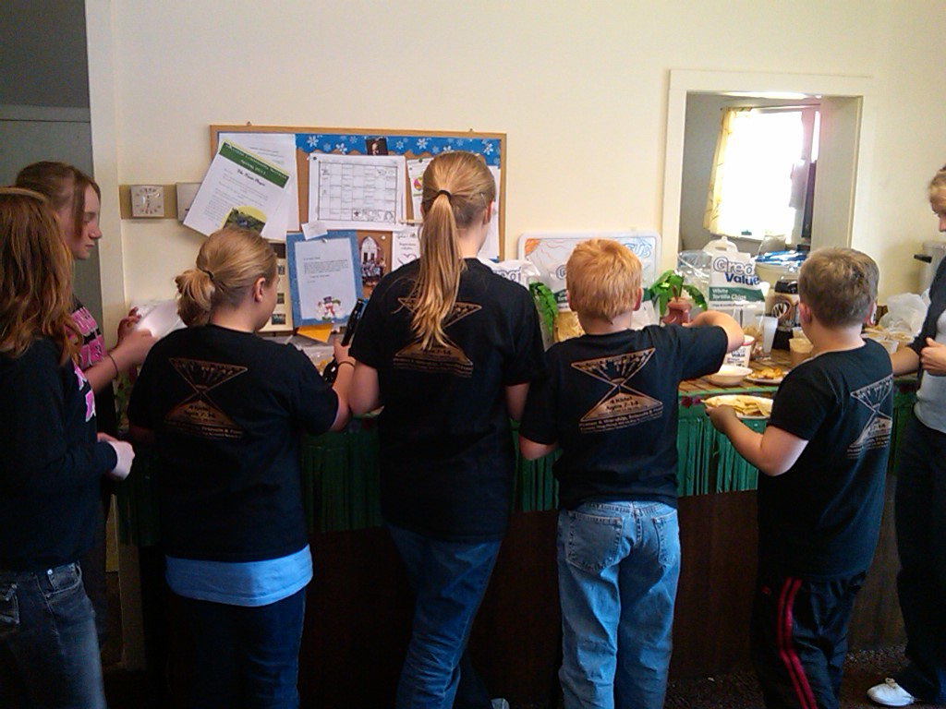
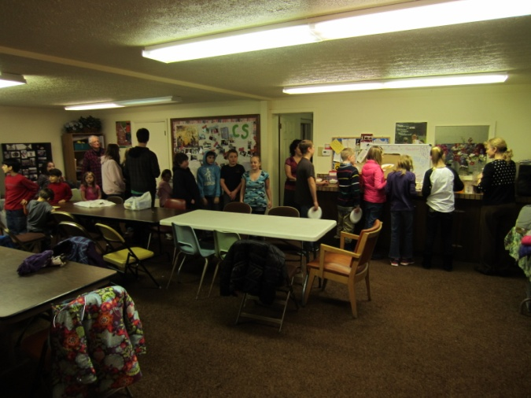
Basic Fact: Kids love FOOD!
Parents love to have a night off from fixing supper too!!!

Slide 16
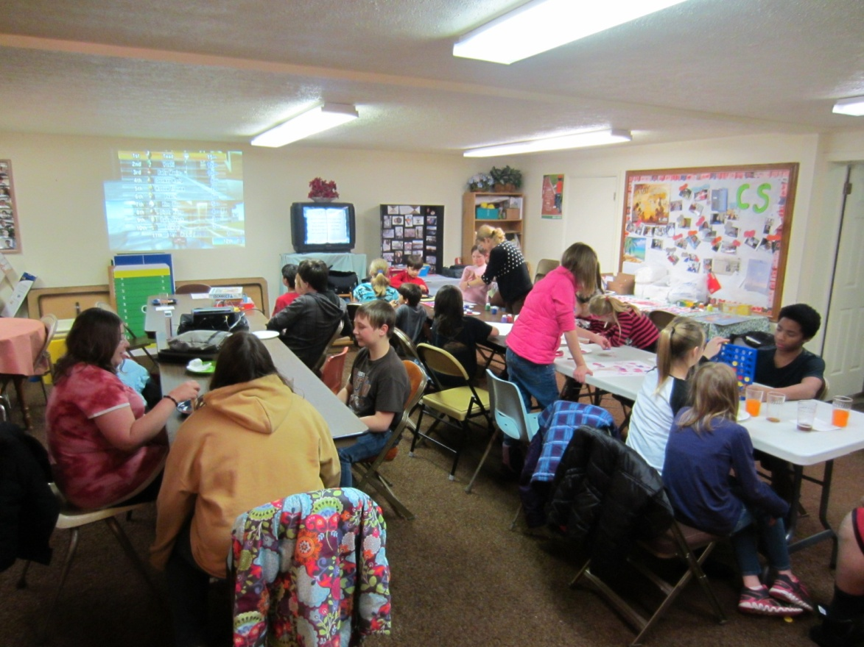
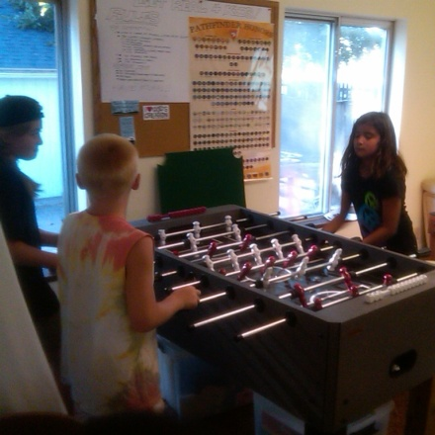
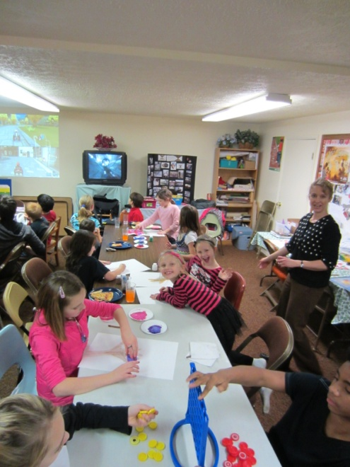
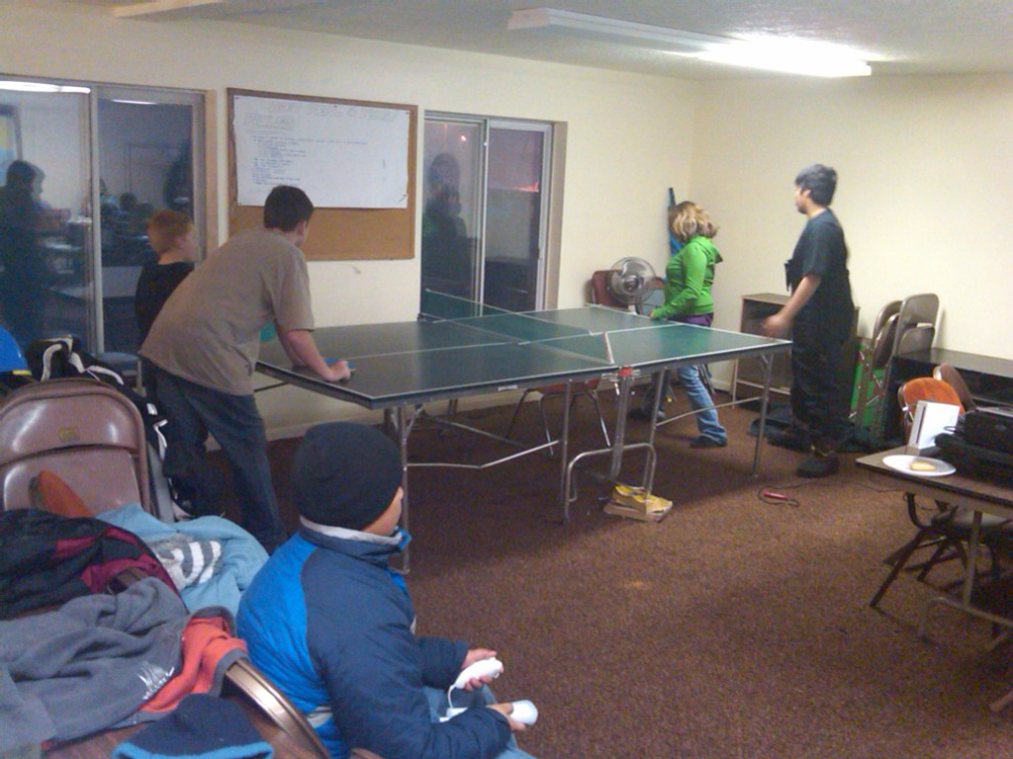
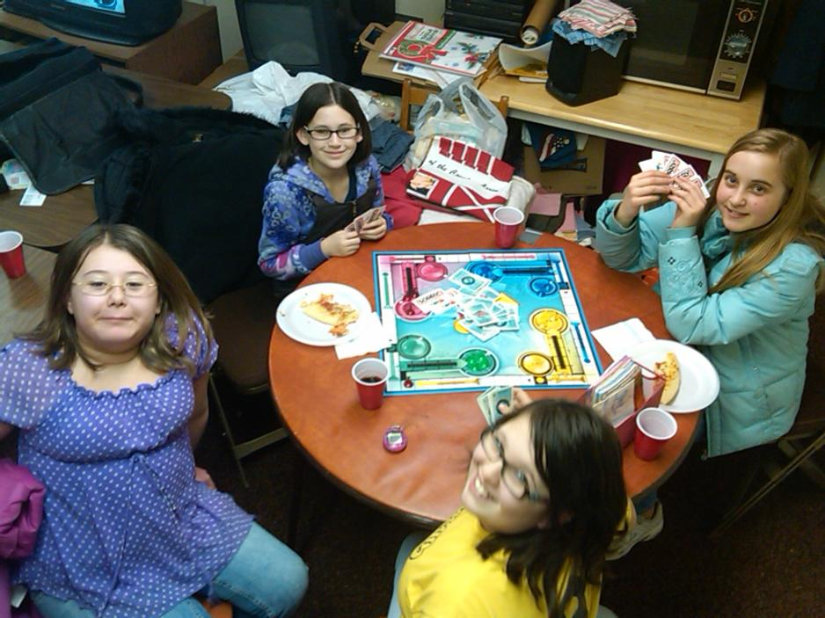
Game Time!

Slide 17
Is it time to go outside yet?!!!

Slide 18
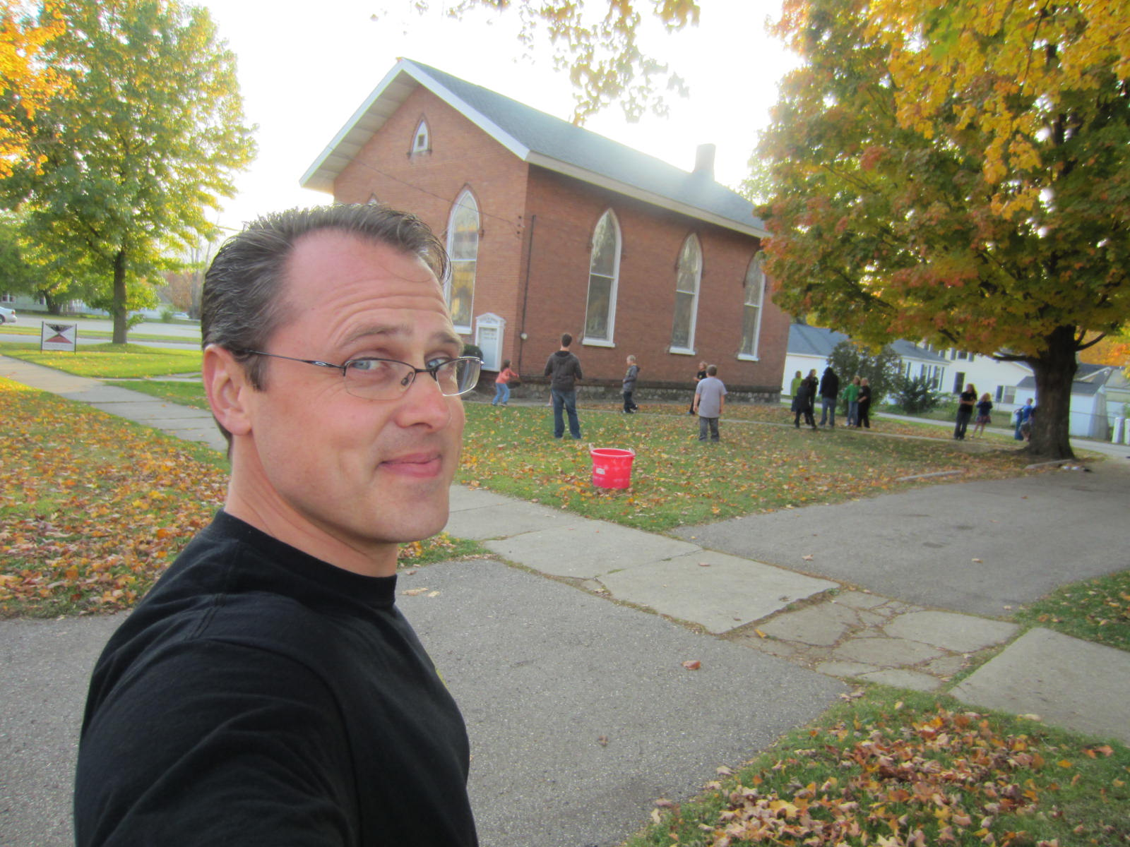
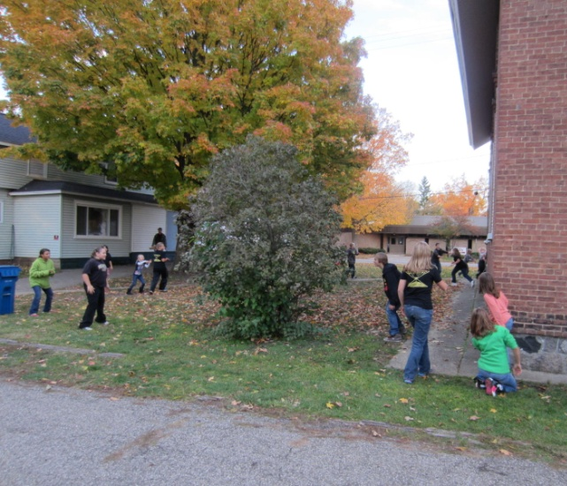
Basic Fact: Kids don’t need much to have fun!
Capture the flag & B-Ball!
Get exercise
Learn to “play nice”!

Slide 19
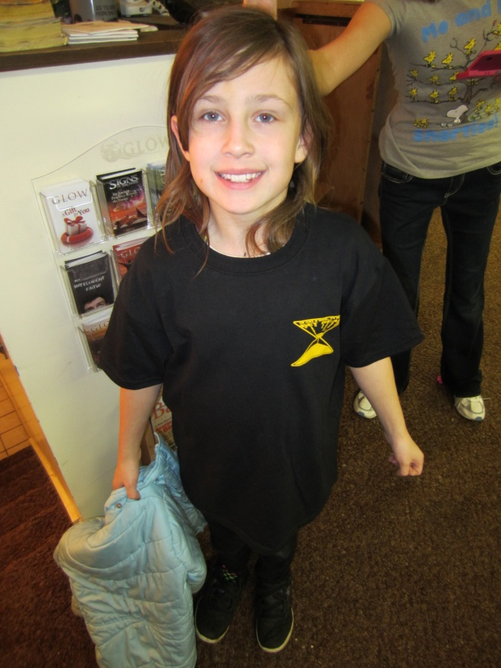
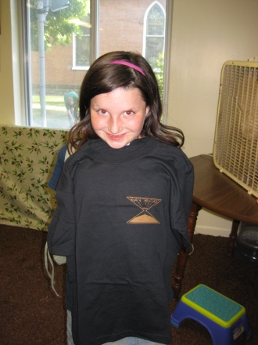
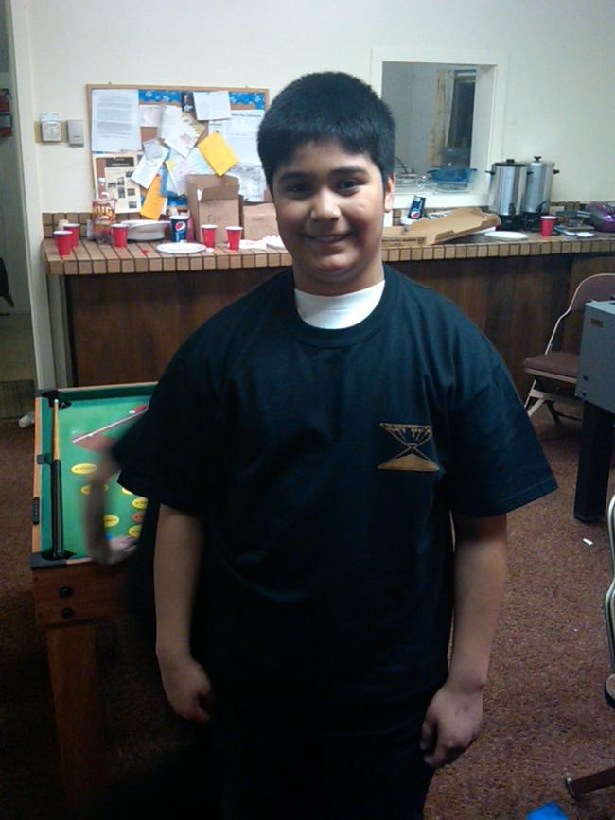
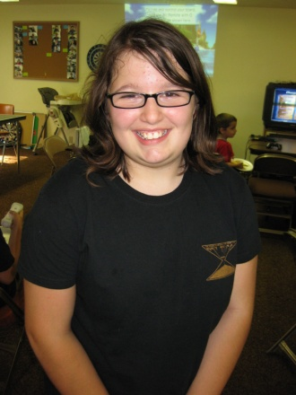
Oh yea! New Shirts!

Slide 20
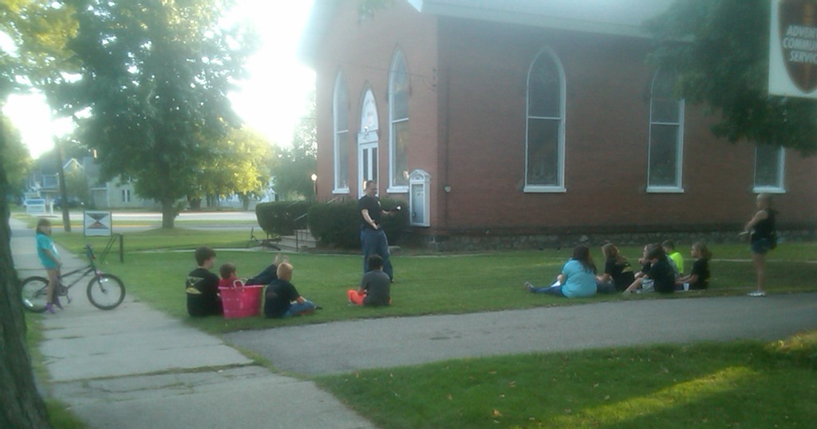
Basic Fact: Kids love to learn about God!
Make God REAL
Keep it short and to the point
Show the Power of God
Lift up Jesus!

Slide 21
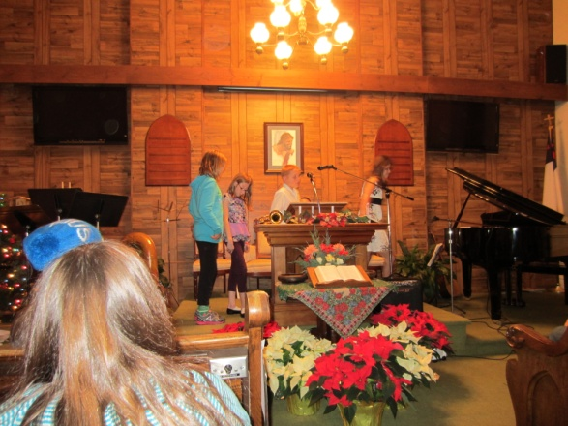
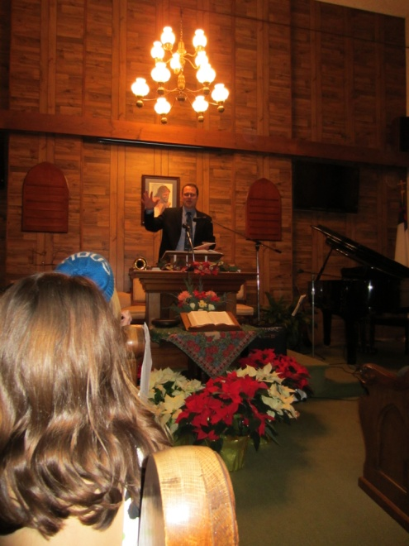
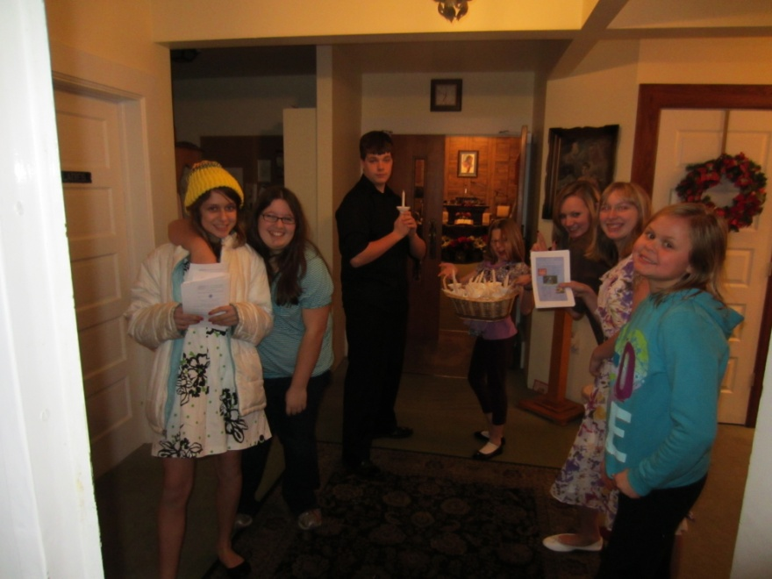
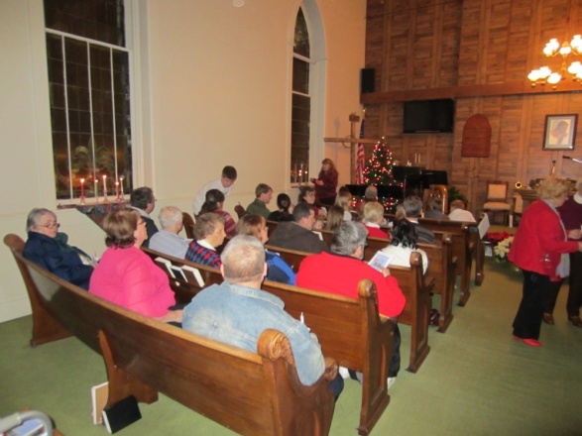
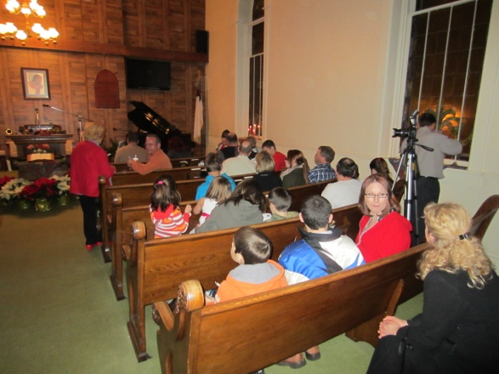
Christmas Program with GET REAL 4 Kids!
Over ½ attending were from
our community!

Slide 22
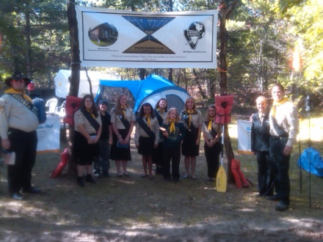
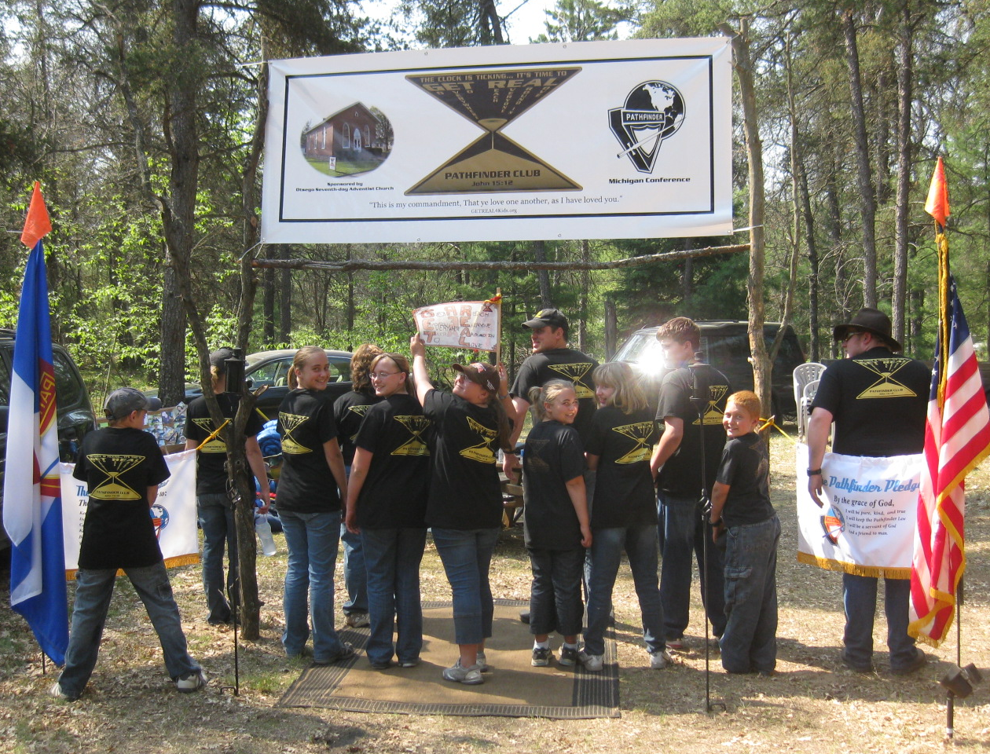
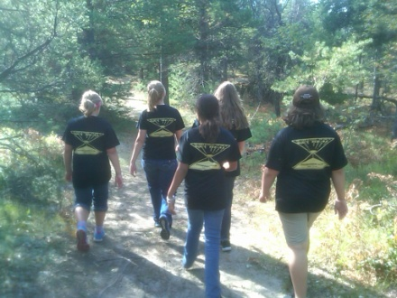
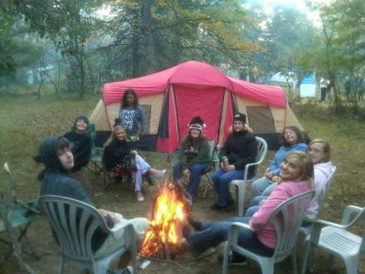
Growing a Pathfinder Club from GR4K!

Slide 23
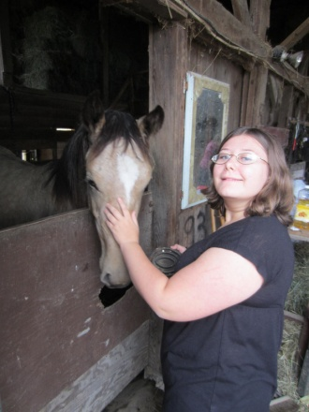
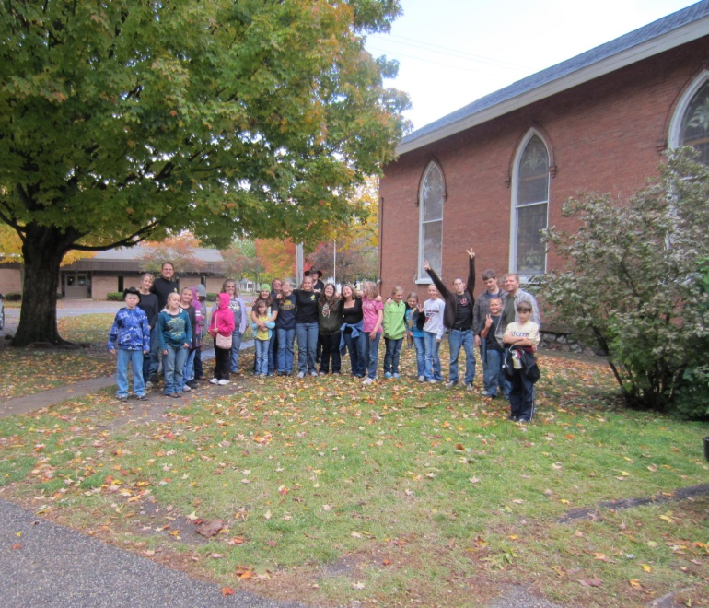
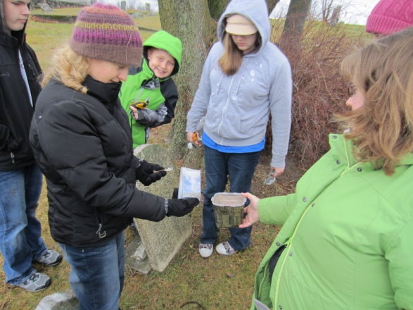
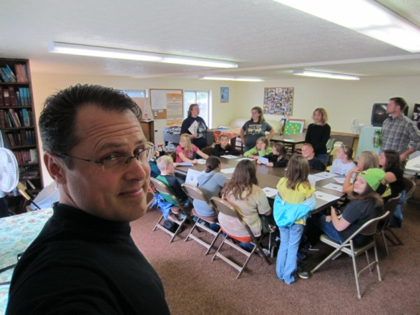
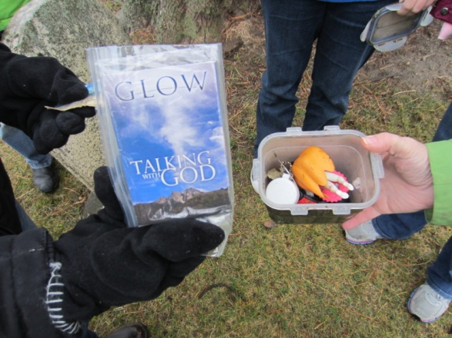
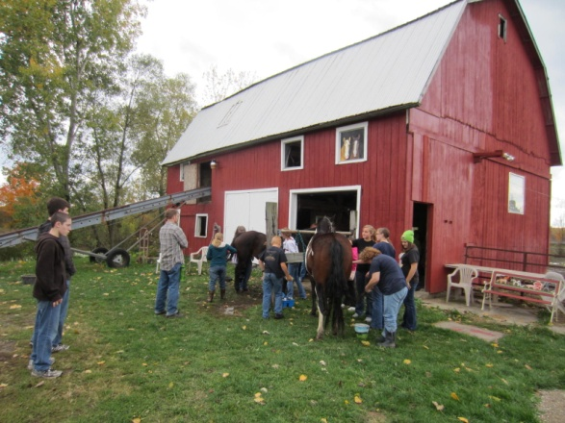
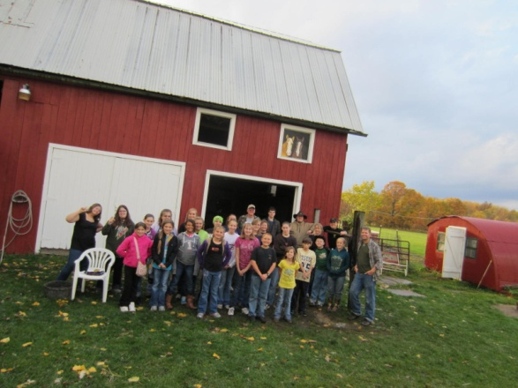
Kids love to learn Pathfinder honors!
Horsemanship!
Geocaching with GLOW Tracks!

Slide 24
Trying on Jesus’ Shoes
By personal labor reach those around you. Become acquainted with them. Preaching will not do the work that needs to be done. Angels of God attend you to the dwellings [BEGIN P.118] of those you visit. This work cannot be done by proxy. Money lent or given will not accomplish it. Sermons will not do it. By visiting the people, talking, praying, sympathizing with them, you will win hearts.

Slide 25
What do you do to get started?
Pray about it and ask God to open the door of opportunity if it is His will.
Talk to your pastor about it and ask Him how this would fit into your church.
Have your pastor help you prayerfully present it before the church board.
Set aside a budget for expenses
Prayerfully recruit leaders
Background checks & training
Create Sign-in log & parent waivers
Set up area and purchase sign
Print flyers and promote to community
Pray hard and GET REAL!

Slide 26
An Old Church Reaching Out in New Ways!
Seeking God’s Power, Guidance, & Love as we move forward to finish the work He has given us to do!

Slide 27
The Clock is Ticking! It’s Time To
GET REAL!
GO
EVERYWHERE
TO
REACH
EVERYONE
AROUND in
LOVE!

Slide 28
To Learn More!
Website: www.GETREAL4Kids.com
E-mail: JLanphear@PowerofGodministry.org
Credits!
All glory and honor goes to our Awesome Heavenly Father and Jesus Christ His Son!
Thank you also to Otsego church members who have supported this program with their time, money, and most importantly their prayers!
Thank you also to my awesome supportive wife Mindy and kidos Heather, Hannah, and David!

