Slide 1
A Passion for
Compassionate Ministry

Slide 2
A Heart of Service
²⁷For who is greater, the one who is at the table or the one who serves? Is it not the one at the table? But I am among you as one who serves. Luke 22:27 (NRSV)

Slide 3
Ellen & Agnes
“From a worldly point of view, money is power, but from the Christian standpoint, love is power.” – Ellen White
“Let us not be satisfied with just giving money. Money is not enough. Money can be got, but others need your heart to love them. So, spread love everywhere you go.” – Mother Theresa

Slide 4
Your Picture of God
Notes:
What words come to mind when you think of GOD?

Slide 5
Ministry of Healing
Christ's method alone will give true success in reaching the people. The Saviour mingled with men as one who desired their good. He showed His sympathy for them, ministered to their
needs, and won their confidence. Then He bade them, "Follow Me." (pg. 143)

Slide 6
Cycle of Ministry
Socialize-1
Sympathize-2
Salvation-4
Serve-3
©2000, ROSADO CONSULTING for Change in Human Systems
Notes:
A summary of the MoH quote: Jesus – Socialized, Sympathized, Served, Saved. Focus on cyclical nature of His ministry and how salvation leads to more socializing, sympathizing, and serving, and saving.

Slide 7
Ministry of Healing
There is a need of coming close to the people by personal effort. If less time were given to sermonizing, and more time were spent in personal ministry, greater results would be seen. The poor are to be relieved, the sick cared for, the sorrowing and the bereaved comforted, the ignorant instructed, the inexperienced counseled.

Slide 8
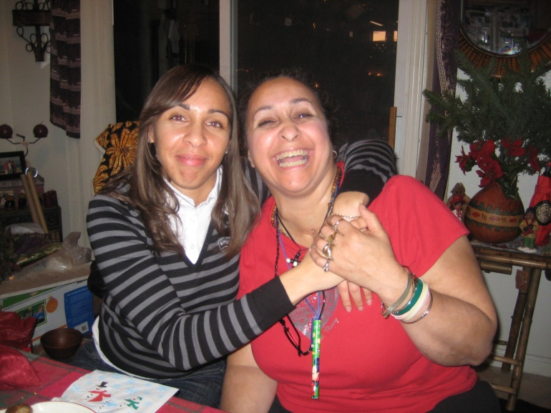
Ministry of Healing
We are to weep with those that weep and rejoice with those that rejoice.
(pg 142)
Notes:
Quote from Romans 12:15

Slide 9
God & Religion
Notes:
Interactive: What does God mean to you?
What does religion mean to you?

Slide 10
James 1:27-28
“Religion that God our Father accepts as pure and faultless is this: to look after orphans and widows in their distress and to keep oneself from being polluted by the world.” James 1:27-28
Notes:
Service to others is based on our Love for God which is manifest in our Love for Others. Without this Love, without a life of service, we are no different than the pharisees who thanked God daily that they were not like the sinners.

Slide 11
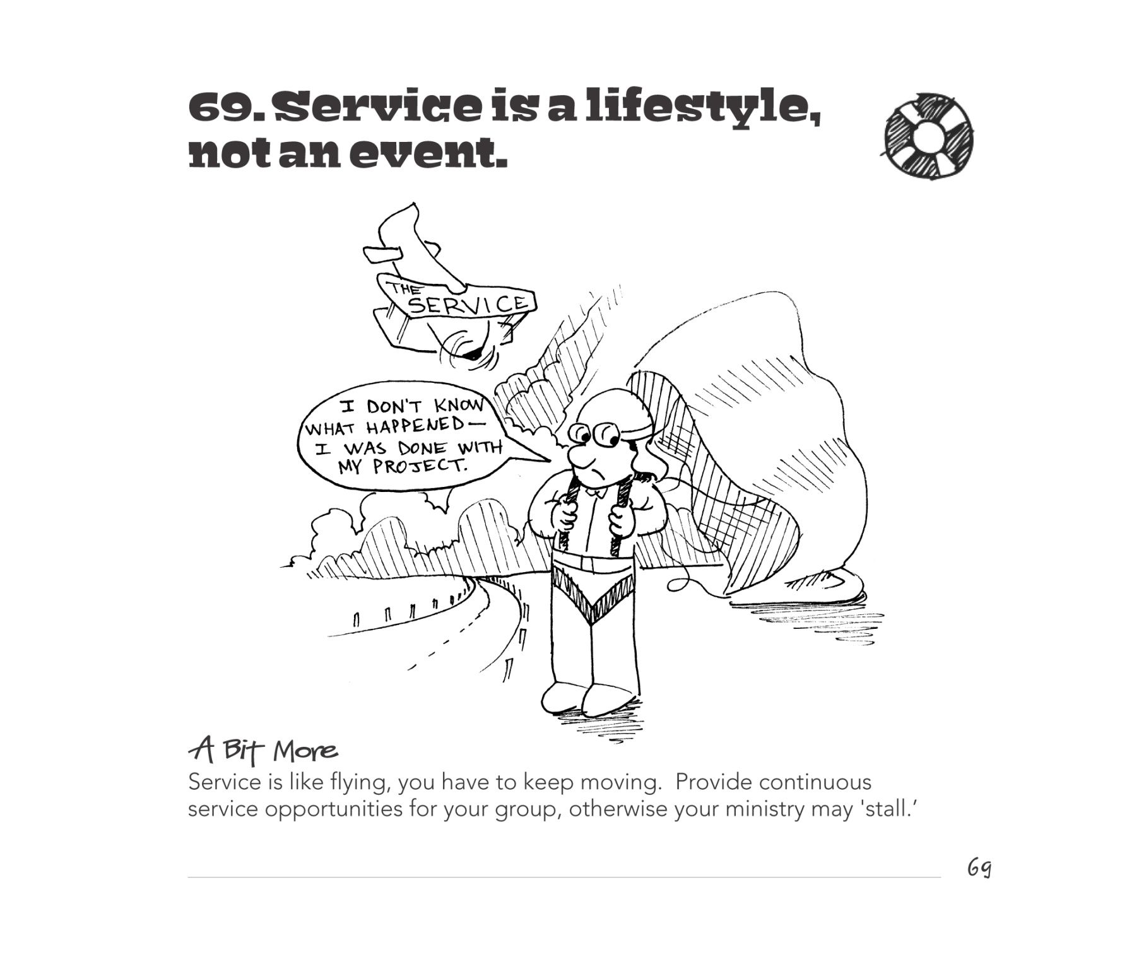
TIPS FOR INVOLVING YOUTH IN SERVICE (AdventSource)
by Vibbard/Conrad Illustrations by Milton Coronado
© 2011 North American Division of Seventh-day Adventists
Notes:
Tip 69 – Don’t let your ministry stall out – make your life all about others.

