Slide 1
By Kamil Metz, Director
Literature Ministries Dept
Michigan Conference

Slide 3
Notes:
Attractive, relevant tracts on Health, Bible subjects addressing contemporary issues

Slide 4
Notes:
The purpose of GLOW tracts is to get the message out and in the same time to produce spiritual interests, mainly Bible study interests.
Contact is for the local conference office…

Slide 5
“There are many places in which the voice of the minister cannot be heard, places which can be reached only by our publications,—the books, papers, and tracts filled with the Bible truths that the people need.”
Testimonies, Vol. 8, 89

Slide 6
Read: “The books, papers, and tracts…”
Nelson Ernst
Age 22
Notes:
The idea of GLOW tracts was born…

Slide 7
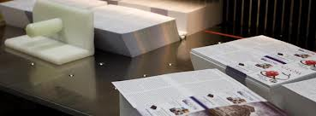
First GLOW Tracts Printed
in September 2007
So far 29,355,000 GLOW tracts printed
Notes:
The first GLOW tracts were printed..
Ministry where everyone can be involved
Children, Youth, Adults

Slide 8
Notes:
Cynthia Salinas

Slide 9
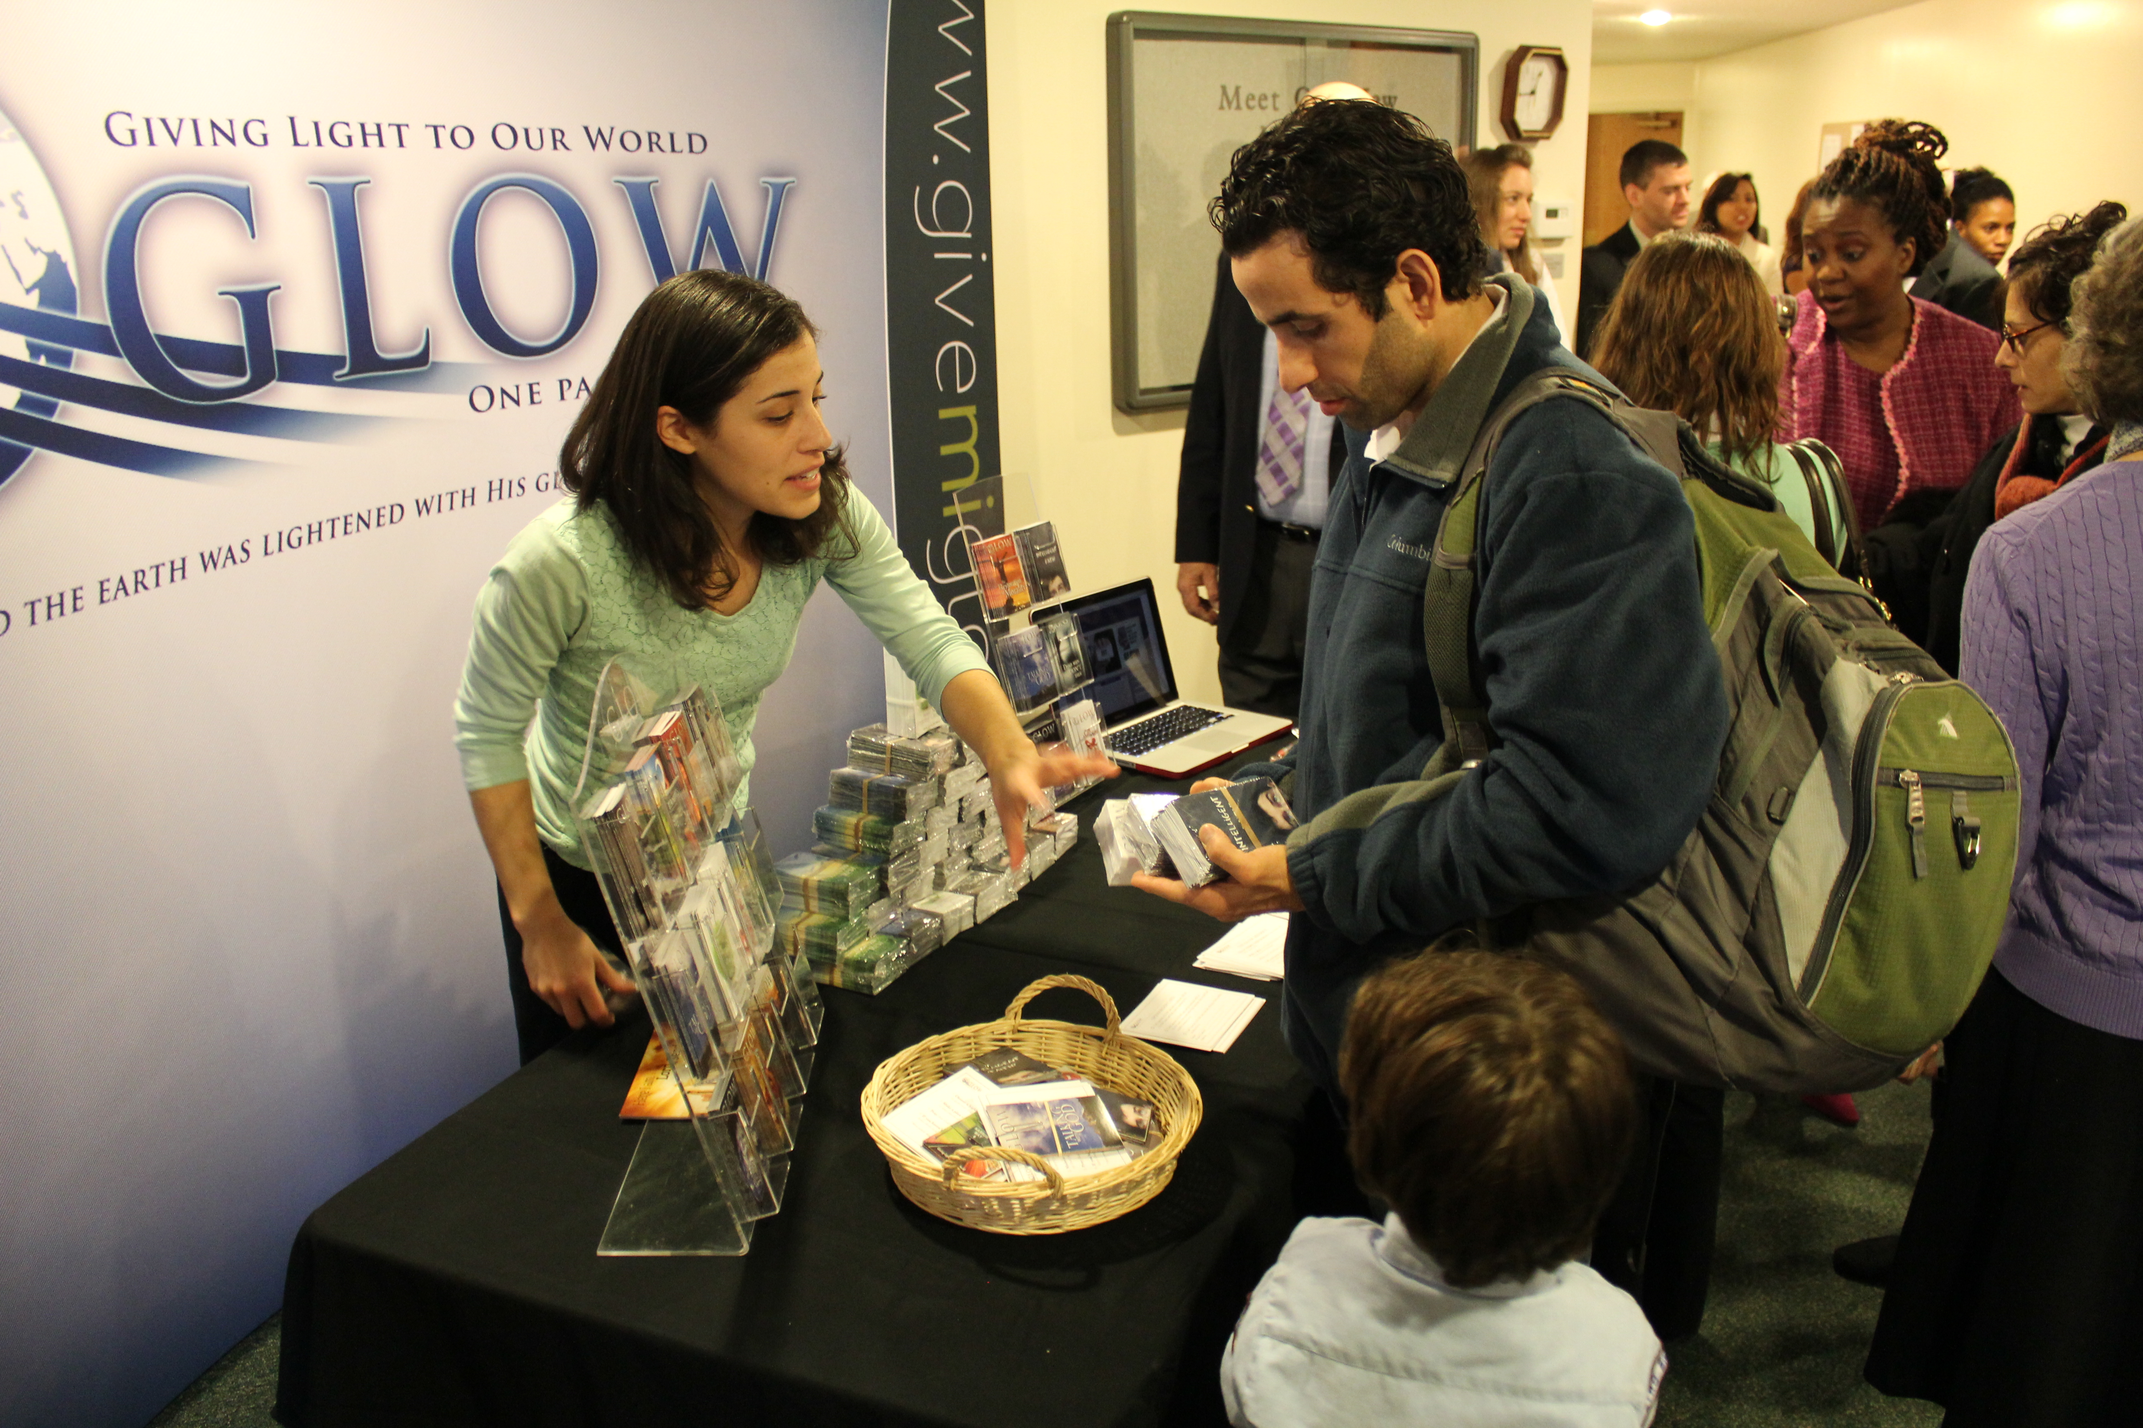
Cynthia Salinas & GLOW-a-thon

Slide 10
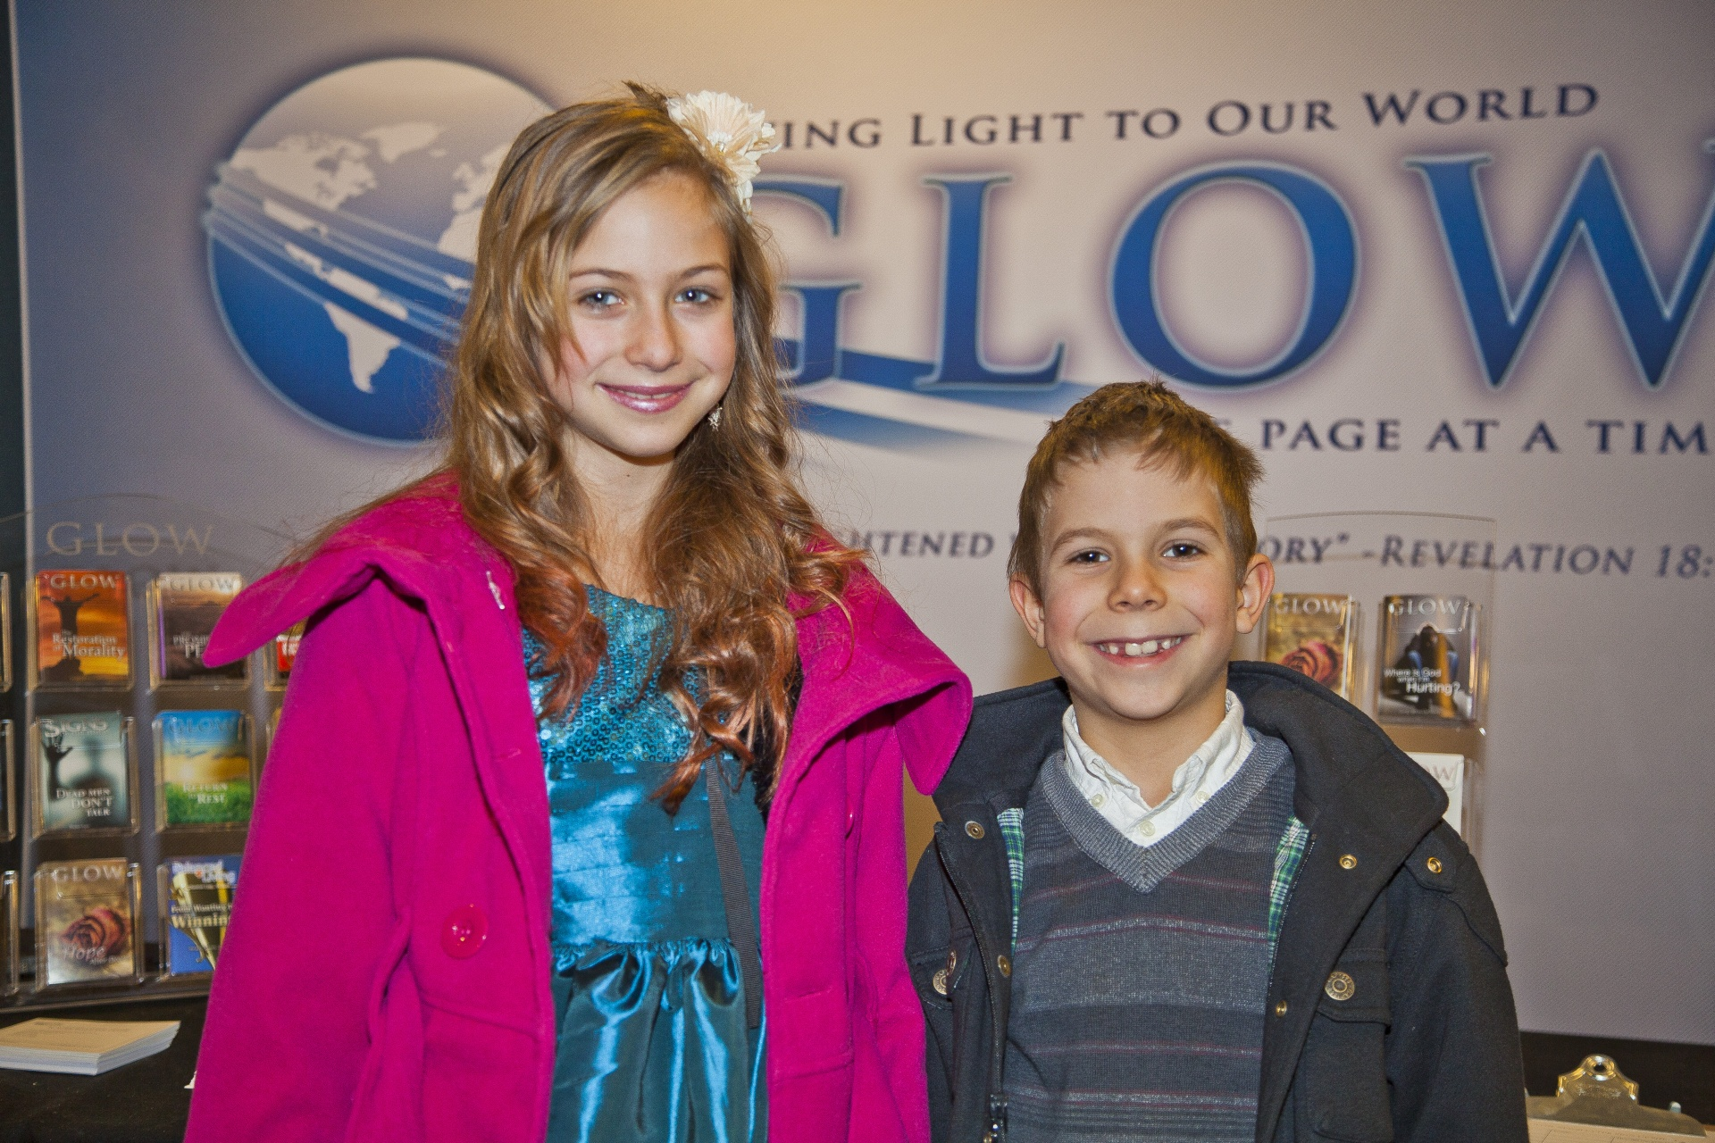
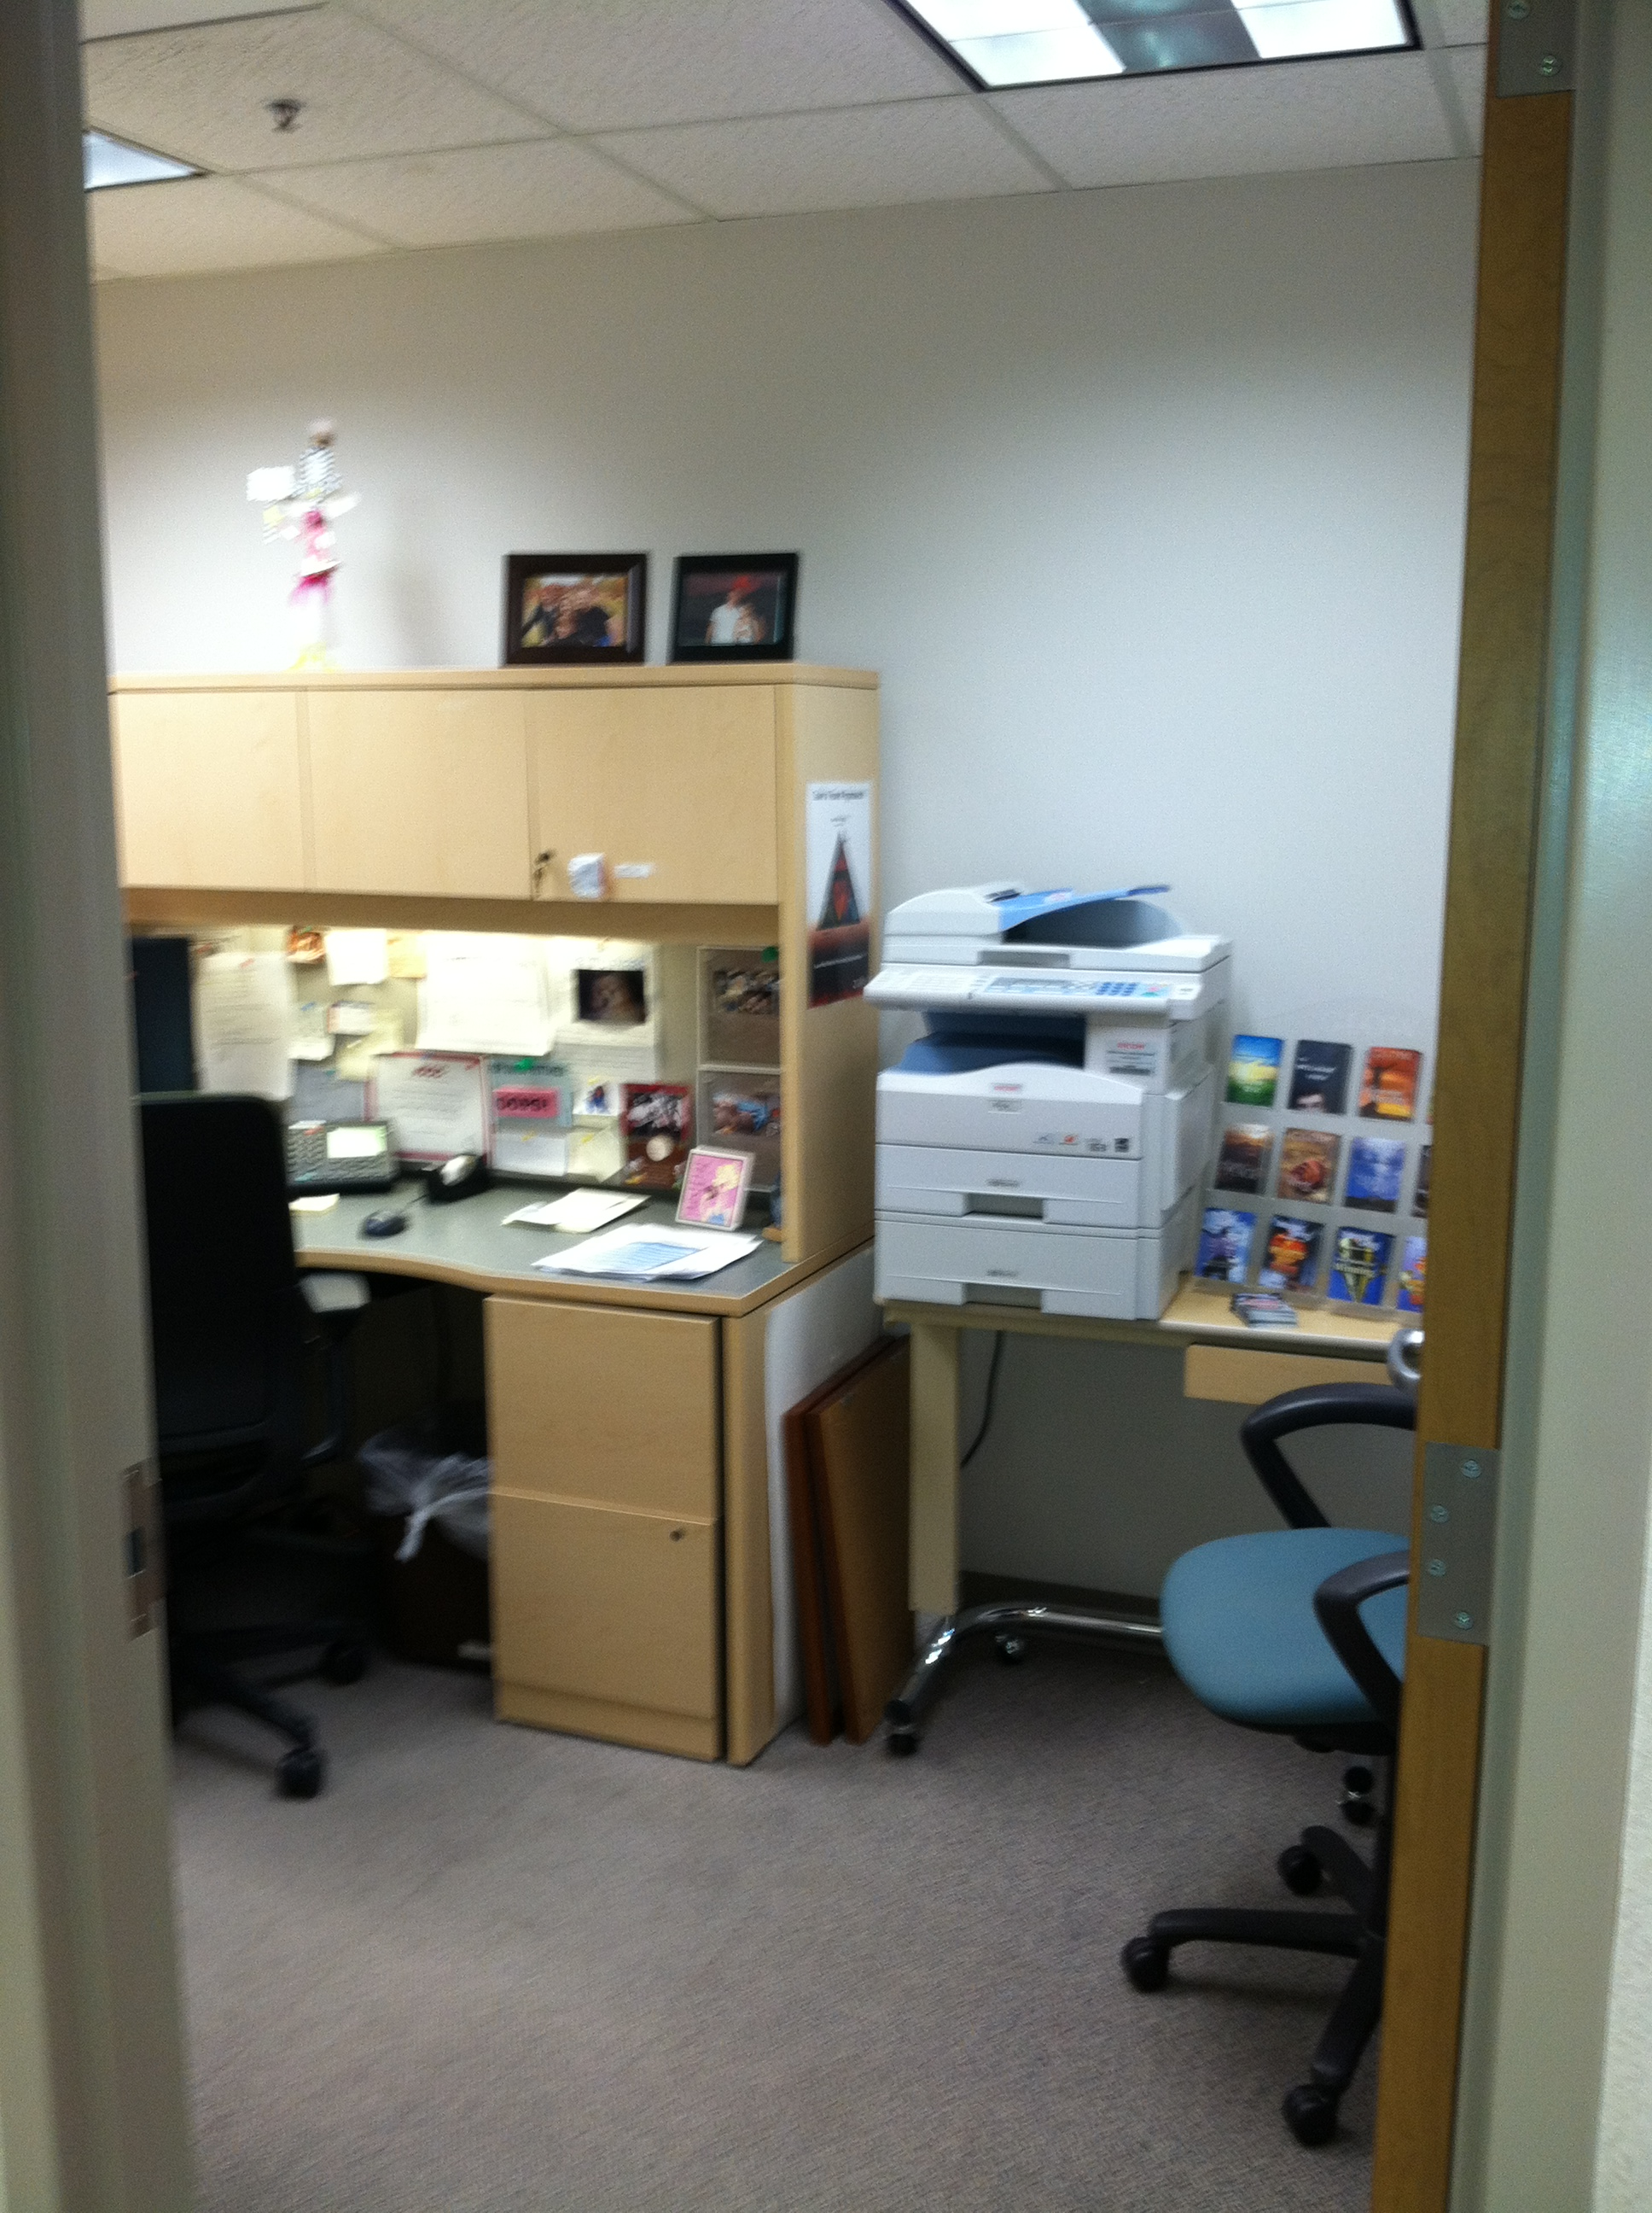
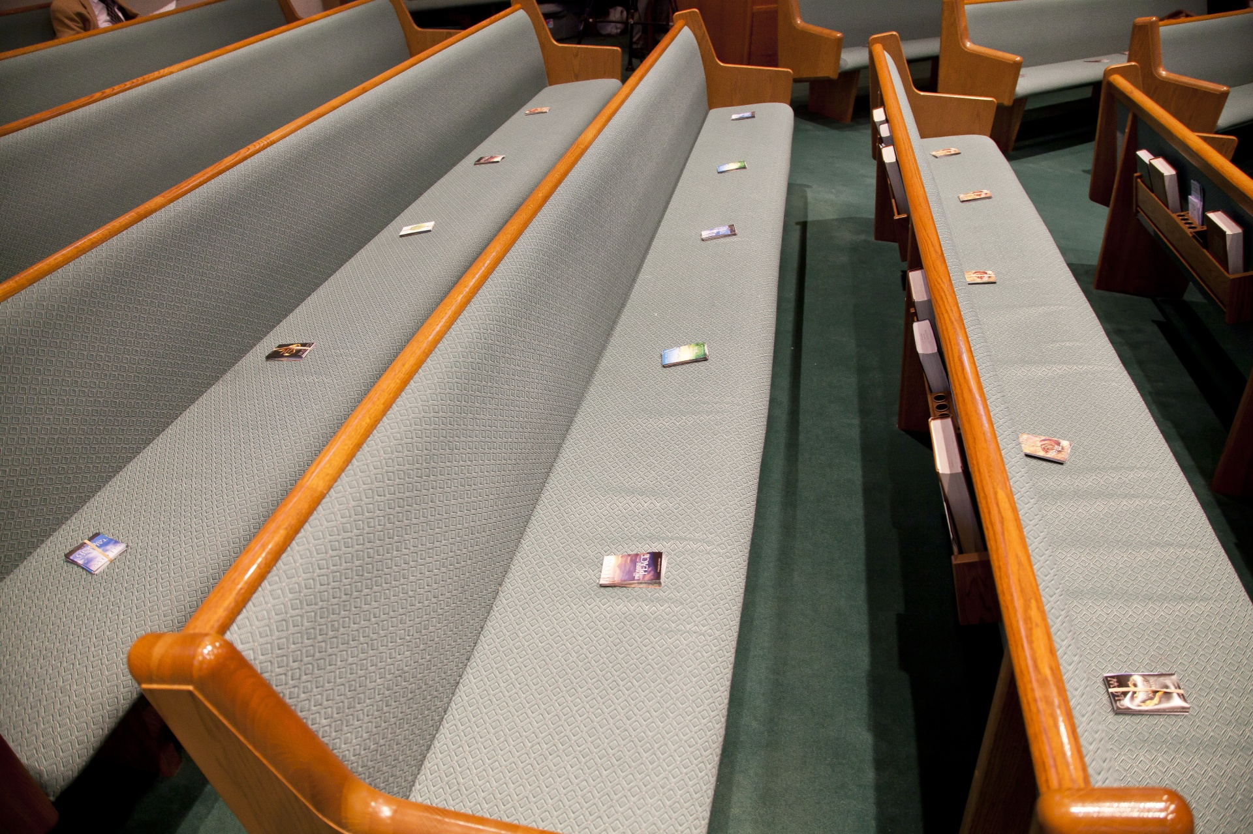
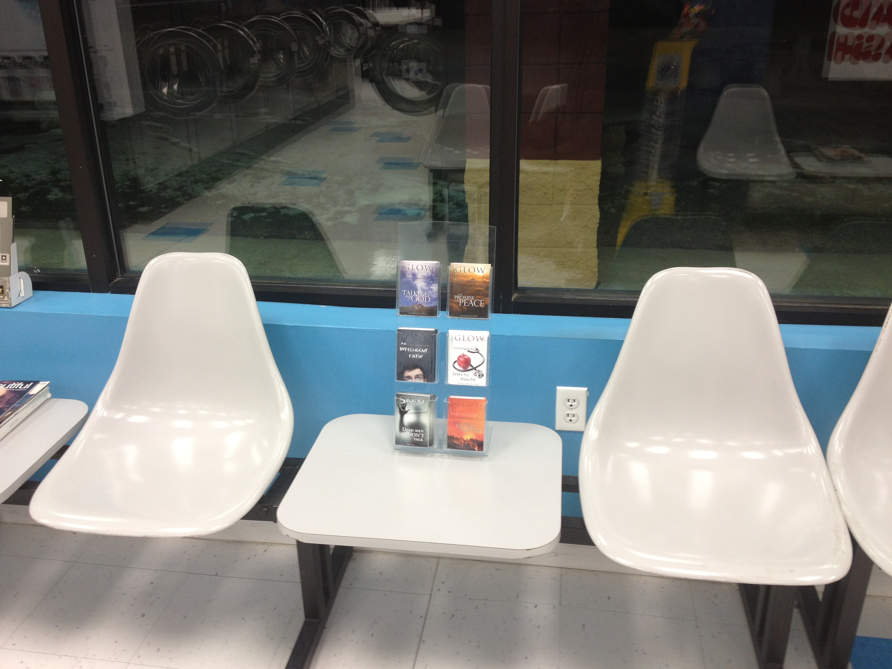
Notes:
Pathfinders at nursing home
Outreach
GLOW rack at the office/Laundromat
Office: MY GOD RACK

Slide 11
Urban Evangelism
Reaching the Big Cities
Notes:
This next weekend kicking off GLOW-a-thon in ALL Detroit churches!
250,000 TRACKS PRINTED.
20 young people – will distribute 50,000 tracts.
Young person’s idea!
PRAISE GOD!

Slide 12
“We are fast approaching the end. The printing and circulation of the books and papers that contain the truth for this time are to be our work.”
Testimonies, vol. 8, 89
Notes:
We are a part of something bigger than ourselves.
We are a part of a world-wide movement

Slide 13
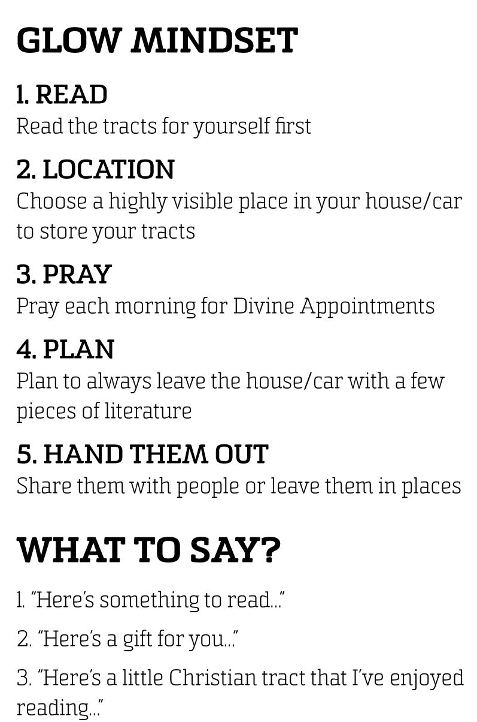
Notes:
IN YOUR GLOW WALLET

Slide 14
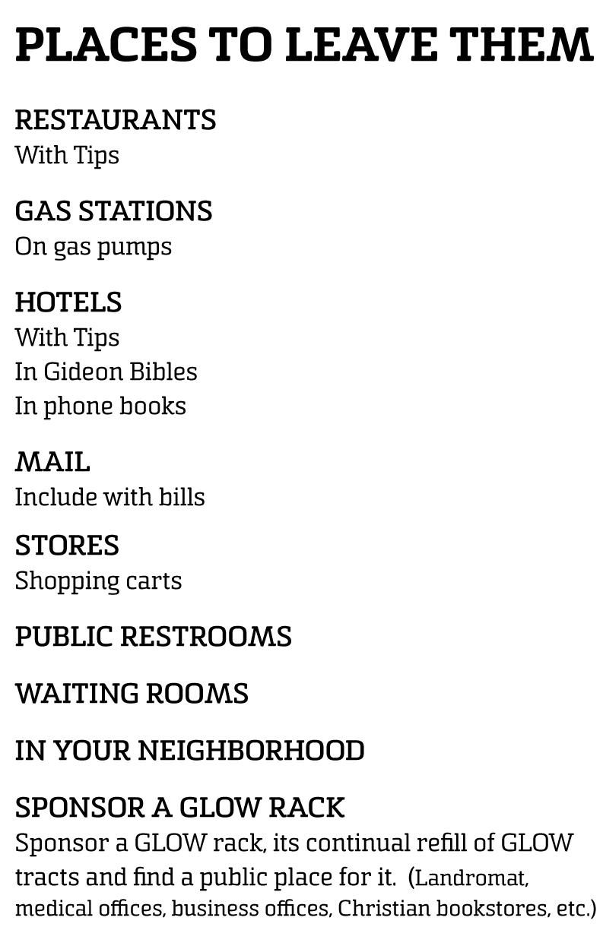
Notes:
IN YOUR GLOW WALLET

Slide 15
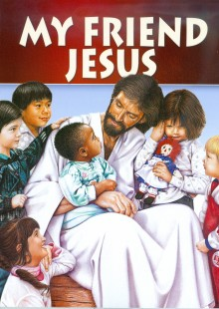
Magabook
Ministry
Notes:
Another literature Idea…

Slide 16
“God desired that the sale of Christ’s Object Lessons shall be recognized by all our people as His method of relieving our schools from debt.”
Publishing Ministry, 363

Slide 17
Summer
Magabook Ministry
Youth Ministry.
Mentored youth lead and train other youth in evangelist efforts
Education/Scholarship Program.
Provides employment for our young people so they can afford a Christian Education
Outreach program.
Teaches our youth to do ministry

Slide 18
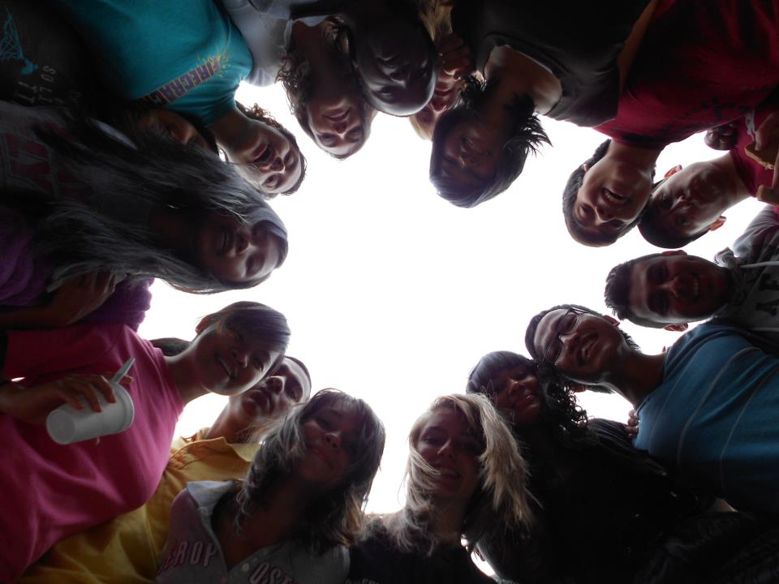
Over the Past 10 Summers…
Our Young People placed over $2.5M worth of literature in communities
Our Young People received over $1.6M toward their education
Through this ministry 100’s of young people have been trained to assist the church in sharing the message

Slide 19
Year-Round
Magabook Ministry
Over 30 Michigan church schools have been involved in this ministry
Pathfinders raising money for Oshkosh
Monies were raised for schools, mission trips, evangelistic projects
AND SOULS WERE REACHED IN THE SAME TIME!

Slide 20
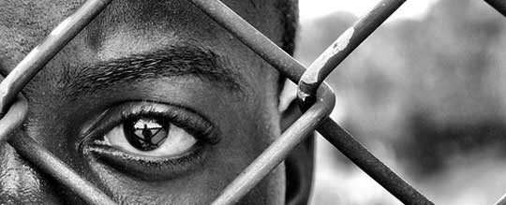
A Prayer for Africa

Slide 21
“More than one thousand will soon be converted in one day, most of whom will trace their first convictions to the reading of our publications.”
Colporteur Ministry, 151

Slide 22
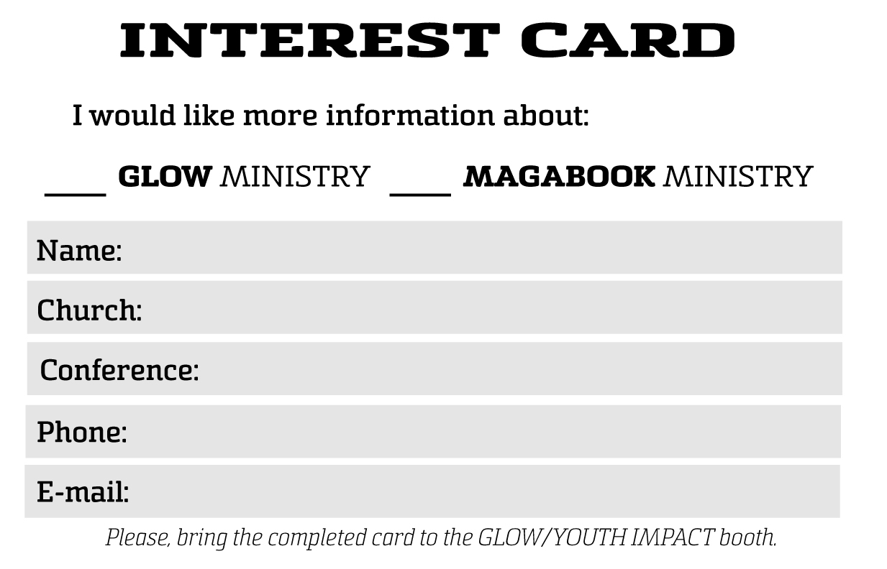
Notes:
In your GLOW wallet you’ll find an INTEREST CARD…

Slide 23
Michigan Conference
GLOW Ministry
517-316-1515
glow@misda.org
giveMIglow.org
Magabook Ministry
517-316-1515
goyouthimpact@gmail.com
goyouthimpact.com

